Slide 1


Internal Strategies to Strengthen Utility Compensation Plans
Webinar
June 17th, 2025

Slide 2

Water Finance Assistance
Elora Arnette
Associate Director
Water Finance Assistance

Slide 3
Retention Motivators
The Basics
Relationships
Career Path
Benefits & Compensation
Work-Life Balance
Flexibility
Leadership
Community
Participation
Opportunity
Training & Development
Age & Tenure
Notes:
Elora

Slide 4
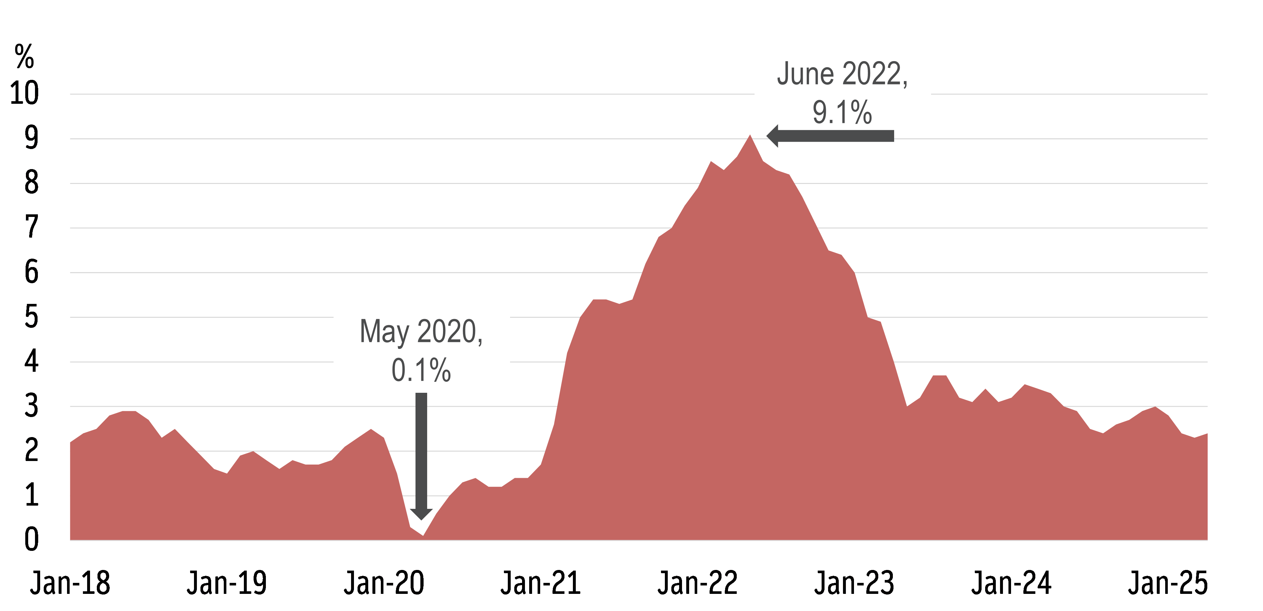
Inflation has been volatile since COVID

Slide 5
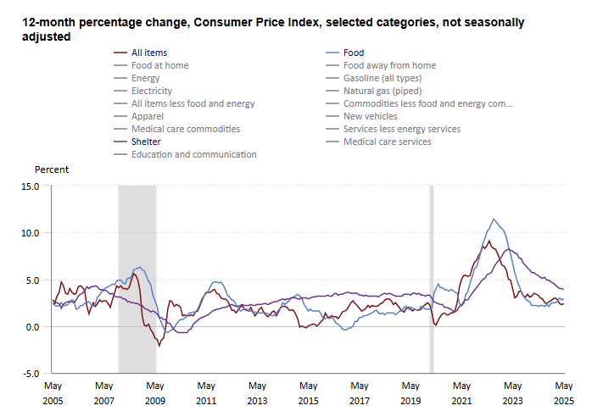
Consumer Price Index

Slide 6
Hiring A Consultant
Compensation Studies should be conducted every 1-2 years
Can cost tens of thousands of dollars (i.e. Average cost for a medium sized utility in Georgia is $40,000)
Depending on the organization size and complexity, may take several months up to a year to complete
Neutral 3rd party perspective

Slide 7
How to Get The Biggest Bang For Your Buck
❶ | Understand your organization’s compensation philosophy
❷ | Audit your data
❸ | Know your resources

Slide 8
All organizations have a compensation philosophy, though sometimes it is unintentional.

Slide 9
What is your organization’s compensation philosophy?

Slide 10
Understanding Your Organization’s Compensation Philosophy
How does your organization define its position for decisions around salary, variable compensation, equity, and benefits?
  Based on many factors including financial position, the size of the organization, the industry, business objectives, market salary information, and the level of difficulty in finding qualified talent
  Supports the strategic plan and initiatives, business goals, competitive outlook, operating objectives, and compensation and total reward strategies

Slide 11
Understanding Your Organization’s Compensation Philosophy
A well-designed compensation philosophy should:
Identify pay programs and total reward strategies
Identify how the pay programs and strategies support the organization's business strategy, competitive outlook, operating objectives, and staffing needs
Attract people to join the organization, retain key talent, motivate employees to perform, and reward high-performing employees
Define how the organization plans to pay and reward competitively, based on business conditions, competition, and ability to pay

Slide 12
Examples of Compensation Philosophies
Fixed Number Compensation Philosophy: plainly states the base salary for each position or employment tier with a policy or schedule for increases
Percentile-based Compensation Philosophy: employee wages fluctuate according to regional wage market

Slide 13
Examples of Compensation Philosophies
Pay for Performance: aims to motivate employees, improve skills, and align individual goals with company objectives by rewarding high-achieving individuals.
Step Rate Structure: Employees typically start at the lowest step and progress through subsequent steps based on factors like tenure, performance, or a combination.

Slide 14
Audit your data

Slide 15
Auditing Internal Data
❶ | Legal Compliance
❷ | Job Descriptions and Job Titles
❸ | Compensation Data

Slide 16
Legal Compliance
Ensure that current and future changes to your organization’s compensation philosophy are compliant with:
Equal Pay Act- prohibits wage discrimination based on sex, ensuring that men and women receive equal pay for equal work in the same establishment.
Age Discrimination in Employment Act (ADEA)- protects individuals aged 40 and older from employment discrimination based on age.

Slide 17
Legal Compliance
Ensure that current and future changes to your organization’s compensation philosophy are compliant with:
Americans with Disabilities Act (ADA)- prohibits discrimination against individuals with disabilities in various areas of public life, ensuring equal opportunities and access.
Fair Labor Standard Act (FLSA)- establishes key labor regulations, including minimum wage, overtime pay, and child labor standards, affecting most workers in the U.S.

Slide 18
When was the last time you reviewed and updated your job description?

Slide 19

Let’s Play

Slide 20
Round One
What do you think this position does?
Community Services Operator
Water/ Wastewater Operator

Slide 21
Round Two
Based on this job description, what is the title of this position?
Supervise operations personnel and oversee the execution of daily tasks and ongoing projects within the community
Prepare and submit EPA-mandated reports, including Discharge Monitoring Reports (DMRs) and Consumer Confidence Reports (CCR), and assist the Utility Director in managing correspondence with the EPA
Monitor the BIA and IHS account for current and delinquent payments, and serve as a liaison between these agencies and the utility department
Billing Clerk

Slide 22
Update Your Job Descriptions
Accurate Job Matching: Compensation studies often benchmark roles against market data. Outdated job descriptions may not reflect current duties, leading to mismatches with salary survey role.
Reflect Current Responsibilities: Roles evolve over time. Employees may take on new tasks, technologies, or responsibilities not listed in old descriptions.

Slide 23
Update Your Job Descriptions
Compliance and Legal Protection: Accurate, up-to-date job descriptions help organizations comply with labor laws and defend compensation decisions in audits or disputes
Internal Equity: When job descriptions are inconsistent or outdated, internal comparisons become unreliable

Slide 24
Update Your Job Titles
Ensure accurate bench marking: Compensation studies rely on matching internal roles to external market data. If job titles don’t clearly or accurately reflect the nature of the work, the organization may match jobs to incorrect benchmarks
Eliminate Title Inflation or Deflation: Some organizations use inflated or inconsistent titles that don’t reflect the actual level of responsibility or scope of work. This can lead to misclassification violations (FLSA).

Slide 25
Update Your Job Titles
Support Clear Job Architecture: A job title audit contributes to a clean and logical job hierarchy or framework, which is essential for grouping similar roles during a compensation study and designing salary bands and career paths.
Improve External Competitiveness: Clear titles ensure candidates understand the role when recruiting and creates apples to apples comparisons with competitors.

Slide 26
Audit Your Compensation Data
An effective compensation philosophy can determine the overall equity of a pay structure by:
Analyzing the overall equity of the program
Determining if the program is defensible and legally compliant
Ensuring the program offers fair, competitive pay in line with the compensation philosophy and policies and is perceived as fair to staff members

Slide 27
Audit Your Compensation Data
Internal Equity
Focuses on the company and compares employees to one another. An internal equity audit
Provides a way to compare what the organization is currently paying each employee
Internal Audits
Look at the role such as job title and description, the employee’s experience, and all compensation including wages, benefits, bonuses
Note any discrepancies in pay between similar positions
Factors should be analyzed before any discrepancies are legitimized which may include education level, seniority, and location

Slide 28
Internal Audit

Slide 29
Know your resources

Slide 30
Know Your Resources
There are many compensation resources that are free or relatively inexpensive to purchase. These data resources can allow a utility a quick check of whether their salaries are in line with other utilities in their area.

Slide 31
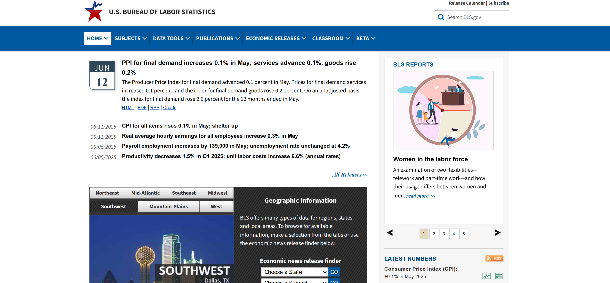
Bureau of Labor Statistics

Slide 32
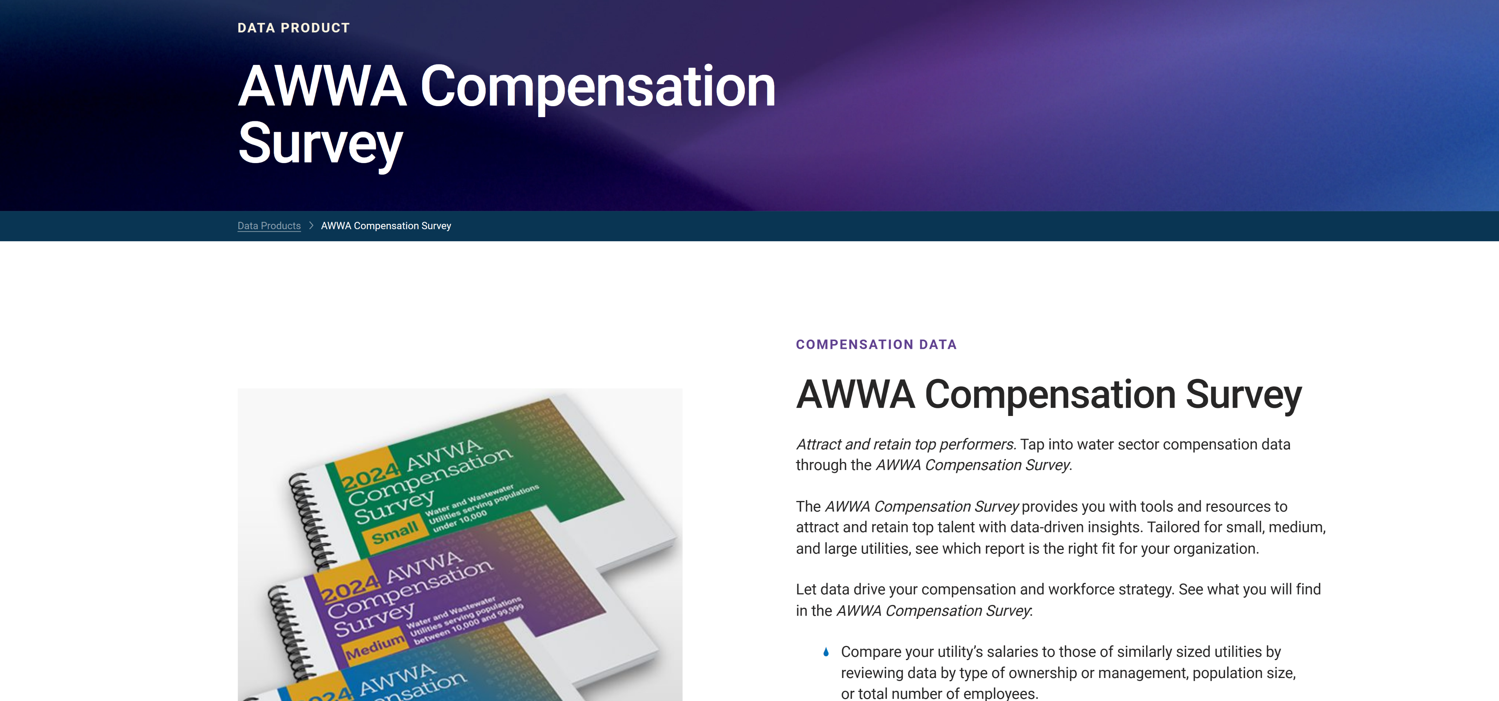
Annual AWWA Salary Report

Slide 33
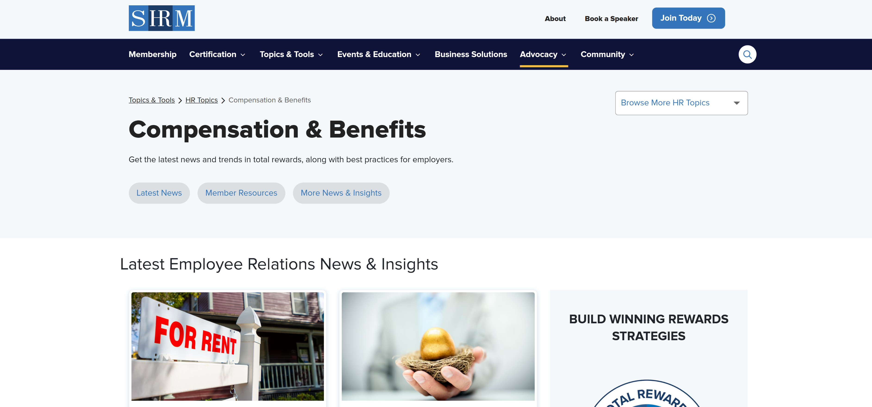
Society of Human Resources Management

Slide 34
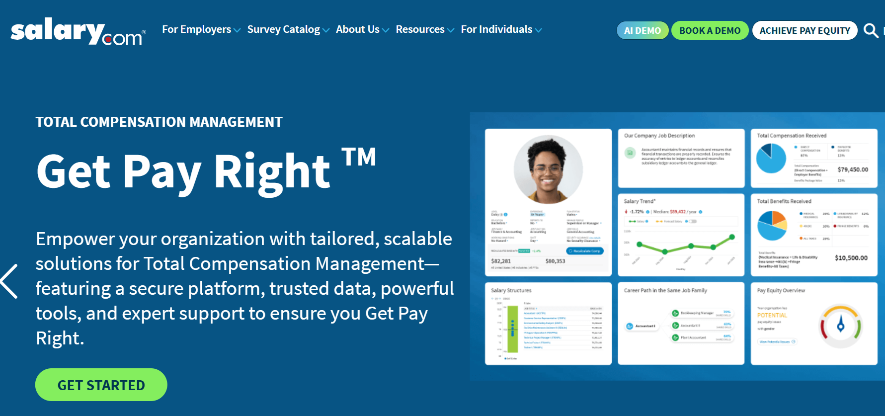
Salary.com

Slide 35
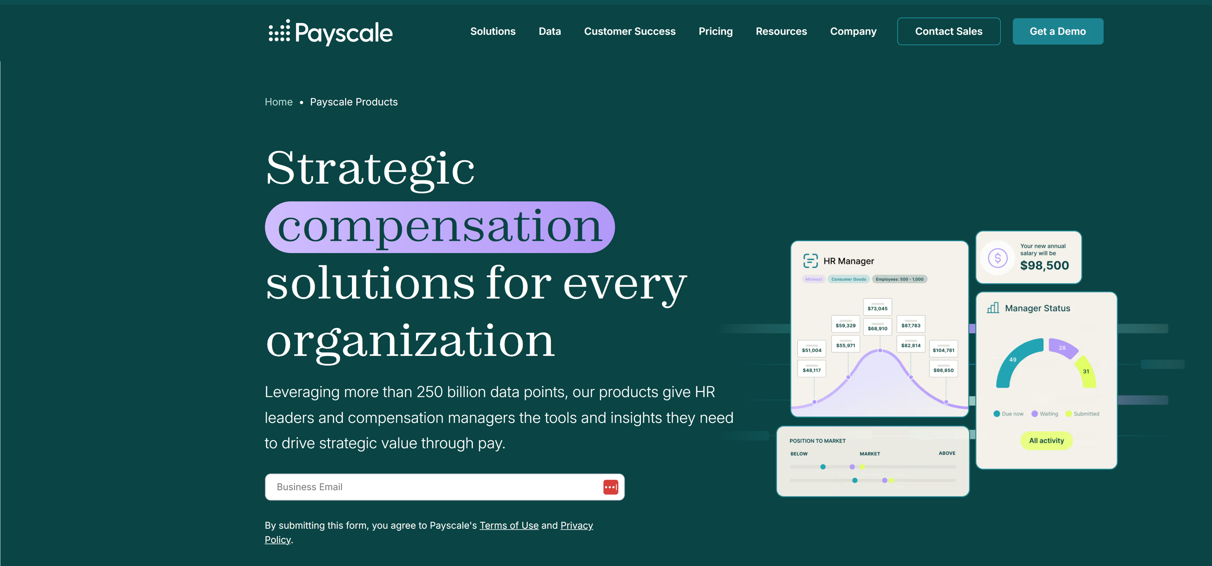
Payscale

Slide 36
Don’t Forget To Ask Your Consultant
In Your Contract Include:
Total Compensation Review- Including Salary & Benefits
Comparisons of Minimum, Mid-Point, and Maximum Pay

Slide 37
Total Compensation Review

Slide 38
Compare Minimum, Mid-Point, and Maximum

Slide 39
Thinking Beyond Compensation
The Basics
Relationships
Career Path
Benefits & Compensation
Work-Life Balance
Flexibility
Leadership
Community
Participation
Opportunity
Training & Development
Age & Tenure
Notes:
Elora

Slide 40
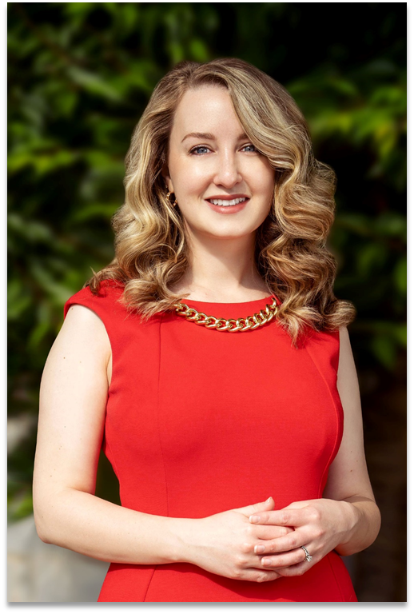
Thank You!
Elora Arnette
Associate Director
Water Finance Assistance
elora@waterfinanceassistance.com
770-910-0372

