Slide 1



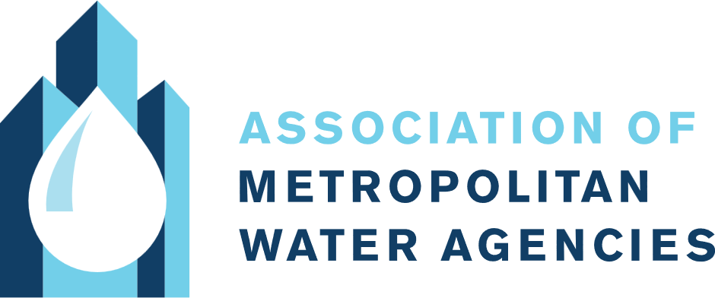
Managing Water Impacts from
AI Data Center Growth
Challenges and Opportunities for Municipal Water Agencies
May 2025

Slide 2

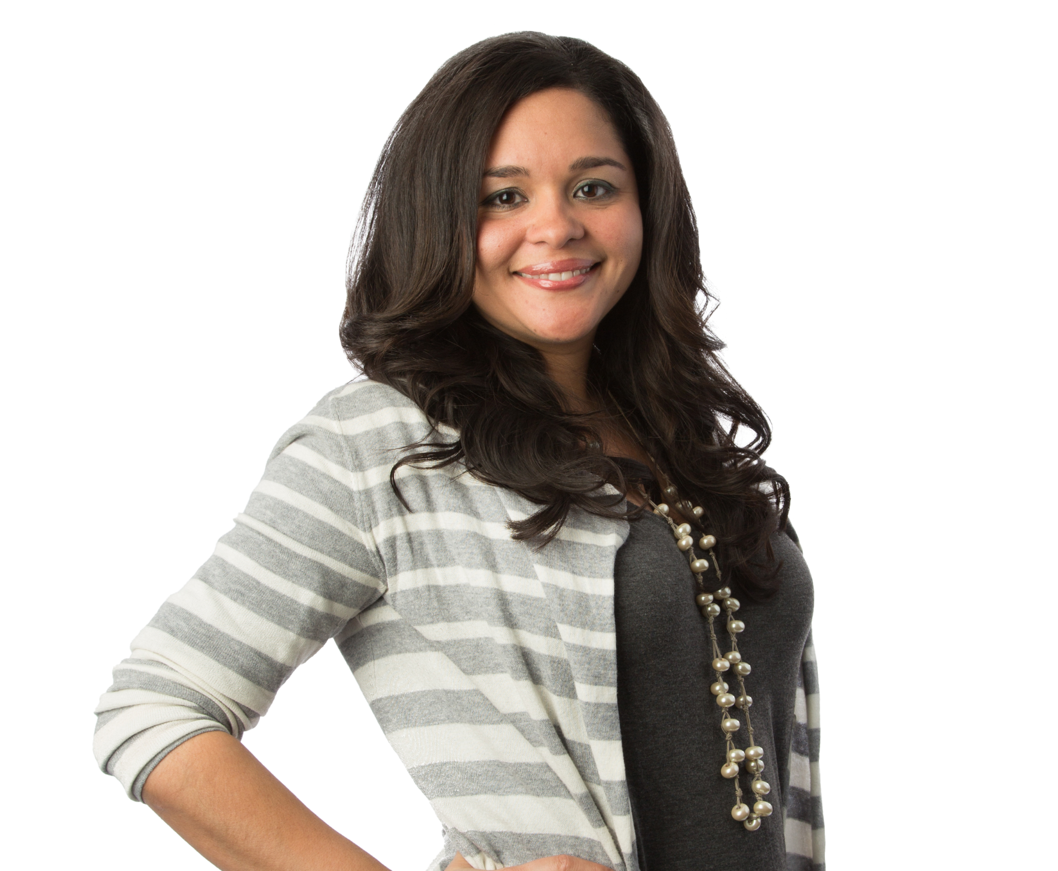
Today’s Speakers
Carla De Las Casas, PhD, P.E. | Patricia Whitby, PhD, P.E.
Director of Client Services, Water Stewardship Services Lead | Water Stewardship Implementation Lead

Slide 3
Setting the Context: AI Data Center Growth Trends
Impacts and Challenges of Growing Data Center Demand on Water Utilities
Corporate Water Stewardship: Mitigating Impacts and Leveraging Opportunities
Opportunities to Improve Water Management Using AI
Key Take-aways
Agenda

Slide 4

AI Data Center Growth Trends
Setting the Context

Slide 5
AI is Driving a Surge in Data Center Demand
Data center load growth has tripled over the past decade and is projected to double or triple by 2028.
Cloud computing, AI, and big data analytics are driving growth.
Technology advancements mean further infrastructure needs. Power availability remains a critical constraint.
Technology companies building these data centers are responding to a rapidly evolving and uncertain market.
Source: Lawrence Berkeley National Lab – 2024 U.S. Data Center Energy Usage Report
Notes:
Significant growth is driven by the increasing demand for cloud computing, artificial intelligence (AI), and big data analytics.
Advances in semiconductor technology are enabling faster processing speeds, more complex AI models, and further infrastructure needs.
More advanced processing translates to higher rack densities, meaning more power requirements for each facility. Power availability remains a critical constraint (driving siting decisions more so than land cost or water availability).
Note numbers are difficult to predict, innovation to improve resource efficiency can play a big role.

Slide 6
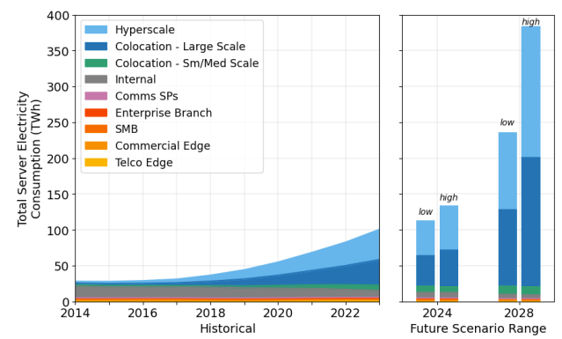
Data Center Growth Trends
Shift to hyperscale data centers (i.e., larger developments at scale).
Cooling systems innovation – evolving designs to use less water.
Tax incentives driving emerging opportunities in key hotspots (e.g., VA, AZ).
Data Center Annual Electricity Use by Space Type
Source: Lawrence Berkeley National Lab – 2024 U.S. Data Center Energy Usage Report
Notes:
Hyperscale data centers: designed to be large-scale, with more sophisticated infrastructure than traditional data centers to support the extreme demands of large-scale cloud computing – also demand more resources.

Slide 7
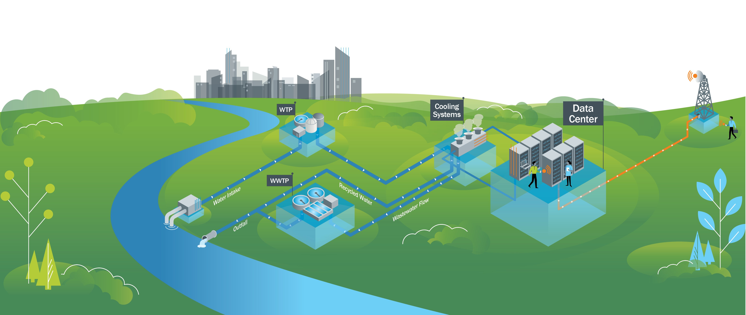
Data Center Water Lifecycle

Slide 8
Data Center Water Lifecycle
Direct water consumption for cooling (depends on the cooling technology and local climate)
Notes:
For data centers using water for cooling, 98% of water demand goes to cooling system, 2% for domestic uses

Slide 9

Data Center Water Lifecycle
Indirect water consumption for power production (depends on the power source)
Notes:
Rising electricity demand is amplifying water dependencies. Renewables dominate new capacity additions, but the continued expansion of natural gas plants and potential nuclear restarts (e.g., small modular reactors) could stabilize market opportunities for high water withdrawal and consumption requirements.
Slower coal retirement is seemingly prolonging coal ash pond liabilities. Surging electricity demand from AI and data centers is delaying the retirement of coal-fired power plants, which were expected to be phased out more rapidly. This slowdown potentially extends the operational lifespan of coal ash ponds—large-scale water management liabilities that require costly remediation and regulatory oversight.

Slide 10
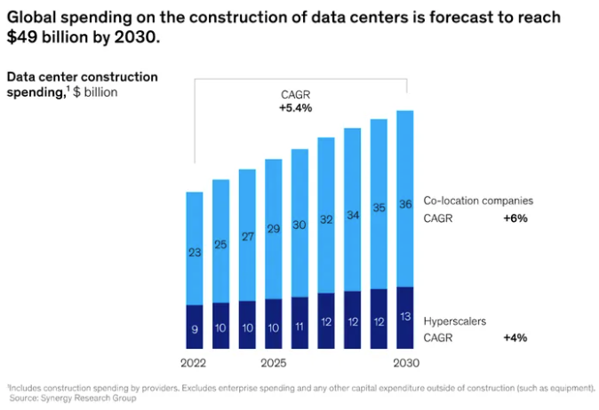
Water Spend by Data Centers
Significant investments in water acquisition, treatment, and reuse.
Source: Synergy Research Group
Notes:
Bluefield Research Data Centers Market Trends and Forecasts 2022-2023
Bluefield 2025Q1 update:
Water stress exposure is reshaping industrial water management. With 53% of analyzed companies operating in regions facing high water stress, firms are implementing targeted water strategies, including infrastructure upgrades and water reuse technologies, to ensure operational continuity and regulatory compliance. Data centers, energy producers, and manufacturing hubs in water-scarce areas face the highest urgency for investment in water efficiency solutions.
Manufacturing investment is redefining water infrastructure priorities. The clear acceleration in capital expenditures across high-tech and industrial manufacturing signals an increasing need for advanced water treatment, reuse, and supply resilience. While economic uncertainty weighs on traditional sectors, water technology providers have a unique opportunity to capitalize on emerging demand from semiconductor, AI, and data-driven industries.

Slide 11
Impacts and Challenges of Growing Data Center Demand on Water Utilities

Slide 12
Data Center Specific Challenges

Slide 13
Data Center Specific Challenges
Direct impact on source water demands

Slide 14
Data Center Specific Challenges
Infrastructure capacity constraints and fast timelines
Notes:
Equalization as an important component – meeting peak water demands

Slide 15
Data Center Specific Challenges
Indirect impact on water demands from power production

Slide 16
Data Center Specific Challenges
Water discharge (quality and quantity)

Slide 17

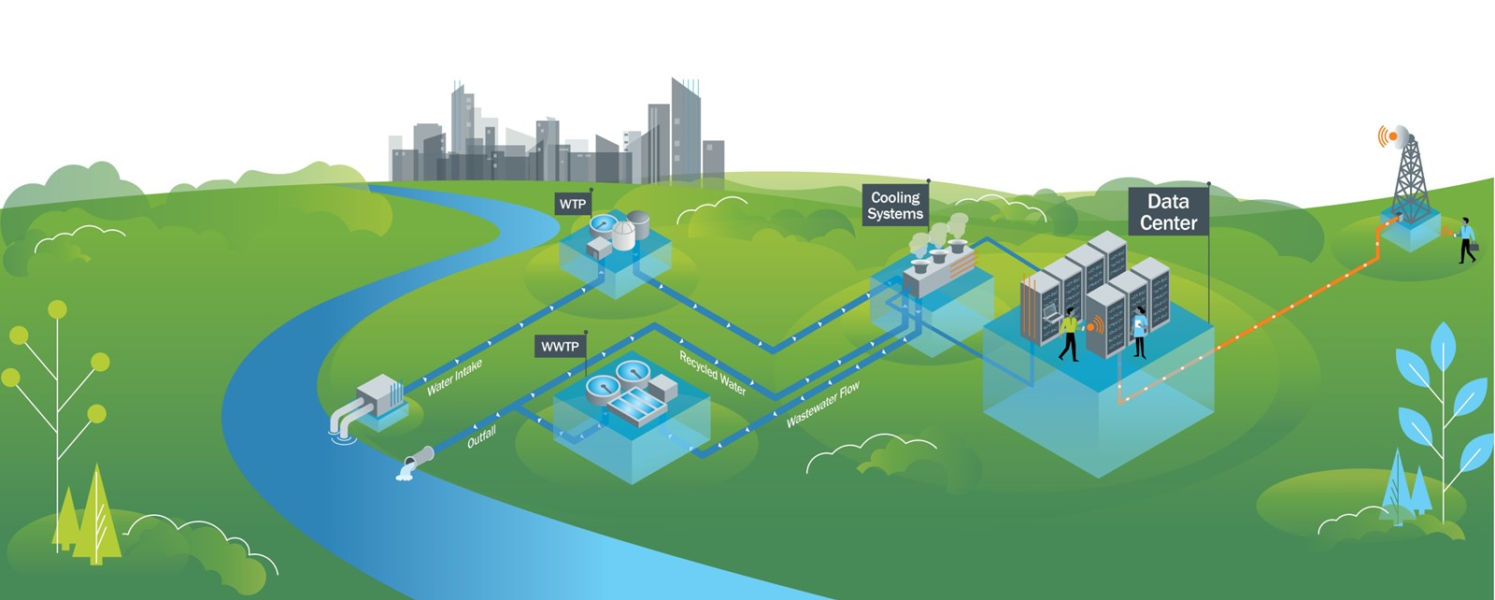
Data Center Specific Challenges
Competition for other resources (e.g., equipment procurement, back-up power)

Slide 18
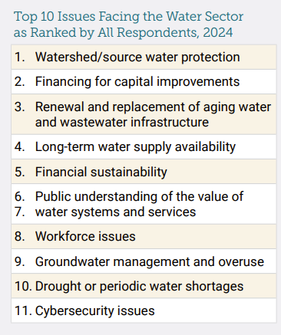
Exacerbating Ongoing Challenges
Need to consider data center pressures in the context of other challenges faced by water utilities today.
Water stewardship partnerships to create opportunities and mitigate impacts
Opportunities to leverage AI in addressing these challenges.
Top 10 Issues Facing the Water Sector
Source: AWWA State of the Water Industry 2024
Notes:
2024-SOTWI-Executive-Summary.pdf

Slide 19
Mitigating Impacts and Leveraging Opportunities
Corporate Water Stewardship
Notes:
In this last section, we want to discuss how utilities could leverage private sector funding associated with corporate WS programs.

Slide 20
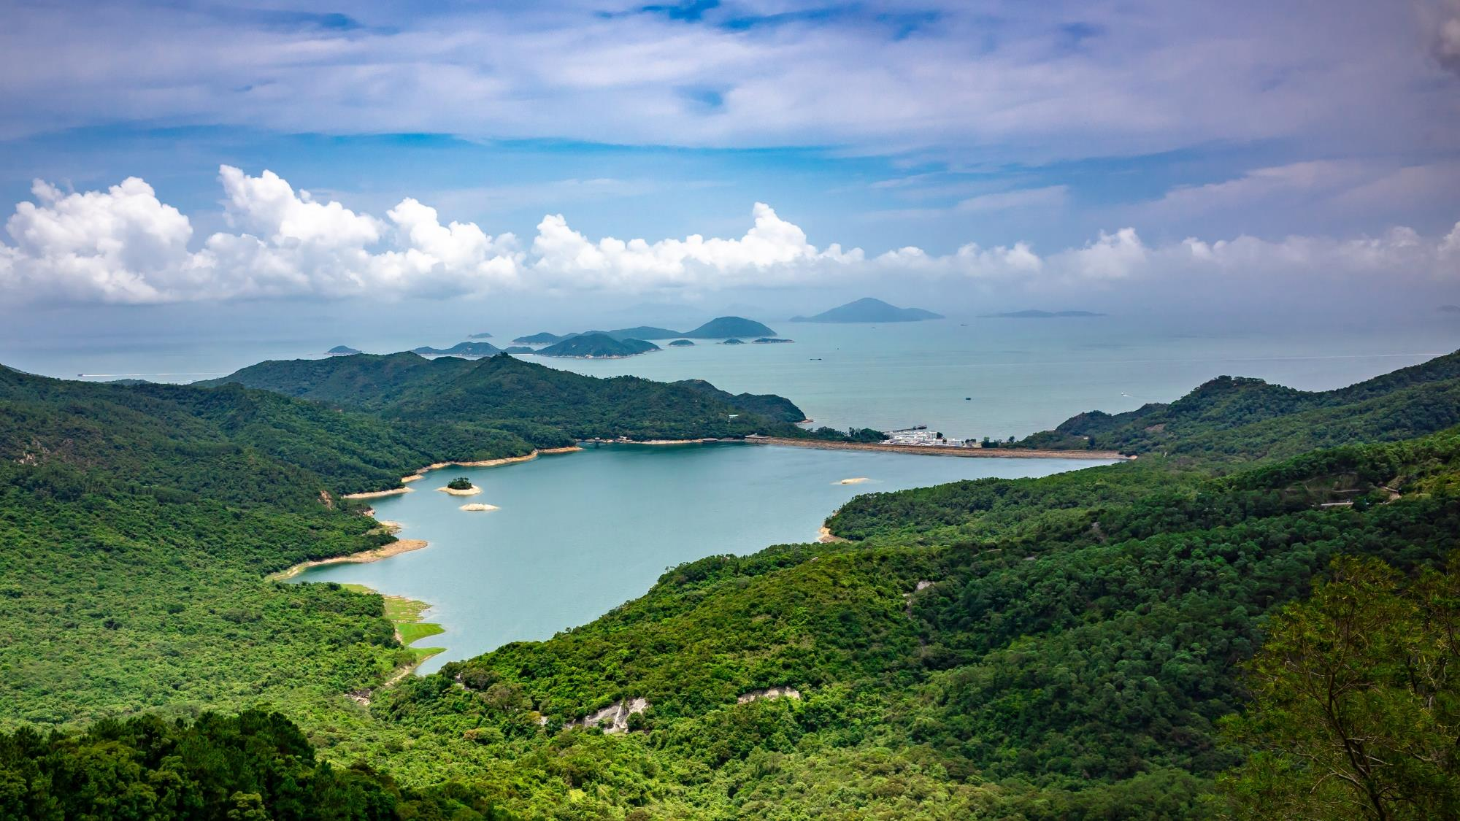
Water stewardship is a framework and set of practices that help businesses manage risks, cut costs, and build trust while promoting long-term water security for all.
CEO Water Mandate

Slide 21
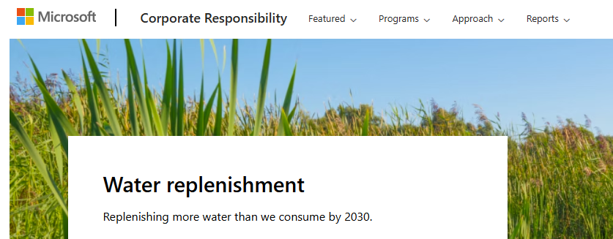
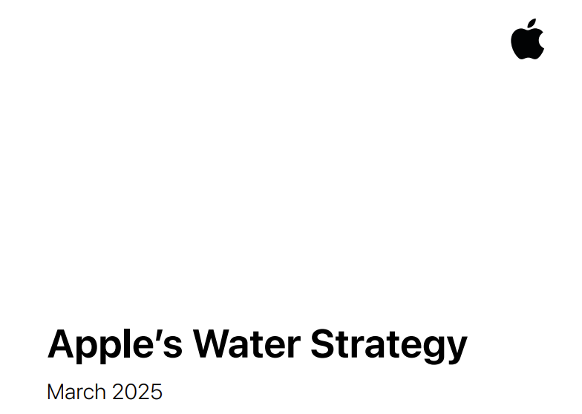
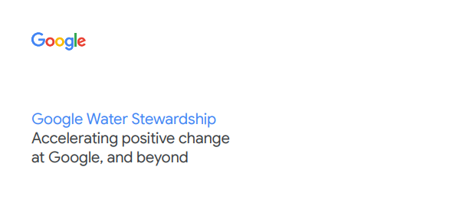
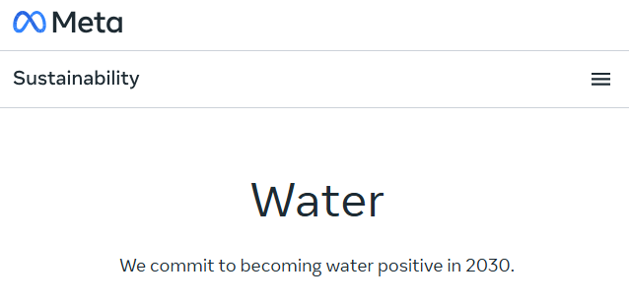
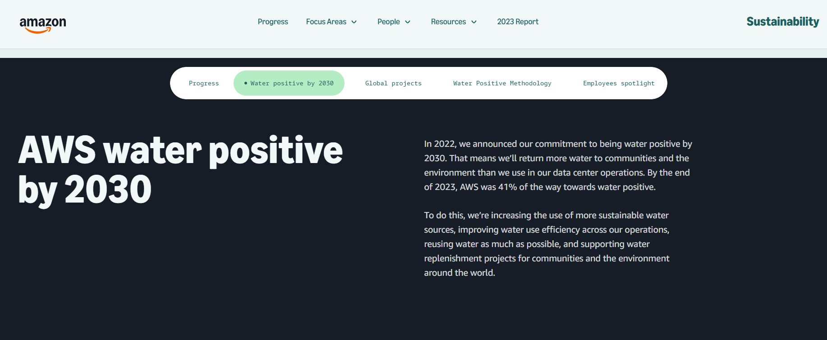
Technology Companies are Leading Corporate Water Stewardship Commitments
Water positive commitments
Improving water use efficiency
Restoring or “replenishing” more water than is consumed in operations
Collaborating with stakeholders

Slide 22
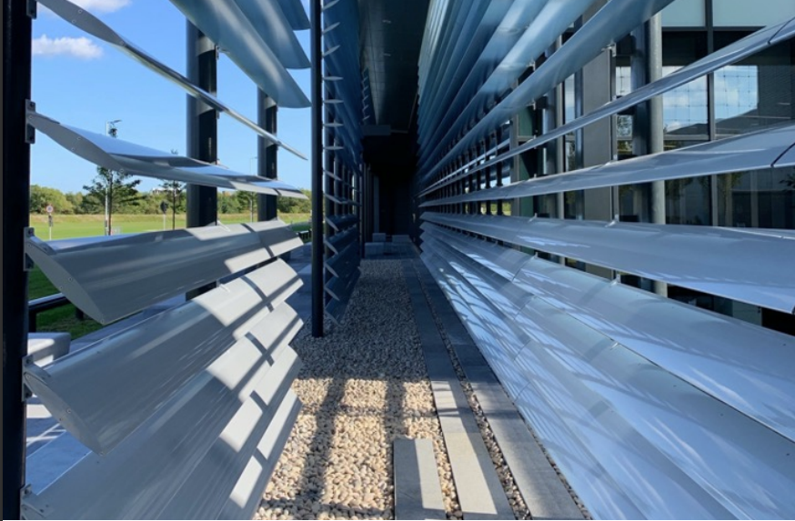
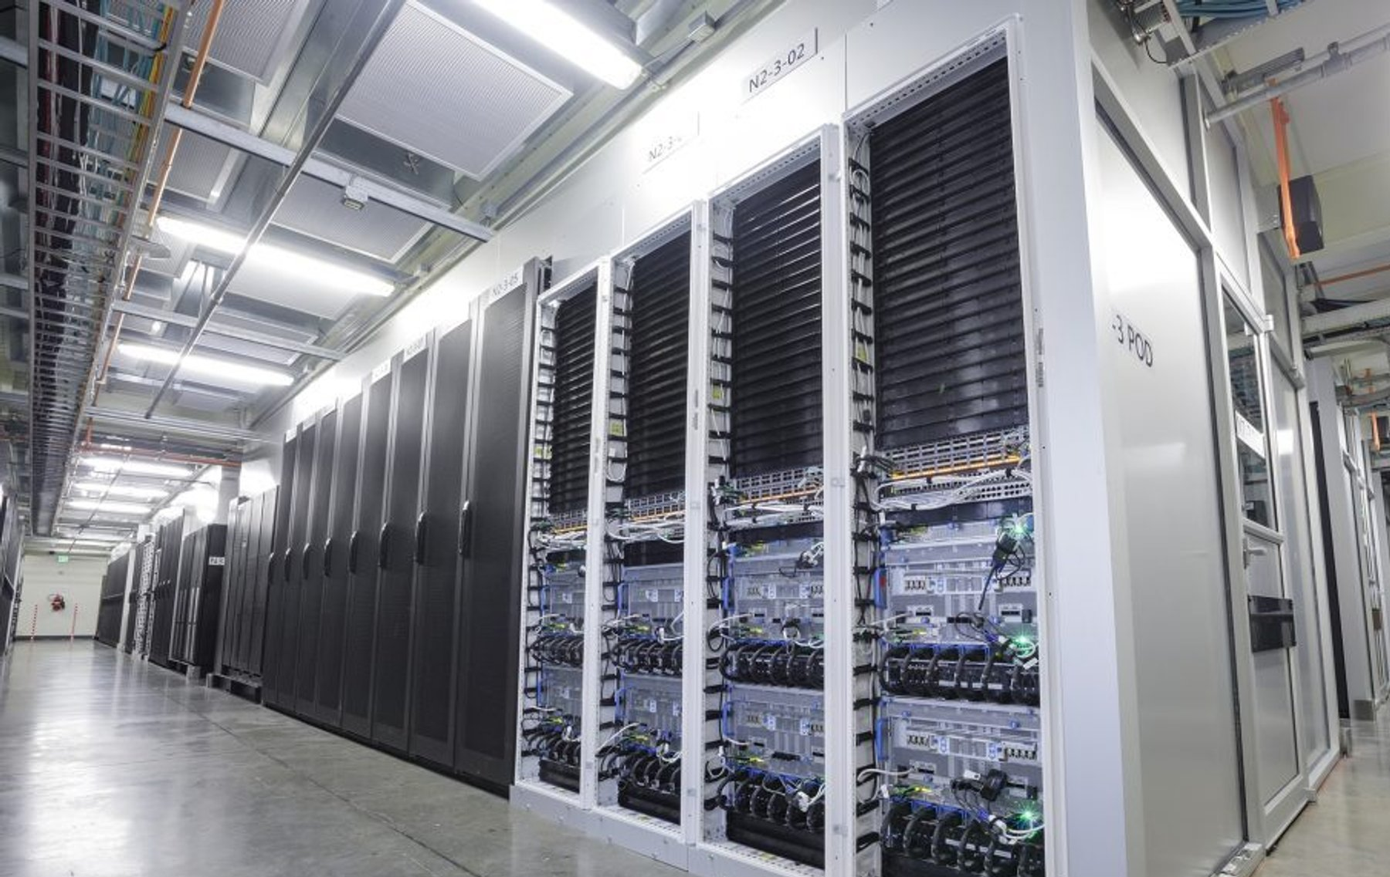
Inside the Fence: Water Use Efficiency
Case Studies
Meta
Piloted optimizing the relative humidity adjustments to lower the minimum from 30% to 13%, resulting in a 40% reduction in water use over 9 months.
Source: Meta Sustainability Case Study
Microsoft
Announced a commitment to zero-water liquid cooling solutions, using novel direct-to-chip cooling plates designed to use liquid coolants with lower energy requirements.
Source: Microsoft Sustainability Blog

Slide 23
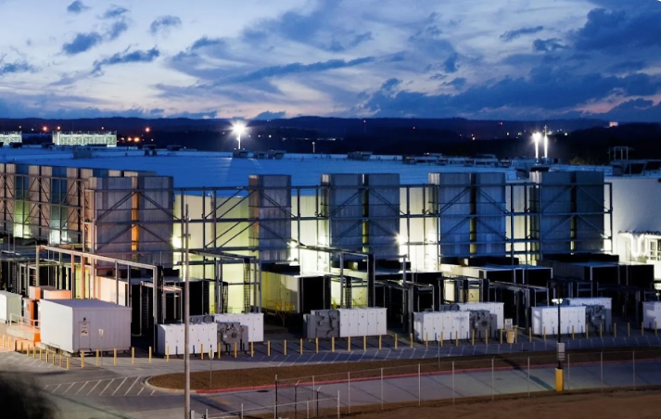
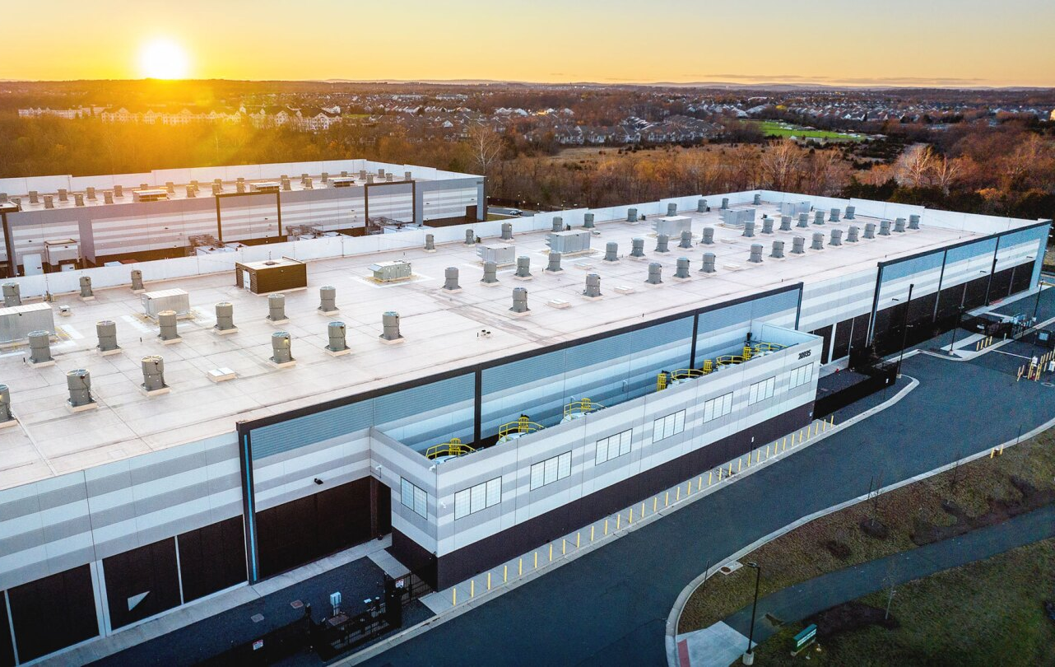
Inside the Fence: Reclaimed Water for Cooling
Case Studies
Google, Douglas County, GA
Data center uses reclaimed water from the municipality for cooling purposes. Resulting wastewater is then treated at on-site effluent treatment plant and discharged into the Chattahoochee River.
Source: Google Sustainability Video
Amazon Web Services, Northern VA
Worked with Loudoun Water to become the first data center operator approved to use reclaimed water in combination with direct evaporative cooling technology.
Source: AWS Blog

Slide 24

Outside the Fence: Water Replenishment
“Replenish” = return water to the watershed that would otherwise have been lost.
Replenishment examples:
Demand reduction/conservation
Wetlands restoration
Grey and green infrastructure for stormwater capture and reuse
Groundwater recharge
Water reuse/reclamation
Water quality improvements that make a supply available for use
Storage that allows water capture in wet periods for use during dry periods
Projects are not “creating new water”, but they are helping keep water in the watershed.

Slide 25
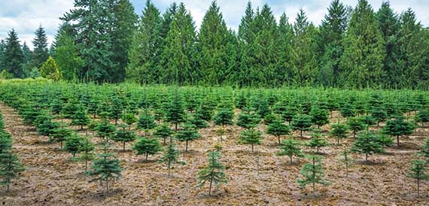
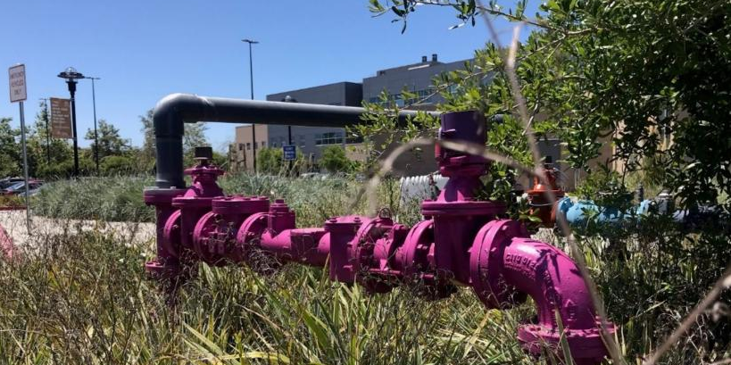
Corporate Water Stewardship Investments Benefit Communities
Both nature-based solutions and infrastructure projects can benefit community water systems.
Opportunity for partnership between technology companies, water utilities, and NGOs.
Corporate investments go through a rigorous process to identify relevant projects and prevent greenwashing claims.

Slide 26
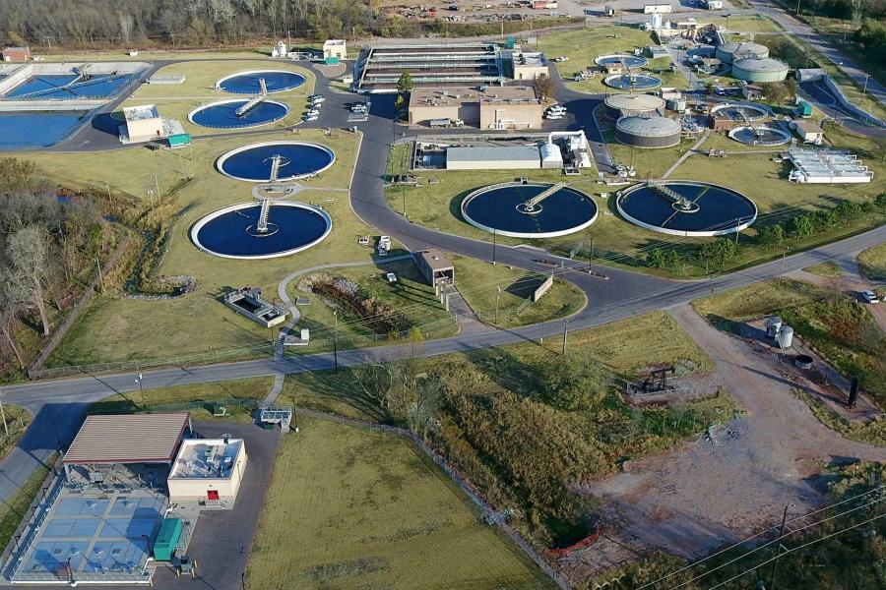
Connecting Private Funding to Public Projects
How It Can Work:
Google and City of Norman
City of Norman, OK Water Reclamation Facility
Google provided $500K grant for on-site non-potable reuse (offset potable demand starting 2026)
Supporting State of Oklahoma’s Water for 2060 Goal and Google’s 2030 Water Positive Goal
Notes:
BC connected with Oklahoma Water Resources Board, who helped us identify innovative/forward-looking utilities in the state, connected with the City of Norman.
Oklahoma not typically considered a water scarce region, but the state is focusing on improving water infrastructure and management, including a goal of consuming no more fresh water in 2060 than was consumed in 2012, despite growth.
City of Norman has been doing some innovative research and exploring potential reuse options, this project was identified as a low-hanging fruit.
There was some existing infrastructure in place as there was a non-potable system previously used on-site that had to be abandoned due to other major construction projects.
There was no plan to bring the system back online until the opportunity of private funding allowed the utility to prioritize this project.
Non-potable water will be sourced directly from the Water Reclamation Facility’s effluent and used for cleaning and maintenance, cooling water, process water, and compost irrigation.
Google facility is not within the City of Norman’s service area, but has a goal to address regional water challenges throughout the Arkansas River basin.

Slide 27
Finding the Right Fit
CORPORATION
UTILITY
Shovel-ready
Other benefits
Replenishment Volume
Good value ($/MGY)
Other funding
available
Meets Schedule
Partnership

Slide 28



Water Stewardship Trends
Water Stewardship Programs are currently focused on volumetric benefit, but there is increasing interest in:
Collective action aims to engage stakeholders to address the most pressing watershed challenges, recognizing that a shared vision is necessary to scaling positive impact and truly mitigating water risk.
Co-benefits quantification (e.g., water quality, biodiversity, carbon).
Basin diagnostics and using science-based approaches to set targets and measure impacts.
Leveraging AI/satellite data for monitoring and confirming benefits.
Co-funding (federal + private)
Collective action and strategic investments
Notes:
WS Program trends from volume to co-benefits.
Pairing corporate dollars with other sources like federal infrastructure funds has the potential to multiply impact rather than simply be additive. Time-sensitive opportunity here!
The immense magnitude of the water challenges facing HWR watersheds like the Colorado River Basin demands a new level of strategic investment
UPCOMING RFI

Slide 29
Opportunities to Improve Water Management Using AI
Notes:
AI technology enables computers to simulate human intelligence. ML is a branch of AI that uses advanced algorithms to solve complex problems in a reliable, reproducible, and observable manner.

Slide 30


Balancing Water Demand and Water Innovation
AI can support water utilities in multiple ways
Water Management
Predictive Maintenance
Resource Optimization
Water quality modeling
Flood prediction and mitigation
Water conservation
Irrigation efficiency
Master planning and infrastructure modeling
Leak detection and repair
Predictive analytics for asset management
Predict water demand patters
Optimize pumping schedules
Adjust water flow and pressure
Respond to drought conditions
Workforce empowerment
Notes:
There are several ways in which AI can support water utilities:
Water quality: AI can be used to continuously monitor the quality of water in real time. By analyzing data from sensors placed in water bodies, AI algorithms can detect changes in water quality and identify potential contaminants or public health hazards such as pollution plumes and waterborne disease pathogens. AI can also detect eutrophication, harmful algal blooms, and the dumping or discharging of hazardous chemicals.
Flood prediction: AI can be used to analyze data from weather forecasts, river levels, and historical flood patterns to predict and manage flood events. By using machine learning algorithms, AI can provide accurate and timely flood warnings, allowing authorities to take necessary measures to mitigate the impact of floods and protect their communities.
Water conservation: AI can help optimize water usage by analyzing data from various sources, such as weather patterns, soil moisture levels, and crop water requirements. By utilizing this data, AI algorithms can provide valuable insights on when and how much water should be used for irrigation, reducing water waste and promoting sustainable agriculture practices. Applications can also support residential and industrial water users understand their water use patterns and opportunities for increased efficiency.
Master planning: E.g. digital twins
A Digital Twin is a dynamic digital representation of real-world entities and their behaviors using models with static and dynamic data that enable insights and interactions to drive actionable and improved outcomes.

Slide 31
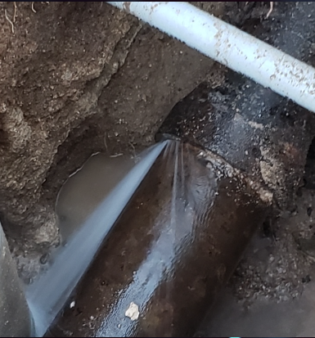
Example: Predictive Maintenance
AI leak detection and repair
15 miles
293 sensors
9,460,800 gallons/yr (water savings)
Notes:
Scottsdale Water is a utility supplying water to more than 242,000 people in the eastern part of Maricopa County, Arizona, through a network of 2,136 miles of pipeline. The area’s main surface water supply comes from the Colorado River, which is an area of high-water stress. The total length of pipeline across both areas was 15 miles, mostly large dia. Cast iron pipe with sections of asbestos cement AND small section of mostly PVC pipe.
THE SOLUTION. 293 sensors to sample overnight acoustic data analysed by FIDO AI, which identified potential leaks for onsite investigation. Scottsdale Water then excavated and repaired the leaks.
The RESULTS. FIDO AI accurately located a number of active leaks that Scottsdale Water was previously unaware of. According to Scottsdale Water, the most impressive was a leak that was under a major roadway (limited dig area and leak was exactly under areas marked with an “x”.
-gasket failure on DI pipe of less than 3 yrs old, losing water at 10 gpm.
Same technology deployed in UK, Missouri and DC Water.
-

Slide 32
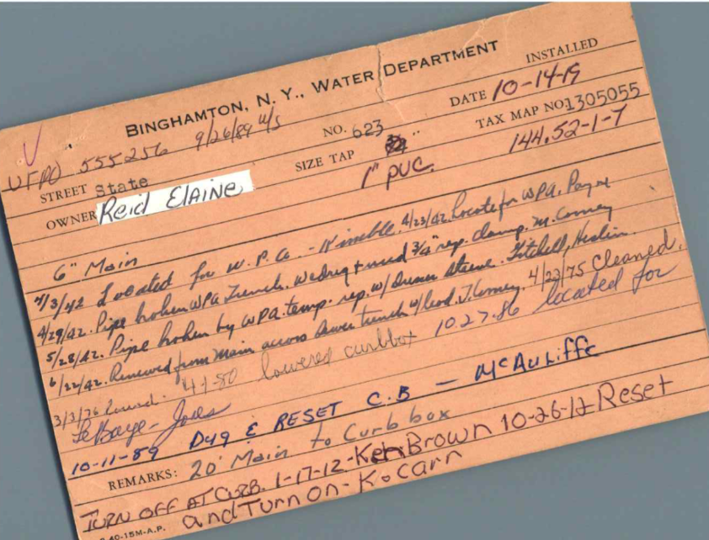

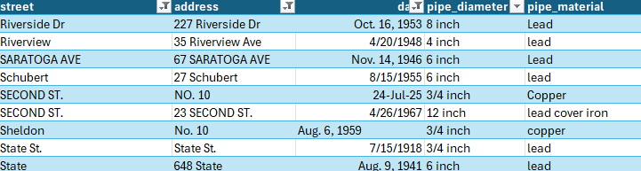
Example: Resource Optimization for Regulatory Compliance
Unlocking the value of data in thousands of scanned documents by using an LLM to automate data processing
BC processed 5,000 notecards with one staff member in just one week!
Notes:
BC worked with a water utility in the northeast that needed to develop an inventory of their water service lines to comply with a regulatory deadline. Their requirements included reviewing all available information to identify all pipes that may be made of lead or copper.
LCRR Example
What:
Handwritten field inspection notes of drinking water lines were available as PDFs.
The goal was to identify the material of the lines from the notes.
How:
We developed an automated process to extract text from each record.
Data was digitized and ingested.
Images and embedded data were fed into a large language model (LLM).
The LLM, connected to other models, produced structured data with fields and values from the notes.
For each record, the LLM output organized data (e.g., street, material, year installed, diameter, maintenance records, etc.)
Outcome:
Classified water lines by pipe material for Lead and Copper Rule compliance.
The client estimated processing 10,000 notecards would take a year with existing resources.
BC processed 5,000 notecards with one staff member in just one week.
Impact:
Demonstrates significant improvements in efficiency using AI and automation.
The LLM-based approach enabled the utility to:
Complete regulatory reporting on-time
Reallocate staff time from data entry to higher-value activities like quality assurance and regulatory reporting

Slide 33
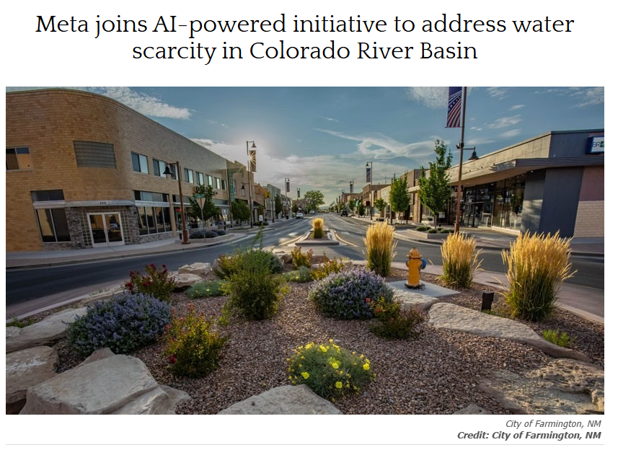
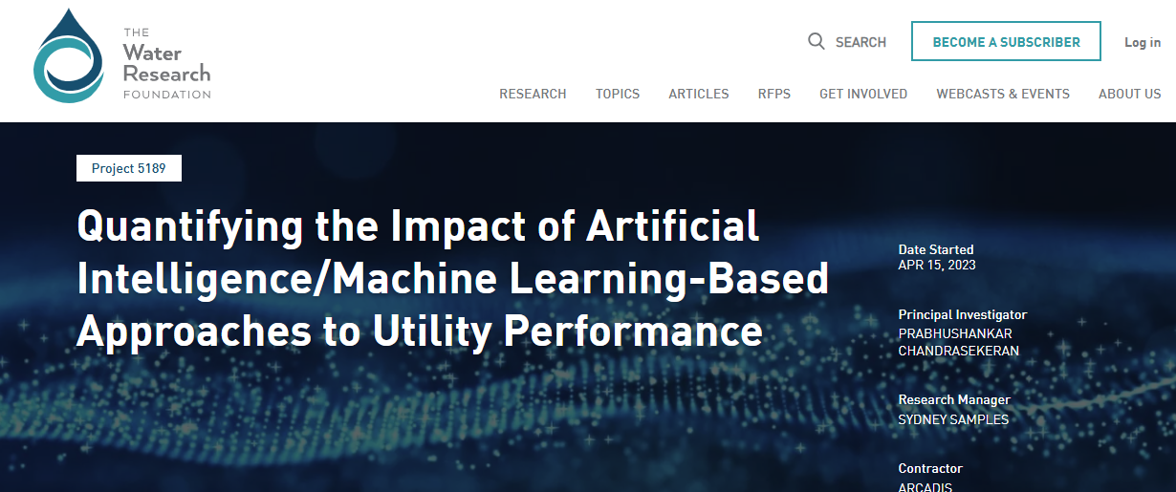
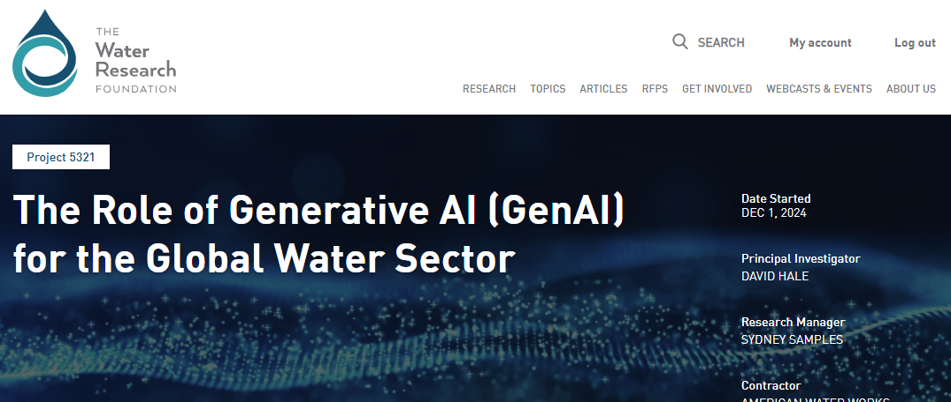
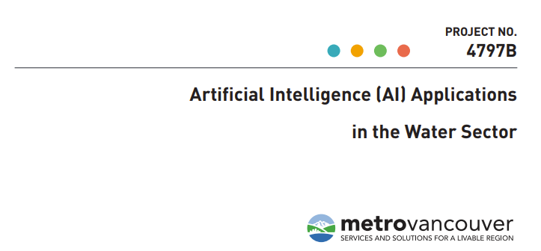
AI is Enabling Innovation in the Water Sector

Slide 34
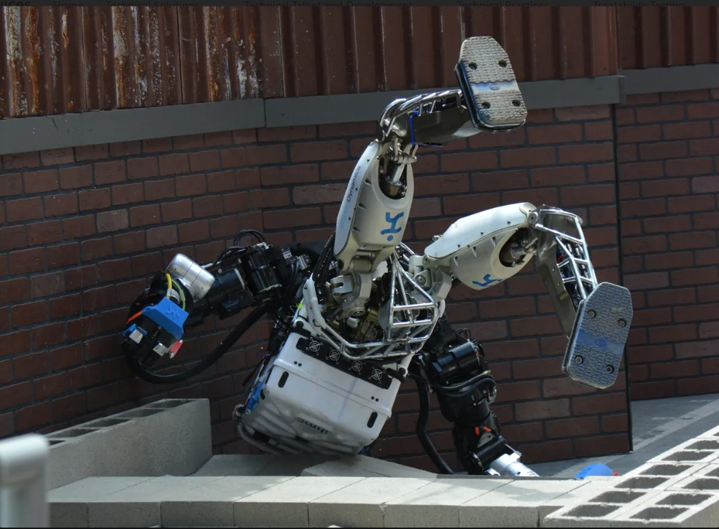
Remaining Challenges
Data quality and bias
Cybersecurity
Knowledge and technical expertise
Trust
A word of caution: Robot prototypes failing is both entertaining and tragic, but in the case of AI for water resources decision making, the consequences of failure can be severe.
Exiting Guidance:
Smart Water Networks (SWAN) Forum
Water Research Foundation (WRF)
aiWATERS
Notes:
All models need high-quality training data.
Cybersecurity. To safeguard against threats.
Knowledge. Appropriate use and application require staff with specialized expertise and an ability to communicate with end users and key decision makers.
Trust. Models operate as black boxes, making it hard to trust the outputs. Thus, collaboration and validation are essential.
Existence guidance from SWAN (smart water networkds forum), WRF has funded several projects, aiWaters (framework to help water utilities implement AI in their systems developed through case studies with MWRD of Greater Chicago, HRSD and others.
Overall, the integration of machine learning into water resources offers a transformative approach to addressing the complexities and uncertainties posed by climate change and evolving water demands. By leveraging advanced AI and ML techniques, we can enhance our ability to model infrastructure and natural systems, improve operational decision-making, and support sustainable water management practices.

Slide 35
Key Take-aways

Slide 36

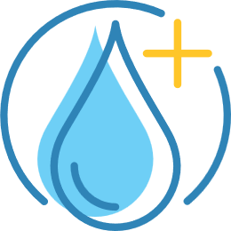

Key Take-aways
AI is driving rapid data center growth, with implications for resource challenges.
Corporate Water Stewardship programs and funding can enable faster implementation of priority water utility projects.
AI technologies can support water utilities in many ways. Lean on existing guidance (e.g., SWAN) for AI for water resources decision making.
Notes:
The data center industry is growing rapidly due to the increasing demand for data storage, processing and networking services. Data centers have a direct (i.e., if water is used for cooling) and indirect (i.e., if water is used to generate electricity) demand for water. The rise of AI workloads is transforming the data center industry, driving unprecedented demand for power.
Due to increasing environmental awareness, intensifying stakeholder scrutiny and climate risks, corporate water stewardship (CWS) is emerging as fundamental element to support operational and financial resilience of the industry.
CWS programs focus on both inside-the-fence efficiencies to reduce water consumption and outside-the-fence investments in partnership with watershed stakeholders to positively impact the communities and watersheds where they operate. Through these programs, corporations can voluntarily invest in water projects in partnership with utilities.

Slide 37

Thank you.
Questions?
Patricia Whitby, PhD, PE
Pwhitby@brwncald.com
Carla De Las Casas, PhD, PE
CDeLasCasas@brwncald.com

