Slide 1




How to Effectively Build a Cybersecurity Program
A Winning Playbook for Success
AMWA | June 2024

Slide 2
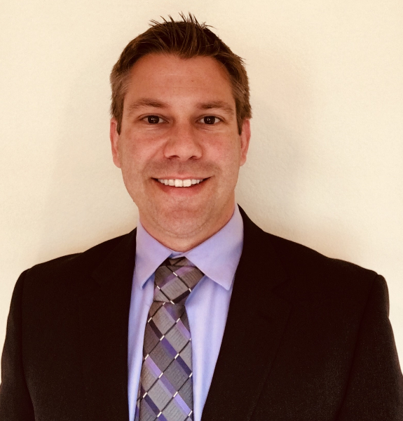

Today’s Speakers
John Brosnan
Valley Water
Norm Anderson, PE, GICSP
Carollo Engineers, Inc.
Denis Cuvalo, PMP
DuPage Water Commission

Slide 3
Cybersecurity Program - Building a Championship Program
01

Slide 4

Norm Anderson, PE
Principal EI&C Engineer
Global Industrial Cybersecurity Professional (GICSP)
Norm has been providing secure and reliable SCADA, I&C, electrical, and physical and cyber security solutions for over 20 years for water, wastewater, and environmental projects in both the public and private sectors. He is experienced in the planning, design, commissioning, and management of highly technical automation projects and able to generate innovative solutions to complex problems. He has specialized in industrial control system network security and also served as the SCADA Manager at a municipal utility dealing with the challenge of maintaining and expanding automation and communications systems first hand. Norm is a certified Global Industrial Cyber Security Professional and former Chairman of the AWWA Cybersecurity Subcommittee.
Carollo Engineers

Slide 5

Talent wins games, but teamwork and intelligence wins championships.
Michael Jordan

Slide 6
Steps for a Cybersecurity Program
An Operational Technology (OT) Cybersecurity Program encompasses management and operation of the entire control system security and generally encompasses the following key areas:
OT Organization
Policy and Procedure Management
Document Control Policies
Change Management Procedures
Work Order Policies
Risk Assessement
Mitigation Solutions and Improvement Projects
Documented Program and Project Plan
Staff Training
Continuous Improvement and Program Maintenance
Develop the Team
Governance and Planning
Risk Analysis
Address and Mitigate Risk
Monitor and Improve

Slide 7


Developing the Team – Step 1
Select the Team Leader
Selecting the responsible person is key!
Must have responsibility and ownership to make things work
Must be able to work across disciplines
Organized and a strong manager not necessarily the most technical

Slide 8
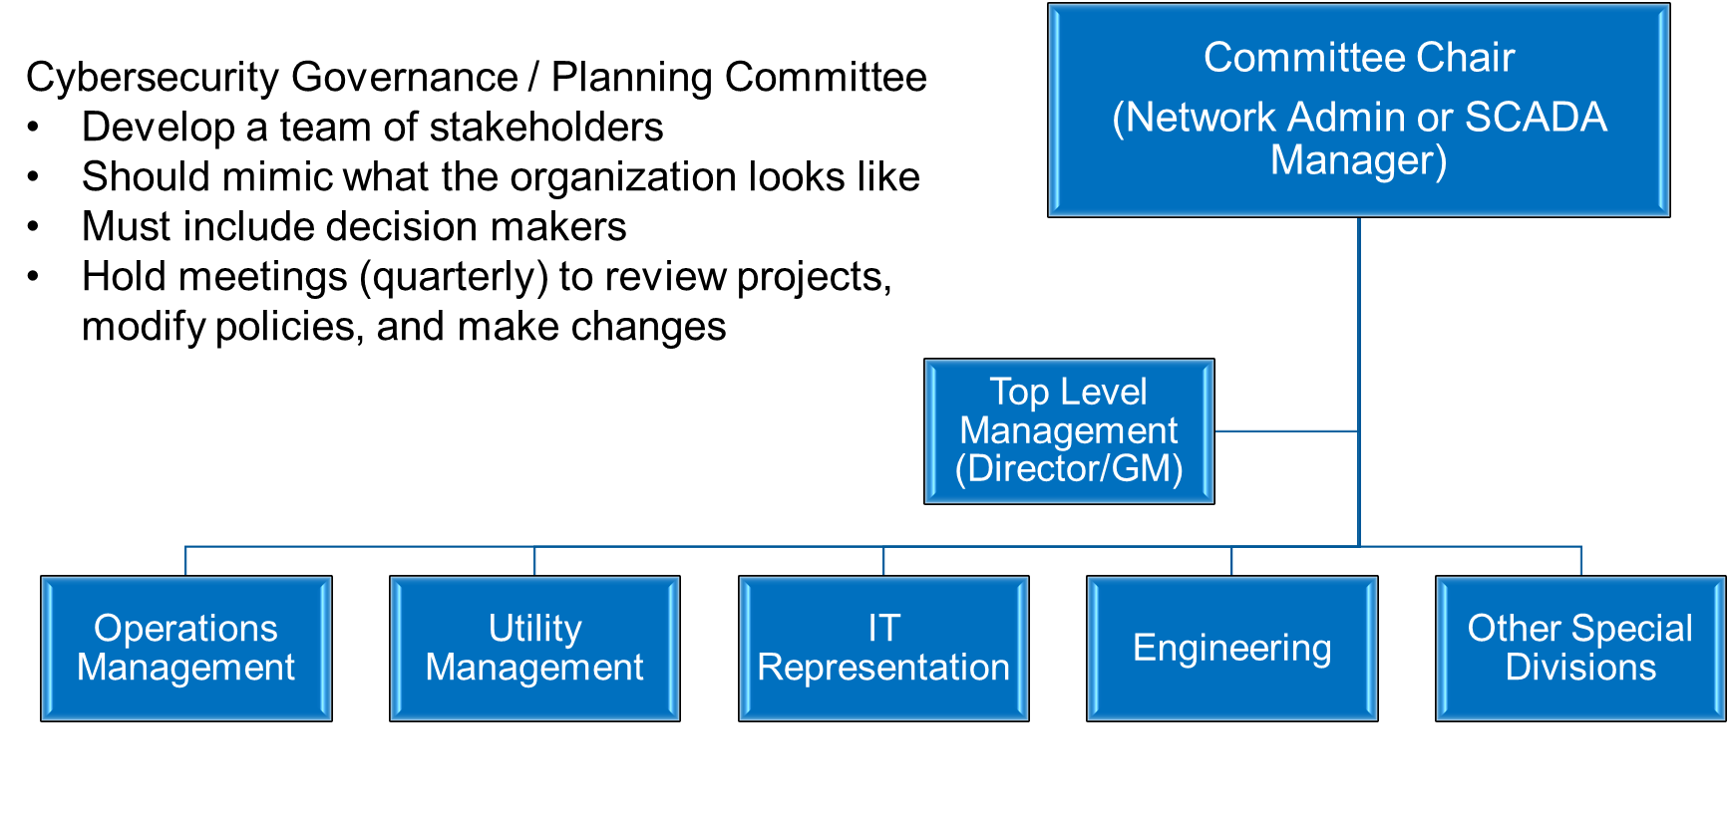
Developing the Team – Step 1

Slide 9
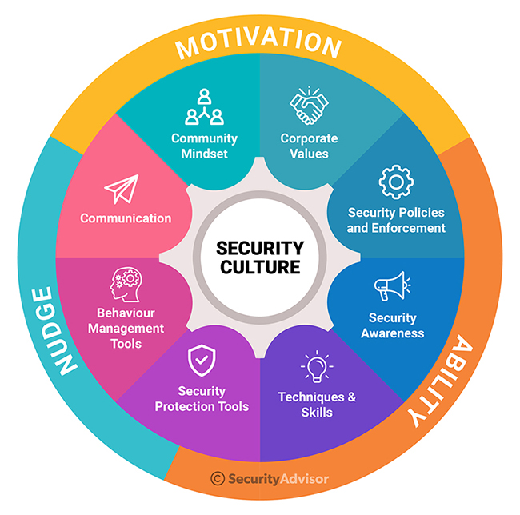

Governance and Planning – Step 2
Develop consensus and engagement

Slide 10
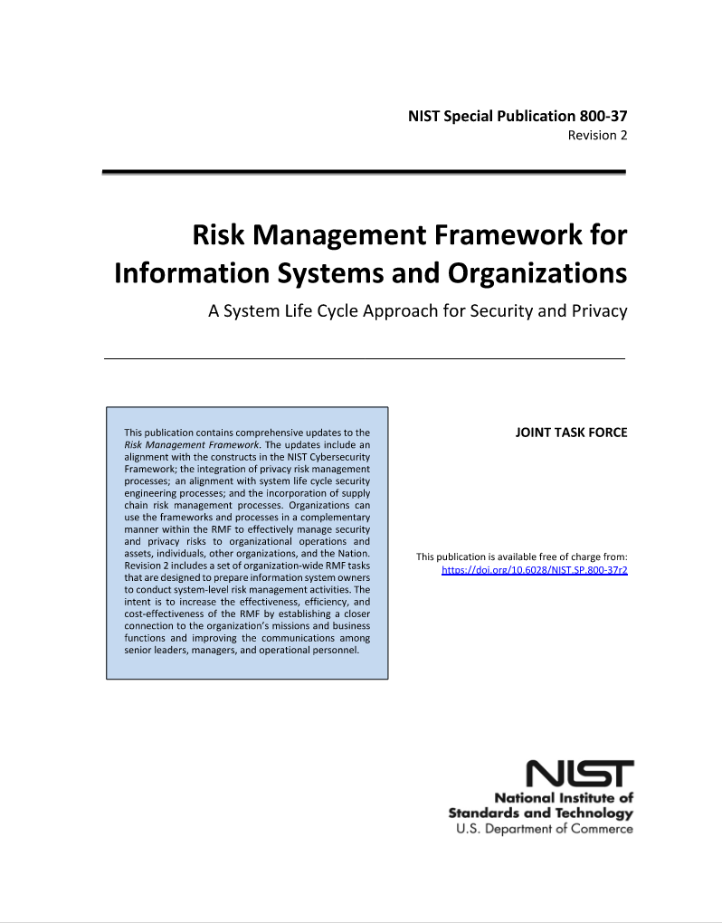
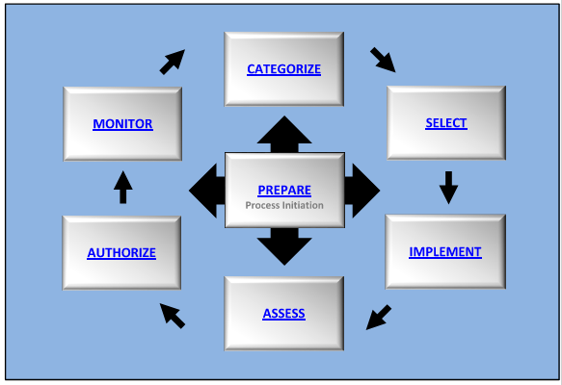
Risk Management Framework – Step 2

Slide 11
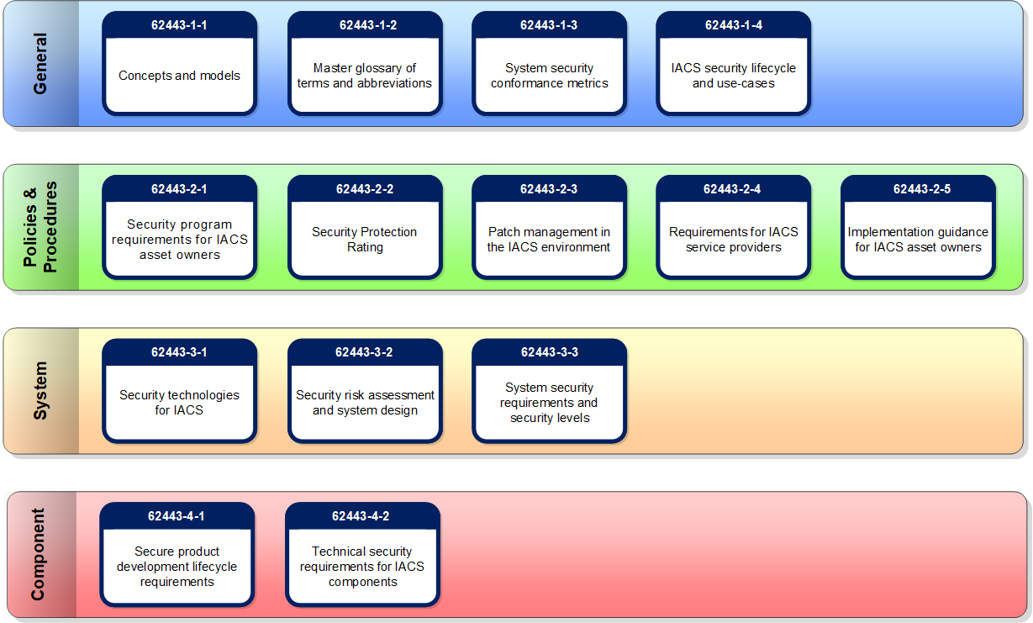
Available Resources – ISA / IEC - 62443

Slide 12
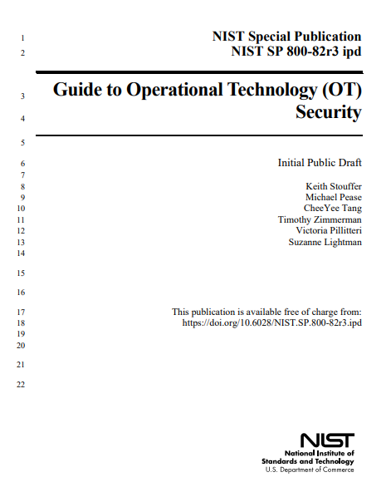
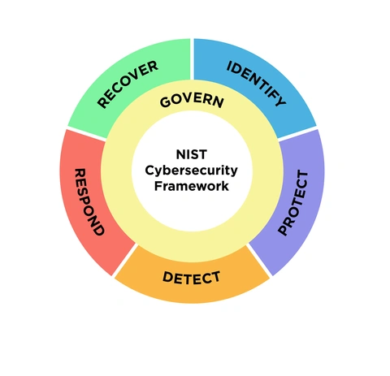
Available Resources – NIST
NIST Cybersecurity Framework 2.0

Slide 13


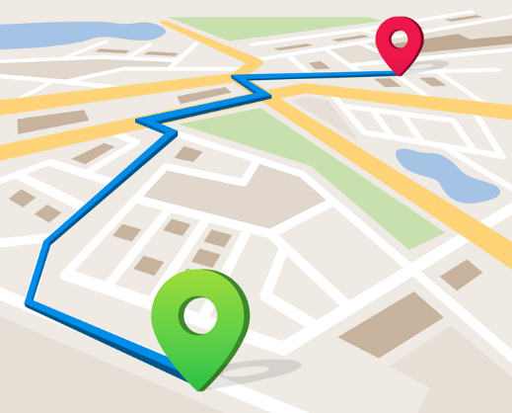
Strategic Vision
Develop a Vision for the Cybersecurity Program:
Mission statement
Core values, culture, ethical standards
Acceptable risk level
Goals and Strategies
Performance Metrics – measureable
Decision making rules and teams
You cannot get somewhere if you do not know where you are and where you are going.

Slide 14
Valley Water
02

Slide 15

John Brosnan – Valley Water
John Brosnan is the Utility Electrical & Control Systems Engineering Manager responsible for energy
management, power distribution, control systems, and SCADA activities for Valley Water’s wholesale
water importation, transmission, treatment, and recharge operations. He works with a team of talented
and dedicated electrical, control systems engineers delivering day-to-day O&M engineering services
and supporting nearly twenty active capital projects. He has been serving as a board member for the
Joint Powers Authority that serves the electric loads at Valley Water since 2005.
John served as the chairs of the Energy Management Committee and Water Utility Technology & Automation
committee at American Water Works Association (AWWA). John served on the advisory committee for
Water Sector Cybersecurity Risk Management Guidance.
John has a bachelor’s and master’s degrees in electrical engineering from Santa Clara University and
is a registered Professional Engineer in California.

Slide 16
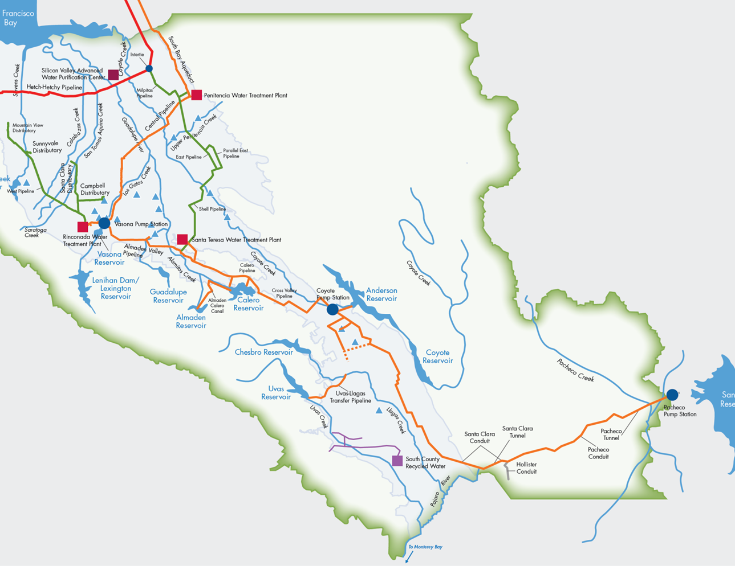
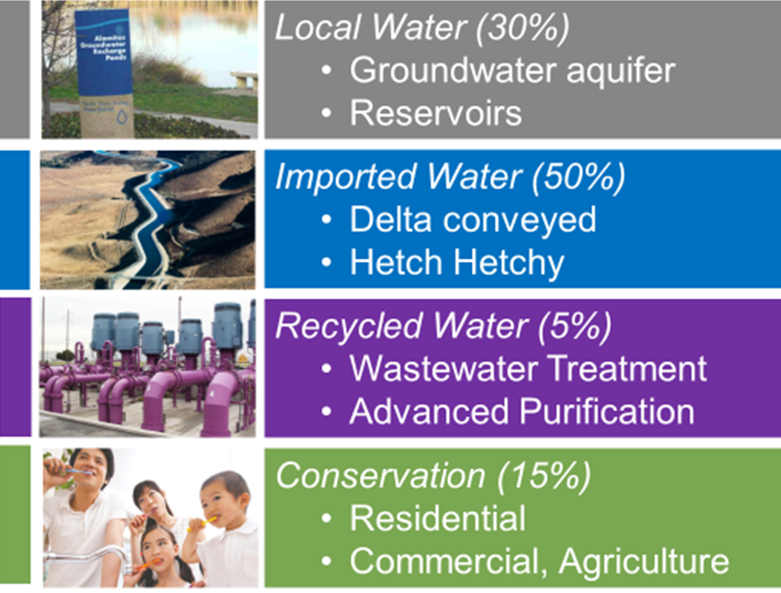
Valley Water’s Comprehensive, Flexible Water System
10 reservoirs
3 pump stations
142 miles of pipelines
4 water treatment plants
277 acres of recharge ponds
294 miles of jurisdictional streams

Slide 17

WATER UTILITY ENTERPRISE
Organizational Chart
Proposed FY23-24 Total Positions: 306 (+3 Limited Term)
WATER UTILITY ENTERPRISE
Office of the Chief Operating Officer
Water Supply Division
Treated Water Division
Raw Water Division
Water Utility
Capital Division
Notes:
FTE This Year = 306 +3 LT. FY24 Additions are 2.0 Inspectors, 1.0 Assoc Eng for Pipelines, 2.0 Apprentices, and reduction of 1.0 Fellow plus 1.0 SMA transferred during the year.
FY25 Adds: 1.0 Chemist, 1.0 Assistant Mech Engineer project commissioning, & 1.0 Program Admin pipeline tech maintenance.
FTE Last Year = 300 +1 Fellow and 3 LT. (LT are the 3.0 Inspectors added in FY23.)
FTE by Div: COO=3.0, WSD=37, RWD=105, TWD=93, WU Cap=71.
WUE Core Functions:
Water Supply
Measure Water Production and Protect the Groundwater Basin
Advance water reuse and conservation
Provide affordable and reliable imported water
Plan for and manage water supply
Water Utility Capital
Plan, Design, & Deliver high quality innovative projects for Water Treatment Plants, Pump Stations & Pipelines
Construction Management & Inspection for District wide Capital Projects
Structural Engineering and specialized services
Operations & Maintenance
Convey local and imported source water to water treatment plants, recharge facilities, and streams
Treat and deliver water to retail customers
Maintain infrastructure
Provide civil, mechanical, electrical, and control systems engineering support

Slide 18
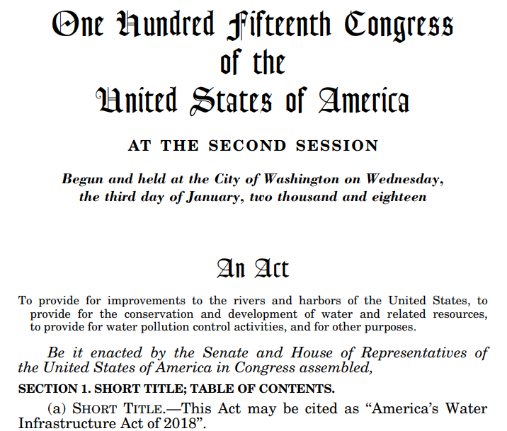
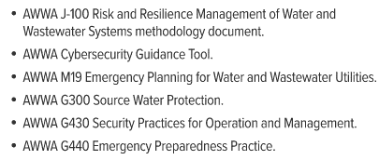
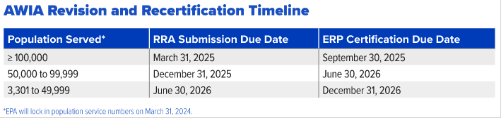
Cybersecurity requirements and foundation
America’s Water Infrastructure Act of 2018
Amended Safe Drinking Water Act Section 1433
Increased emphasis on Cybersecurity for the next recertification
Recommended resources:

Slide 19
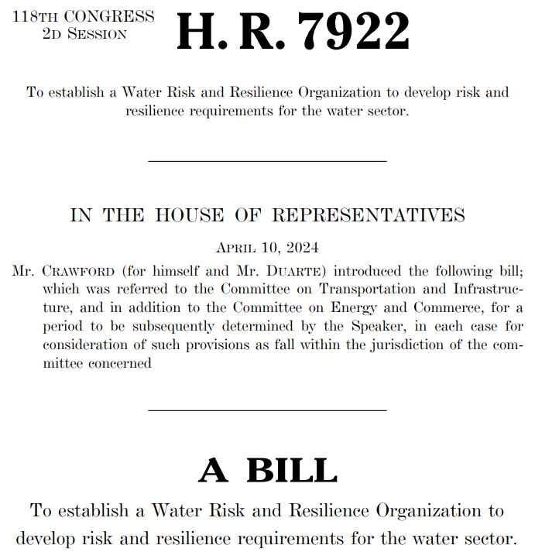
Cybersecurity requirements and foundation
New and pending legislation continues
H.R. 7922 sent to congress in April 2024 to establish a Water Risk and Resilience Organization
National Cyber Strategy Implementation (July ‘23)
National Cyber Strategy (March ‘23)
Establishment of Cyber Safety review board (Feb ‘22)
TSA’s Second security directive for pipeline owner’s and operators (July ‘21)
Executive Order 14028: Improving the Nation’s Cybersecurity (May ‘21)
State Level Legislation:
Ohio passes Data Protection Act that provides legal protections for entities implementing a Cyber Framework
Iowa, Connecticut, and Utah pass Data Protection Acts, modeled closely after Ohio statute
Many others

Slide 20
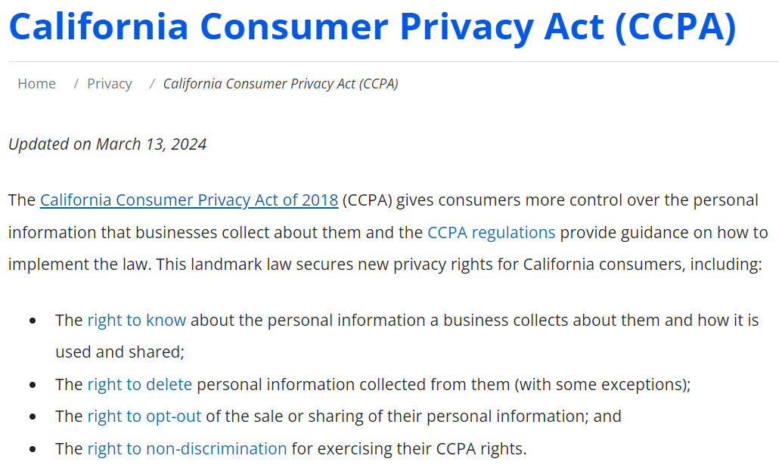
Cybersecurity requirements and foundation
Amended by proposition 24, the California Privacy Rights Act
Added new additional privacy protections
These laws can affect how customer data is collected and used

Slide 21
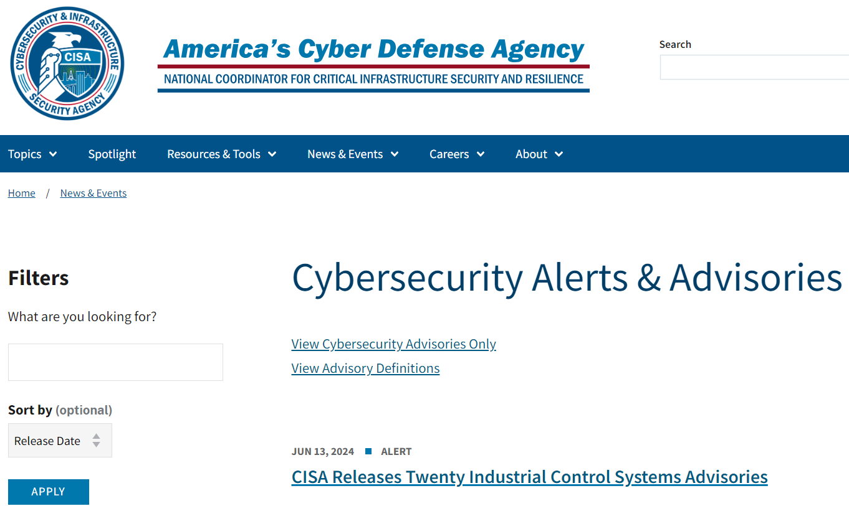
Cybersecurity requirements and foundation
Implementation of CISA Alerts and Advisories

Slide 22
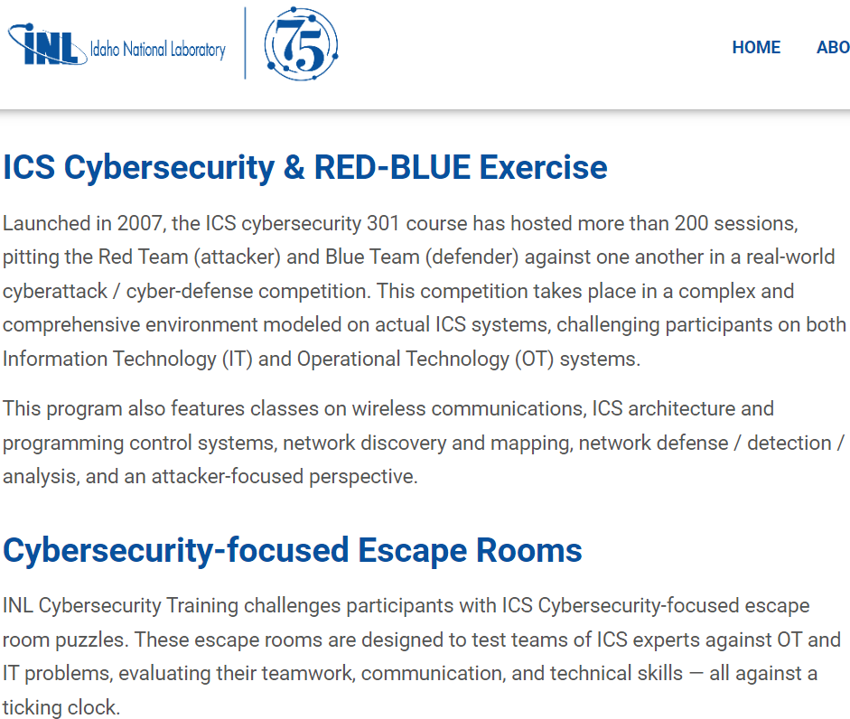
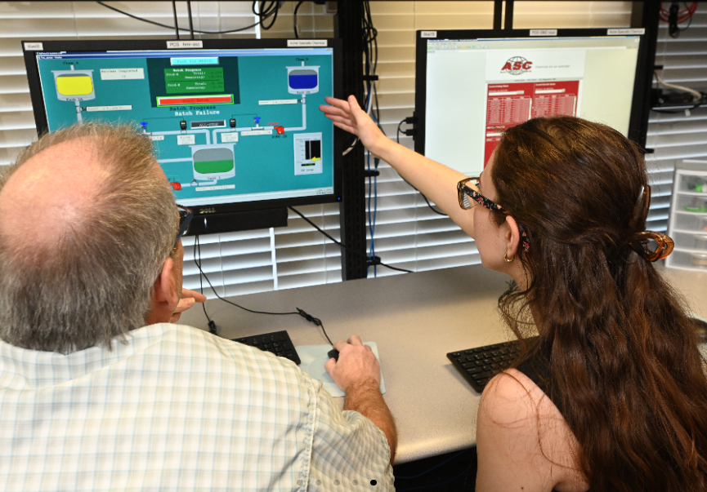
Actions Taken
Reduce Exposure
Regular Monitoring Assessments
Credential Management
Inventory assets
Incident response and recovery plans
Data and Application Backup
Patching
Training

Slide 23
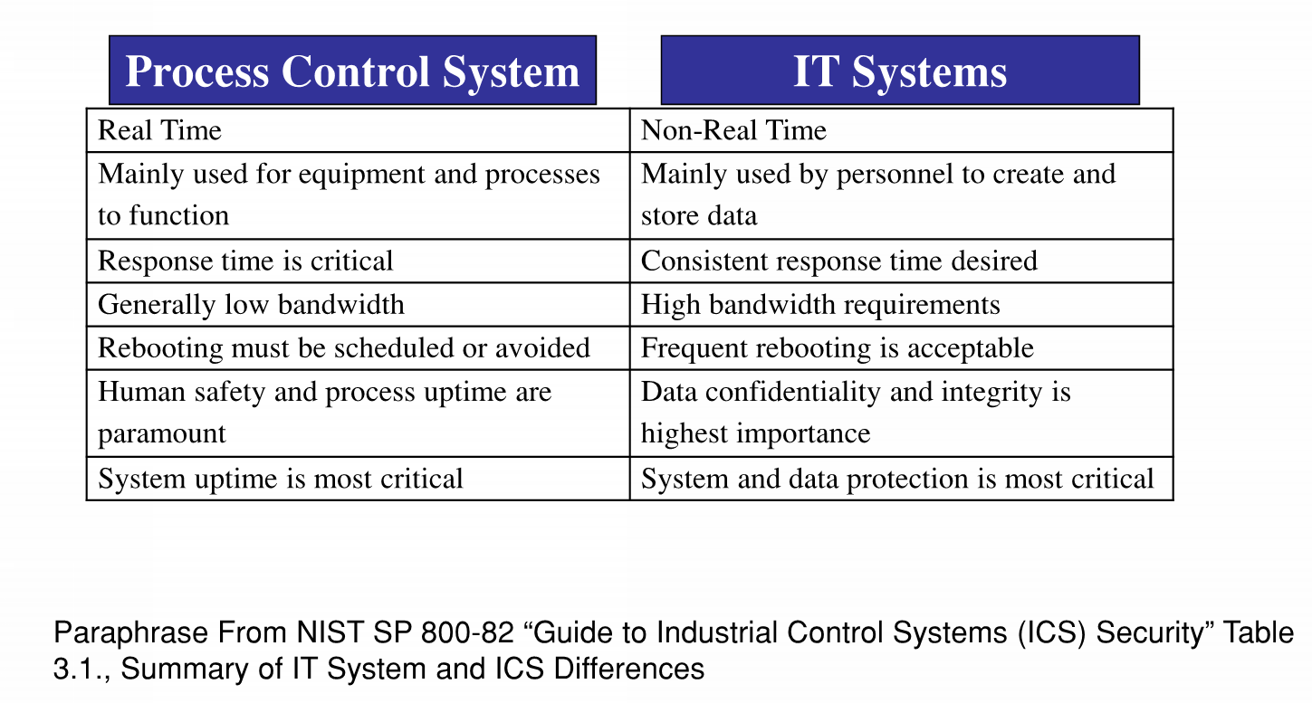
Who is leading the Cybersecurity Effort?
IT and OT systems have different features and NIST recommends tailoring security measures to the OT environment to protect these systems.

Slide 24
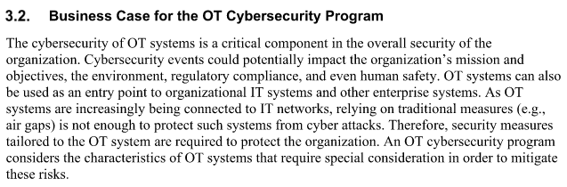
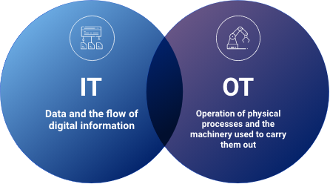
Who is leading the Cybersecurity Effort?
*From NIST SP800-83 Rev 3.
Who is leading the cybersecurity effort at Valley Water?
  IT is leading the cybersecurity effort
  What is the role of OT?
  How do IT and OT work together?

Slide 25
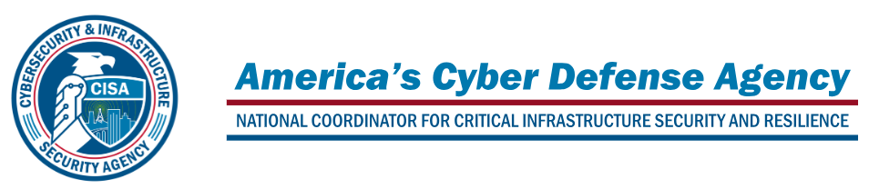
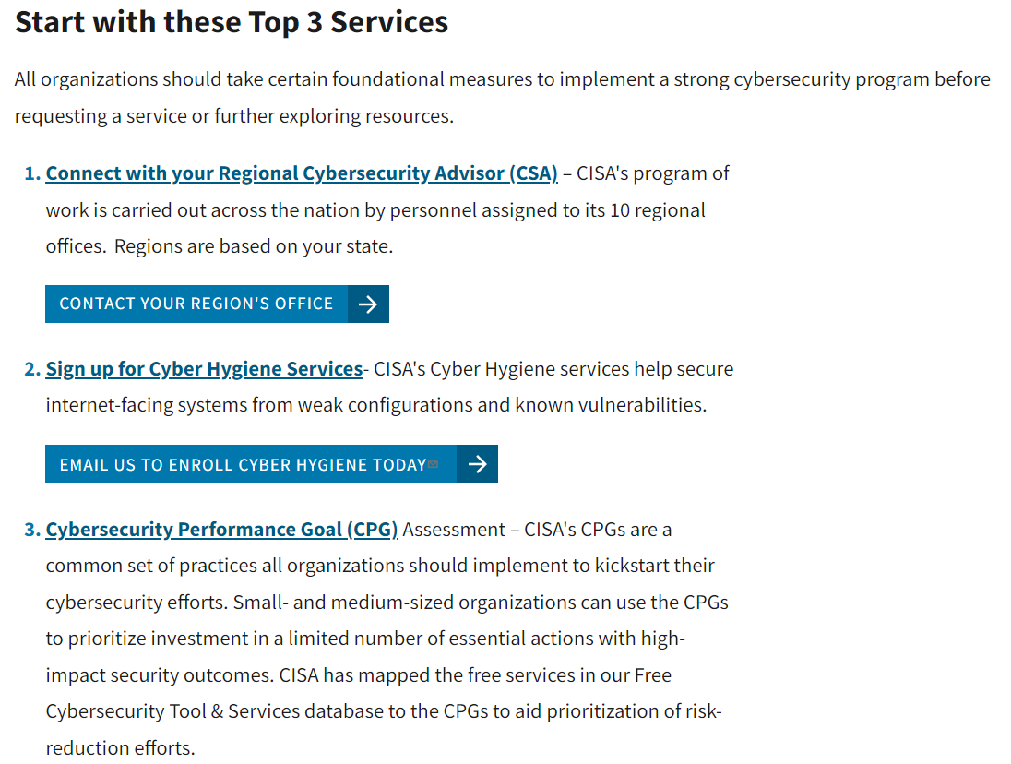
Where should a utility start?
Cybersecurity and Infrastructure Security Agency (CISA)
Many no cost services offered
https://www.cisa.gov/resources-tools/resources/free-cybersecurity-services-and-tools

Slide 26
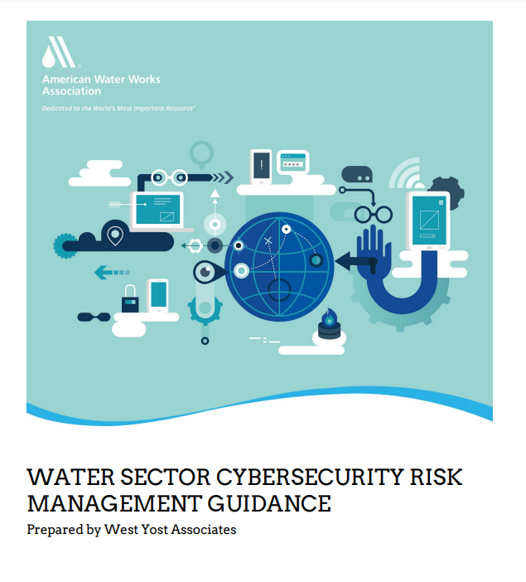
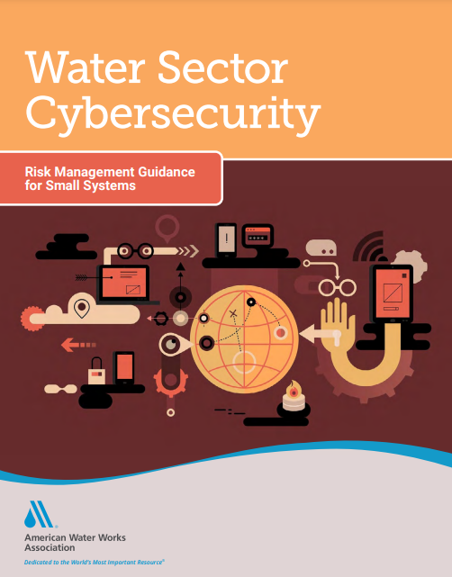
Where should a utility start?
Cybersecurity Use Case Tool
Simple 20 question utility
Approximately 90 recommended controls for implementation
https://www.awwa.org/Resources-Tools/Resource-Topics/Risk-Resilience/Cybersecurity-Guidance

Slide 27
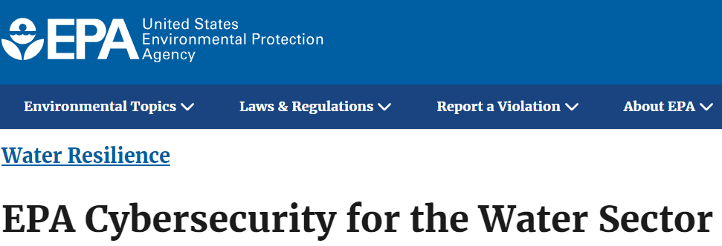
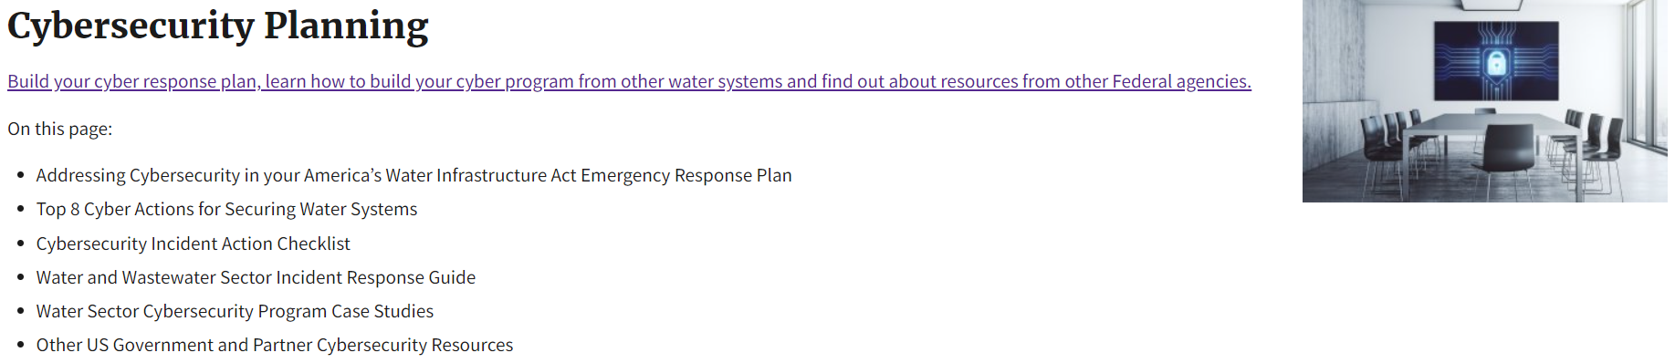
Where should a utility start?
https://www.epa.gov/waterresilience/epa-cybersecurity-water-sector

Slide 28

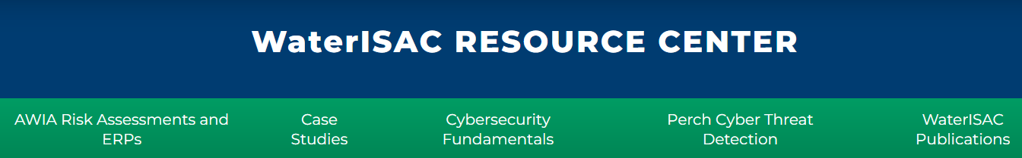
Where should a utility start?
https://www.waterisac.org/

Slide 29
DuPage Water Commission
03

Slide 30
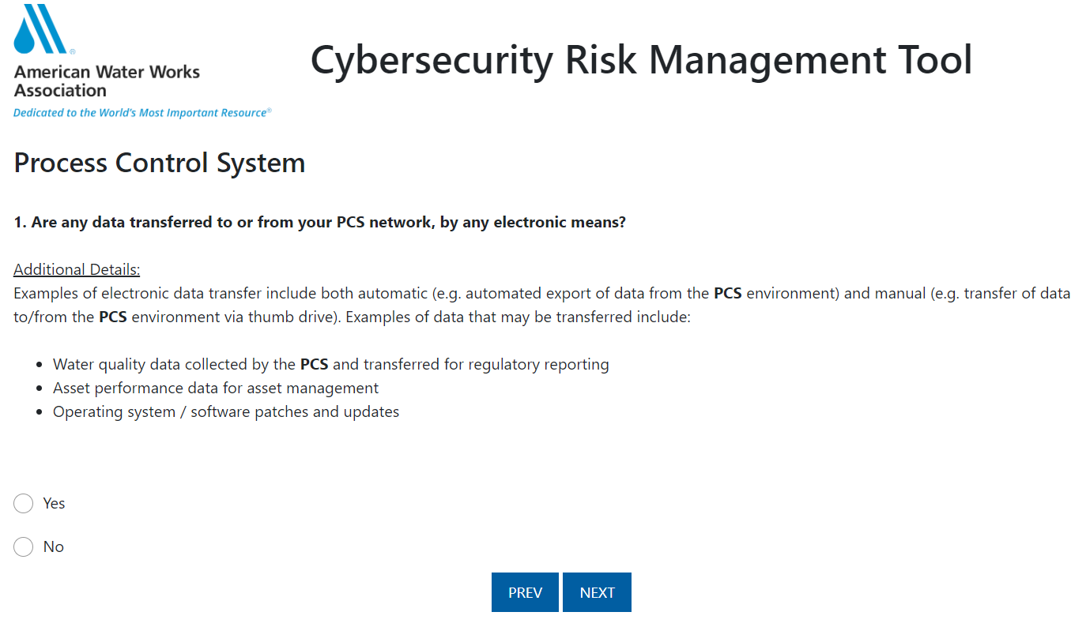
Risk Analysis – Step 3
Align with selected framework
Select a risk assessment method and tool
  AWWA Cyber Tool
  CSET
  NIST CSF 2.0
  CISA Cyber Evaluation Tool
  Many State Tools
Create projects for implementation of recommendations
Consider a penetration test

Slide 31
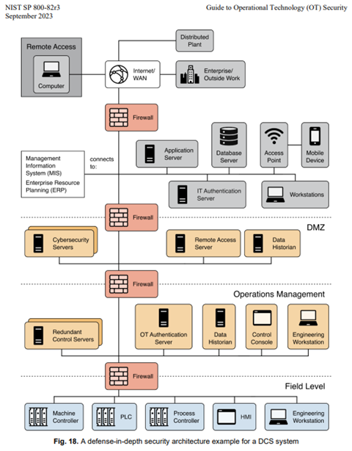
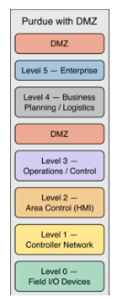
Addressing and Mitigating Risk -
Step 4
Many ways to address and mitigate risk
A starting point is developing a secure topology and network architecture
Additional cybersecurity controls can then be added to further harden the system

Slide 32

Denis Cuvalo, PMP
DuPage Water Commission
Systems Engineer and IT Supervisor
Experience: 6 years
Education: University of Iowa, BS in Biomedical Engineering
Denis is a proud member of the DuPage Water Commission’s Systems and Information Technology team and is the administrator for both the organization’s IT and OT networks. He is currently managing a complete SCADA system replacement project where he is working closely with Operational and Instrumentation staff to implement a state-of-the-art controls system and working to ensure a smooth transition to an OT environment that will elevate the controls management the utility.

Slide 33
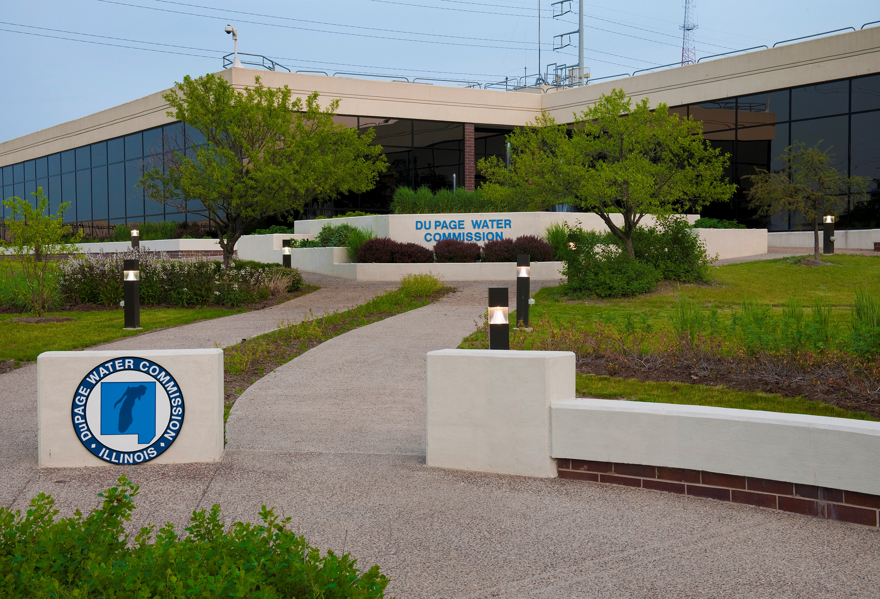
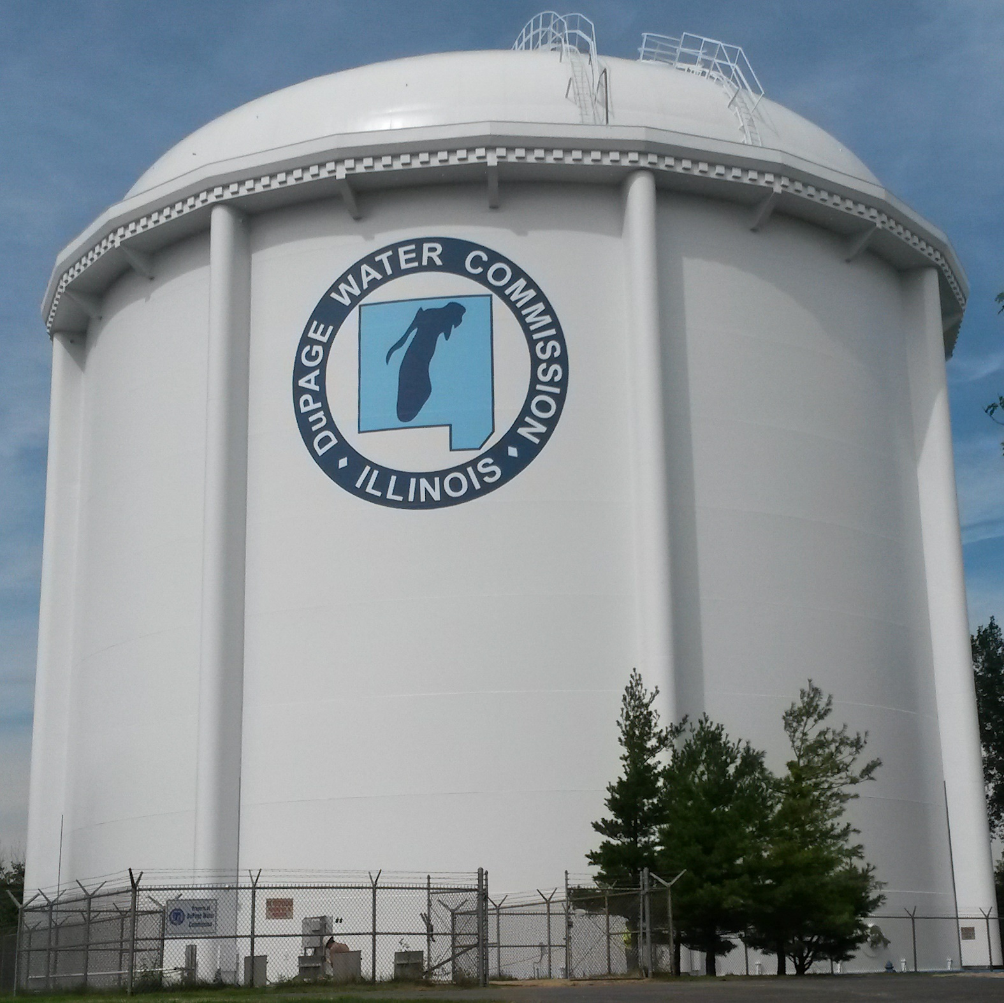
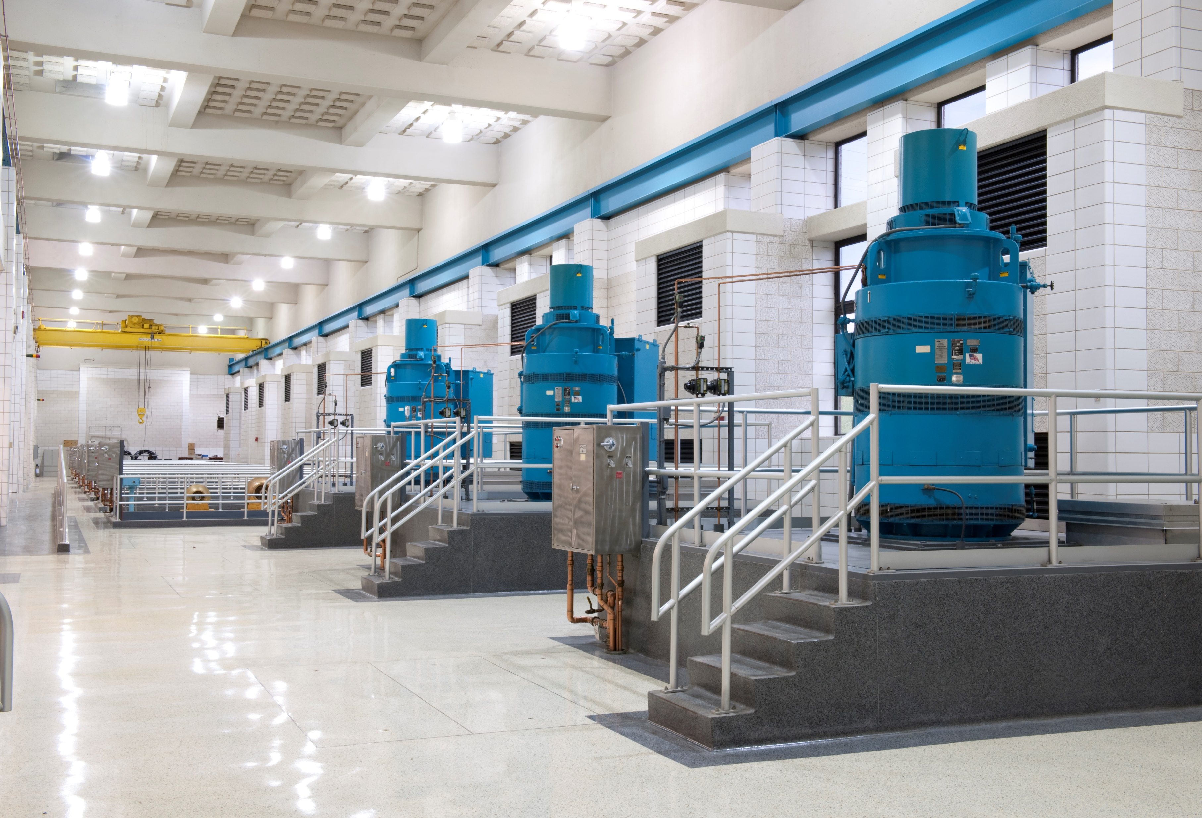

The DuPage Water Commission is the second largest drinking water supplier in the State of Illinois, serving approximate 900,000 citizens throughout DuPage County.
As critical infrastructure, we prioritize the safety and security of our organization and have increased our efforts in the networking and cybersecurity realms over the last decade as our industry has continued to develop and rely on the IT and Operational Technology (OT) systems.
The DuPage Water Commission has been and will continue to its commitment to advancing its cybersecurity practices and preparedness as the EPA, FBI, DHS, and other United States Government agencies spark awareness and initiatives on cybersecurity in the water/wastewater sectors.

Slide 34
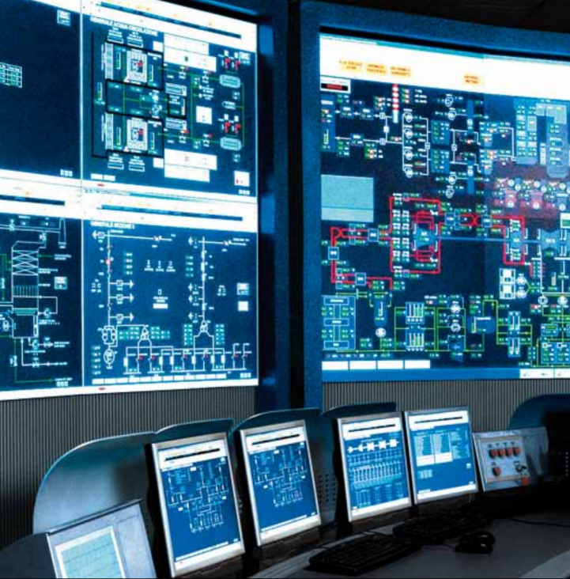
Implementation of Cybersecurity Solutions
Cybersecurity Standards (CISA, NIST)
  Cybersecurity and Infrastructure Security Agency (CISA)
  National Institute of Standards and Technology (NIST)
Understanding your system (NIST – Cybersecurity Framework (CSF) 2.0)
  Take time to understand all aspects of your organizations IT and OT environments
  Categorize your gaps and determine how an approach can be taken to address them
  Prioritize actions to take against such cybersecurity risks
Notes:
Cybersecurity standards are developed by following cybersecurity best practices by industry professionals and organizations such as CISA. The implementation of a solution varies by the need, we have had various methods of approach that range from in-house modifications to implementing a subscription service. When a standard is determined that we have not yet met we work on implementing it in-house but if it is something beyond our expertise we work with industry professionals to assist with recommendations and potentially provide a solution. Depending on its scope and complexity we will approach the implementation process differently. Our approach to implementing stronger cybersecurity standards stems from understanding our network and what we deem to be critical to supplement or bolster and always try to keep our ears open to what is occurring in the water/wastewater/utility and critical infrastructure cyber realm to make sure any new and know vulnerabilities are either addressed or confirm do not apply to our systems. Our approach can also vary based on cost, industry concerns, our organization’s needs, the impact on our staff and end-users, network impact, and maintenance and management requirements. Though the primary goal is to protect our system and our organization, we have learned that in some cases to make a solution truly effective you require personnel resources to potentially justify the cost. In most cases, there are usually several solutions to fit a need and we found that some require more maintenance and monitoring to achieve its highest potential or effectiveness. We have found it to be beneficial in determining what resources are available to maintain, monitor, and sometimes enforce a solution to deem its overall effectiveness.

Slide 35
Implementation of Cybersecurity Solutions Cont.
Resource Requirements and Administration
  What are the solutions that can be considered to achieve the goal?
  Of the potential solutions, it can be helpful to consider the following questions to help you make your decision:
    What are the personnel requirements to achieve the goal?
    What will it take to maintain the solution? Will you be able to provide the resources to maintain and manage it to optimize its effectiveness?
    What are the administration requirements for the solution?
  Determine what the expectations and requirements are for your IT staff and end-users.
IT/OT Standards
  Will the solution apply to your OT Network? Take the same considerations into account.
Notes:
What are the solutions that can be considered to achieve the goal?
Solutions will vary by the need and can have various methods of approach that range from in-house modifications to implementing a subscription service. When a standard is determined that we have not yet met we work on implementing it in-house but if it is something beyond our expertise we work with industry professionals to assist with recommendations and potentially provide a solution
Of the potential solutions, it can be helpful to consider the following questions to help you make your decision:
What are the personnel requirements to achieve the goal?
What will it take to maintain the solution? Will you be able to provide the resources to maintain and manage it to optimize its effectiveness?
What are the administration requirements for the solution?
Determine what the expectations and requirements are for your IT staff and end-users.

Slide 36

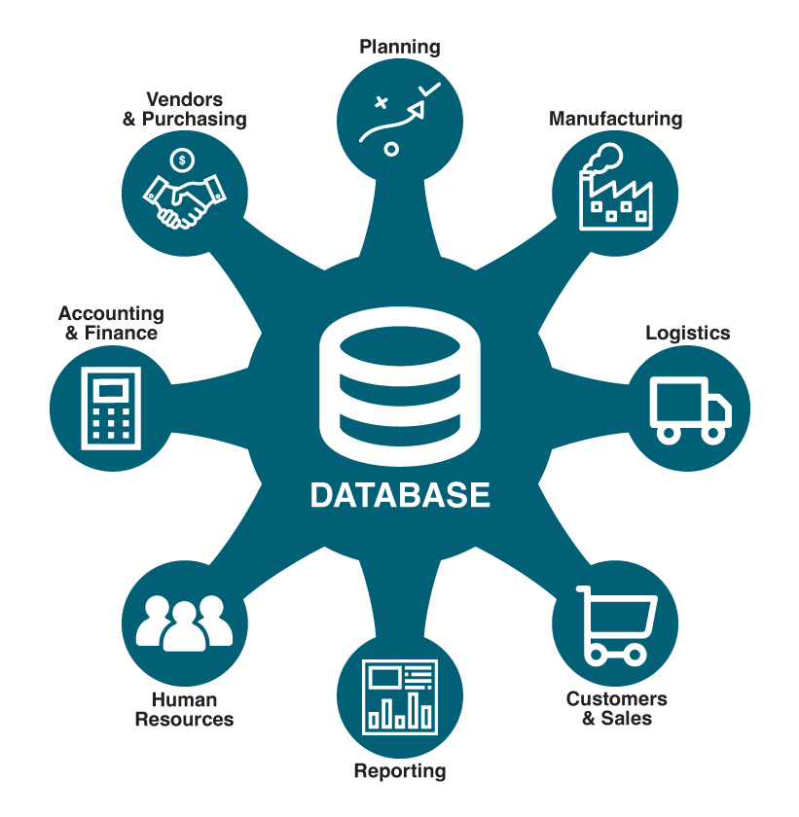
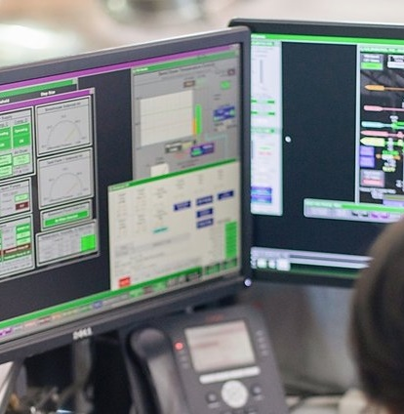
Considerations for Cybersecurity and Systems Management
Enterprise Network Cybersecurity Policies
Third-Party Cybersecurity Solutions
Control Network Cybersecurity Considerations
Cybersecurity Training Initiatives

Slide 37
Enterprise Network
Cybersecurity
Policies
IT/OT Network Segregation
Multifactor Authentication*
Password Policies*
File Structure Account Management*
Enterprise Network Maintenance and Patching
Vendor Access Management
Firewall Policies
Disaster Recovery Plan*
Active Employee Communication and Training*
3rd Party Network Monitoring
Notes:
MFA – Could be utilized on multiple levels, AD login, VPN, OT login, etc.
Password Policies – Complexity, length, update requirements
File Structure Management – Managing who has access to what in your organization’s file structure. To prevent document access, loss, manipulation, or movement.
DR Plan – This can be a useful document to centralize information about your network, support contacts, vendor information, key personnel information, recovery plans, and configuration information.
Training – Training end-users could be a big step to protecting your networks and your organization. Having open and active communication with your staff can lead to a better understanding on threats in the cyber realm and also create a comfort level with reporting suspicious emails or activity.

Slide 38
Third-Party
Cybersecurity Solutions
Managed Defense (SOC) Solution
  In-line network monitoring device
  24x7x365 coverage
  Hunting campaigns
Email Threat Protection
  Inbound and outbound email security
  Email attachment and URL hidden threat analysis
  Automated policies, updates, and threat hunting
Endpoint Protection
  Quarantining and investigation of device-level threats
  Protection against ransomware and credential theft attacks
Notes:
Managed Defense
In-line network monitoring device
24x7x365 coverage
Automatic signature response
Advanced threat detection and investigation
Proactive threat hunting
Bi-weekly threat briefings
Identification of new threat campaigns
Remediation support
Network Monitoring and Hunting portals
Email Threat Protection
Comprehensive inbound and outbound email security
Integrated investigation and response
Automatic email quarantining pre- and post-delivery
Email attachment and URL hidden threat analysis
Automated policies, updates, and threat hunting
Email Threat Protection portal
Endpoint Protection
Quarantining and investigation of device-level threats
Protection against file-less and script-based attacks
Protection against ransomware and credential theft attacks
Continuous monitoring and real-time response
Automated policies, updates, and threat hunting
Centralized portal to view threat and event history

Slide 39
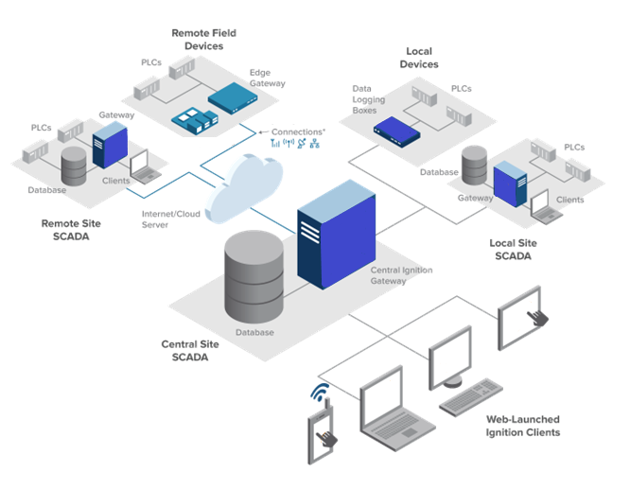
Control Network Cybersecurity Considerations
Industrial Control System (ICS) Purdue Model
  Segmentation of control network (Enterprise/DMZ/Operation/Control/Process)
  Implementation of an air gap between the IT and operational technology (OT) environment
Private backhaul communication
  Redundant communication methods
Zero trust architecture
  Remote access limitations
  User management policies
OT Environment monitoring solutions
Notes:
Industrial Control System (ICS) Purdue Model
Segmentation of control network (Enterprise/DMZ/Operation/Control/Process)
Level 4/5 – Enterprise (PCs, Servers, SAN, etc.)
AIR GAP - DMZ (Servers, Historian mirror, etc) (firewall between Level 4/5 and Level 2)
Level 3 – Operation and Control (Engineering Workstations, Servers, Historian)
Level 2 – Control (HMI, SCADA)
Level 1 – Process (PLCs, RTUs)
Level 0 – Process (Sensors, Analyzers, Actuators, etc)
Implementation of an air gap between the IT and operational technology (OT) environment
DMZ network, unidirectional gateway, firewalls, etc.
Private backhaul communication
Redundant comm methods (private fiber, private cell, licensed radio)
Zero trust architecture
Remote access limitations (view only remote access)
User management policies (tight control of user permissions and access)
OT Environment monitoring solutions
Claroty

Slide 40
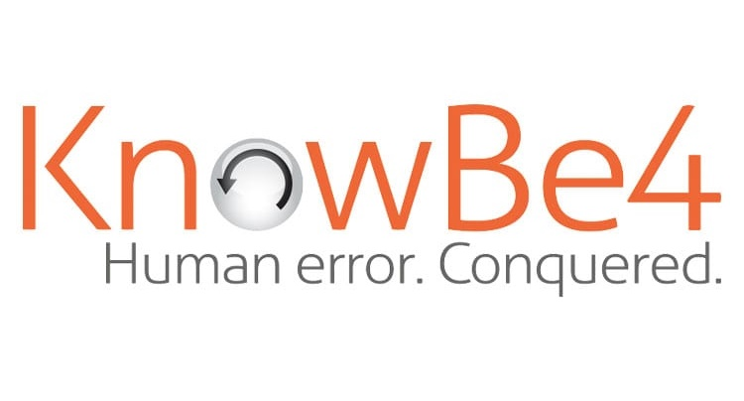
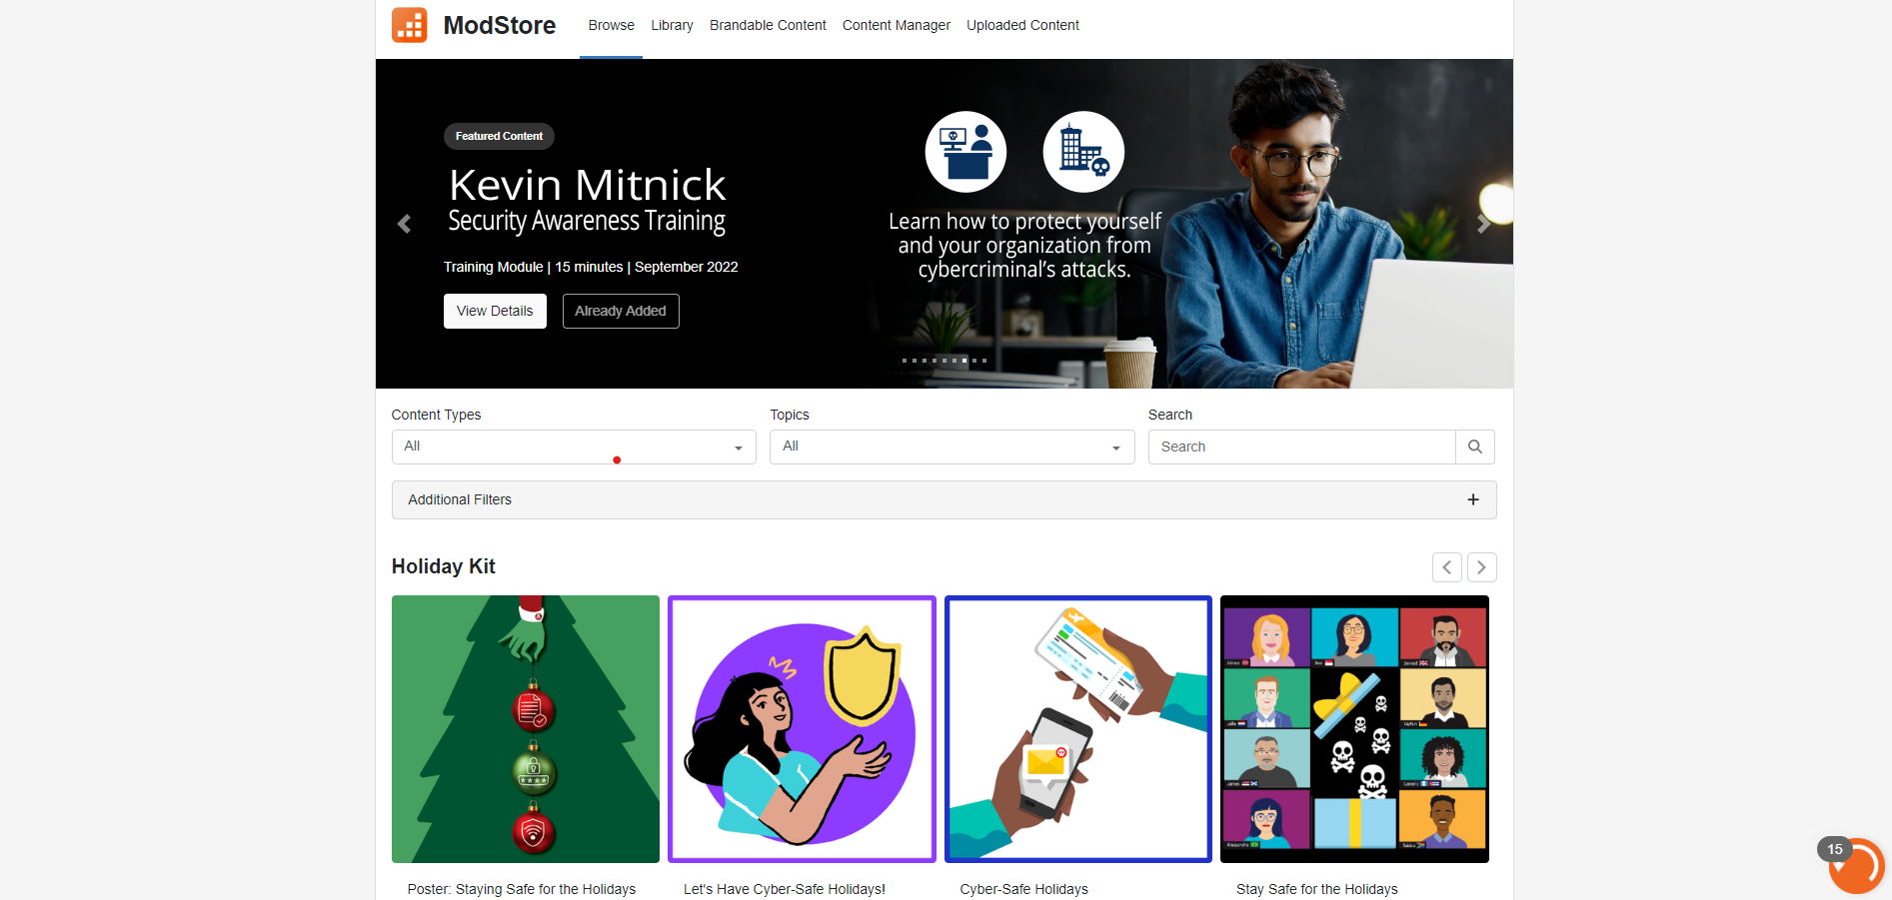
Cybersecurity
Training Initiatives
Cyber Security Threat Briefings
Employee Knowledge Sharing
KnowBe4 Cybersecurity Awareness Training
  Cyber Security Informational campaigns
  Phishing campaigns
Tabletop Exercises
  Review means and methods in responding to potential cybersecurity scenarios
  Review Disaster Recovery plans and documentation
Review of employee roles and responsibilities
Notes:
Cyber Security Threat Briefings
Monthly/Bi-weekly meetings to review the health of the network, review any investigations or potential findings, discuss new topics in the cybersecurity realm.
Employee Knowledge Sharing
Share articles, webinars, info bites of important cybersecurity best practices, news, updates, or information your organization could use to become more prepared and informed.
KnowBe4 Cybersecurity Awareness Training
Cyber Security Informational campaigns
Phishing campaigns
Tabletop Exercises
Review means and methods in responding to potential cybersecurity scenarios
Review Disaster Recovery plans and documentation

Slide 41
Summary and Questions
04

Slide 42
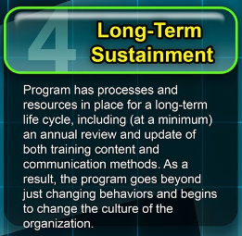

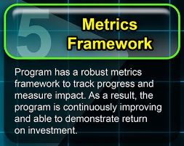
Monitoring and Improving – Step 5

Slide 43



Summary
Document system, implementations, projects, response, and initiatives in a Cybersecurity Plan.
(Corresponds to AWIA ERP)
Policies and procedures developed should be part of the overall cybersecurity plan, and training, and acceptable use policies tuned to match these overall strategies.
Program should be reviewed by the Cybersecurity Governance Committee to verify information is still accurate, plans are on track, progress is being made, and new threats and risks are addressed.

Slide 44
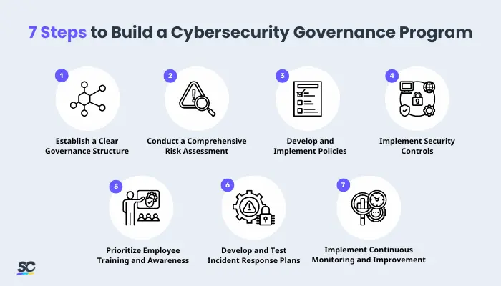
Summary and Questions
Develop the Team
Abundance of Guidance – Key is to pick a path and follow it
Governance and Planning
Risk Analysis
Address and Mitigate Risk
Monitor and Improve

