Slide 1
BAYWORK:
An Innovative Approach to Workforce Reliability
Ingrid Bella
Santa Clara Valley Water District
BAYWORK Chair

Slide 2

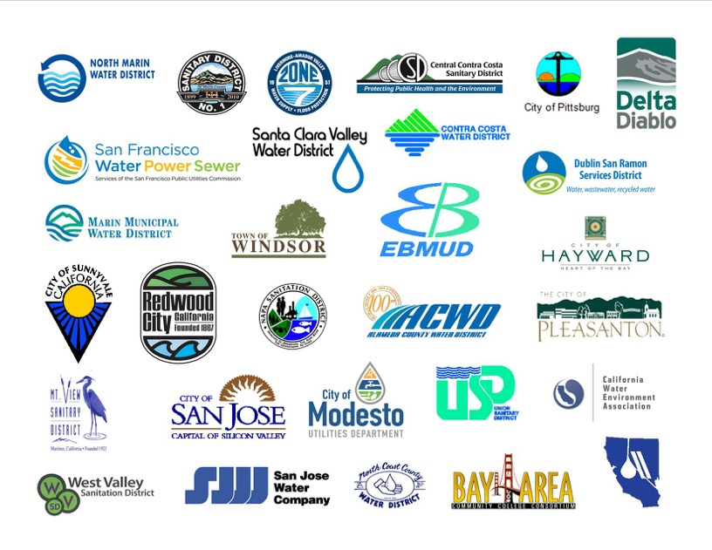





BAYWORK a Regional Consortium
South San Francisco & San Bruno Wastewater Treatment Plant

Slide 3









Mission-Critical Jobs
Electrician
Wastewater Treatment Operator
Electronic Maintenance Technician/Instrument Technician
Water Distribution Operator
Water Treatment
Operator
Engineer
Wastewater Collections Operator
Machinist/Mechanic
Notes:
3 highest need occupations: M/M, E/E, EMT/IT
Others are mission critical but these 3 are also in high demand in OTHER industries, especially given our booming economy in the Bay Area

Slide 4
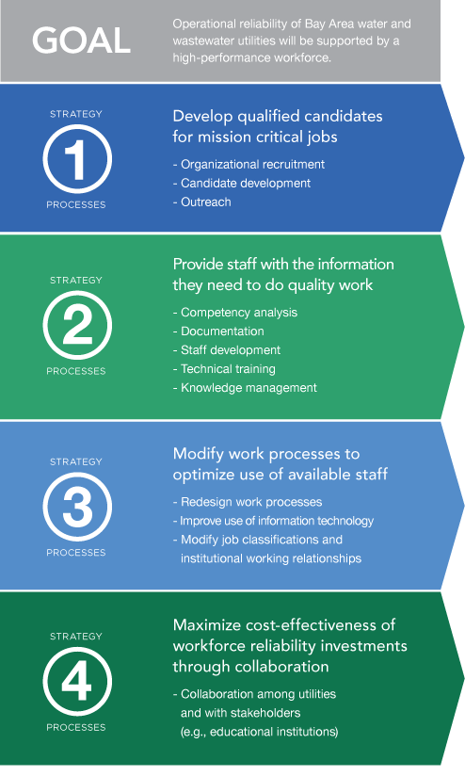
BAYWORK Roadmap

Slide 5
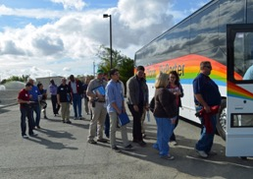
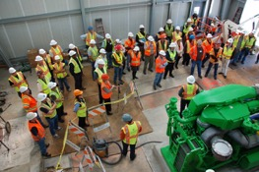
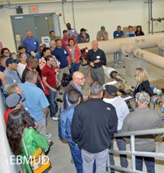
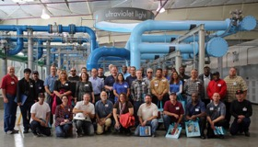
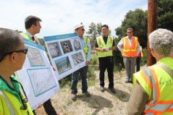
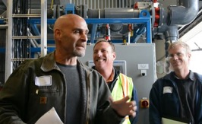
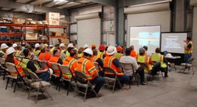
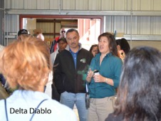
Workshop On Wheels
City of Hayward
East Bay Workshop on Wheels
SFPUC
Las Gallinas
South Bay Workshop on Wheels
Oro Loma

Slide 6
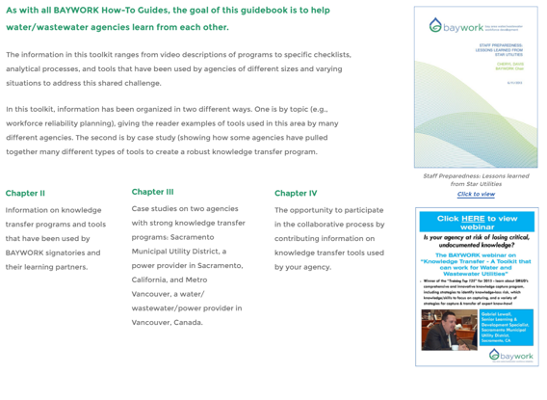
Goal of Toolkit
Knowledge Transfer Toolkit
The goal of this Knowledge Transfer Toolkit is to help water/wastewater agencies learn from each other.
On-line interactive book
Provides direct on-line links to specific resources.
Notes:
Unique in that book includes links to hundreds of resources: videos of interviews and presentations, powerpoint slides, examples of work and templates for replicating work in your own utility.
Going to walk through some of the sections and give you a sense of the kinds of resources included…

Slide 7
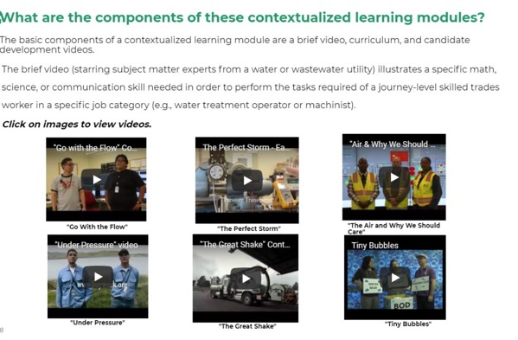
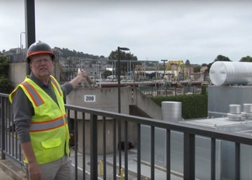
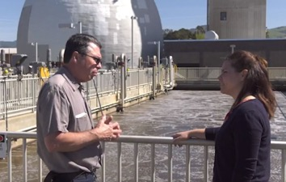
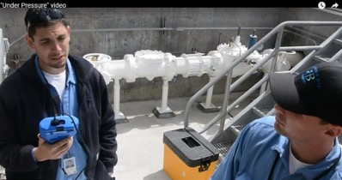
Contextualized Learning Guidebook
“Air and Why We Should Care” video
“Tiny Bubbles” video

Slide 8
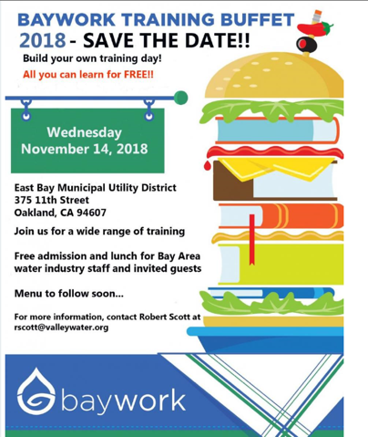
Cost-Effectiveness through Collaboration
BAYWORK Training Buffet
Pick and choose classes
Instructors from many utilities
Contact hour credits

Slide 9
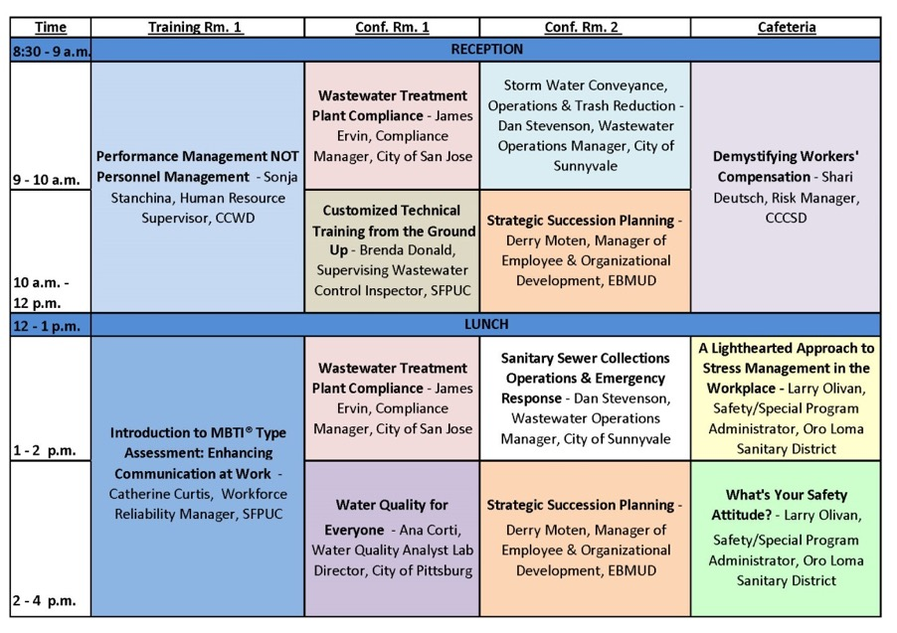
Collaboration Among Utilities

Slide 10











Partnerships
Notes:
This page is a carry-over from last year’s signatory meeting

Slide 11
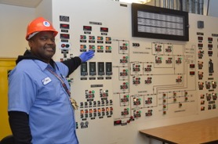


Findings
After a close analysis of 9 mission-critical occupations, 3 rose to the top as high need, high volume and challenging to hire for:
Electrician/Electrician technician
Mechanic/Machinist
Electronic Maintenance Tech/Instrument Tech
These roles cut across multiple sectors, adding to hiring competition, and maximizing the potential impact of career pathways programs.

Slide 12


Utility/NGO Collaboration
Notes:
Part 1: Awareness – brochures, BAYWORK website, career fairs, summer internships, teacher externships, contextualized curriculum, pre-apprenticeships

Slide 13
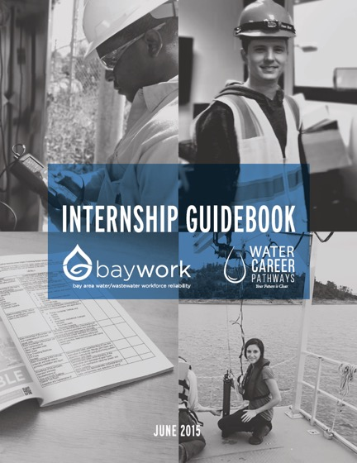
Collaboration with Community College System

Slide 14
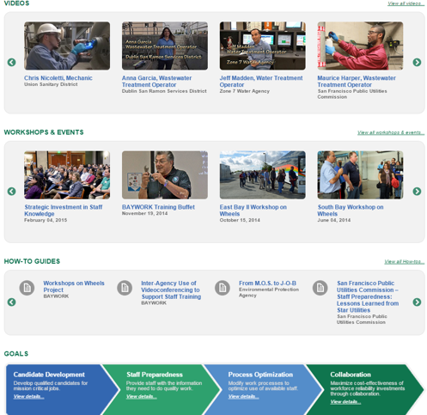
Website Resources Page
baywork.org/resources

Slide 15
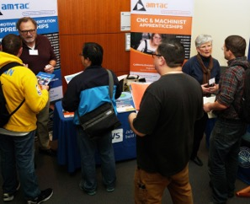
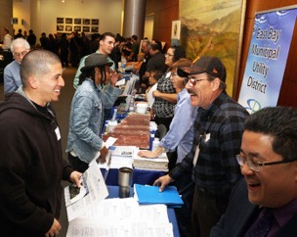
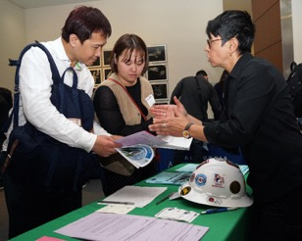
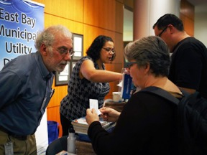
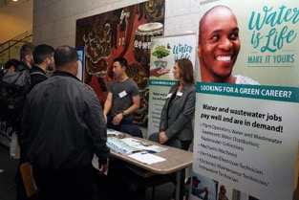
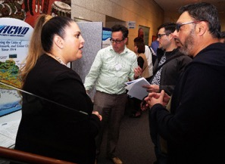
San Francisco Career Fair 2018
Wed. March 7, 2018 24 tabling agencies 174+ total attendance
Notes:
Steven

Slide 16
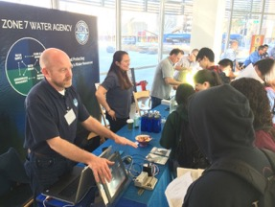
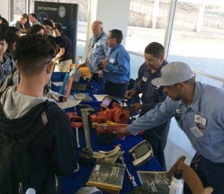
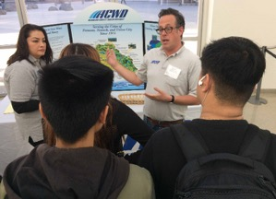
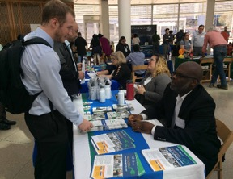
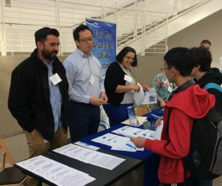
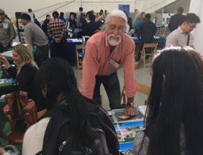
San Jose Career Fair 2018
Wed. March 28, 2018 23 tabling agencies 640+ Total Attendance* *including 443 high school students from 7 South Bay High Schools
Notes:
Lisa

Slide 17
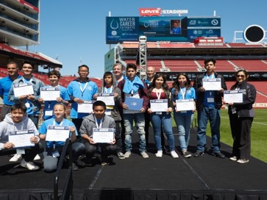
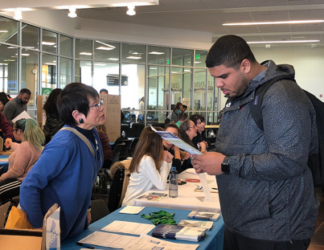
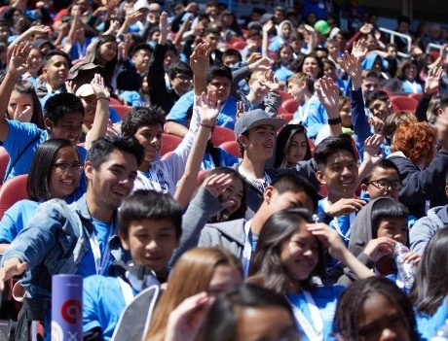
Bay Area Water Challenge
A semester-long academic competition:
Project Participation:
800 students from 10 high schools
Awards Event: @Levi’s Stadium (4/19/18)
attended by 500 students
Lead Partner: W. Valley College/
Water Career Pathways Consortium
Notes:
Steven - Water Challenge 2018 A Huge Success!
...semester-long team projects focused on real issues faced by water districts.
Each student presentation was videotaped and presented for judging.
high-profile presentation and award ceremony at Levi’s Stadium. …with guest speakers, the three winning teams’ Water Challenge project presentations were viewed on the jumbotron for the entire audience to see.
Students cheered for their fellow students as the three winning teams were awarded scholarships.
According to winning team teacher Gabriela Huynh, “The students and I were both thrilled… The Water Challenge is project-based learning at its best.”
Participating schools included:
Yerba Buena HS
Independence HS
James Lick HS
Morgan Hill Live Oak
Fremont (OUSD)
Balboa HS (SFUSD)
O’Connell HS (SFUSD)
Silver Creek HS
Andrew Hill HS
Santa Teresa HS

Slide 18
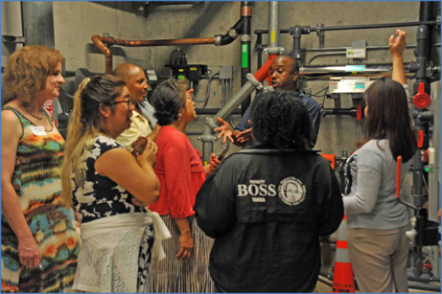
Teacher Externships
A partnership with IgnitEd, an education non-profit in Silicon Valley
Participating agencies:
Santa Clara Valley Water District
City of San Jose
San Francisco Public Utilities Commission
Funded by: Water Career Pathways Consortium
OUTCOMES
15 summer + 22 spring externs = 37 externs
100% of those 37 developed complete lesson outlines
AND 100% said they planned to use those lessons with students
Lesson Brainstorms Generated: 186
Notes:
Lisa
Teacher Externships
Total cost: $83250
No cost directly to Baywork, all leveraged funds
Here are a few brief ones:
• The externship is so informative and is such a great learning opportunity for me. There's tremendous amount of info regarding career and options with water for our students
• The learning experience was awesome!
• This program definitely helped me improve my project-based learning lessons.
• I LOVE the real-life examples that we were given to bring back to our classrooms. My students want to have things that they can apply to life. This program was full of them and I am very grateful
• It definitely increased my awareness of the different careers in the water world!! I will pass on this information to my students. Hope to see some of them choose this career path.
• I'm definitely more aware of the impact water and water treatment has on our community and how much science and math is involved in these careers. I look forward to using this information as context for teaching concepts in my subject.
• Thank you for being an injection of energy and purpose for teaching.
• Overall this was amazing - thank you for having such rich content delivered in an effective way. All of the staff who presented were very knowledgeable and willing to answer all of our questions.

Slide 19
What’s In It For You?
Principles you can apply to your own opportunities for collaboration
Products available from the BAYWORK website

Slide 20

Questions?

