Slide 1
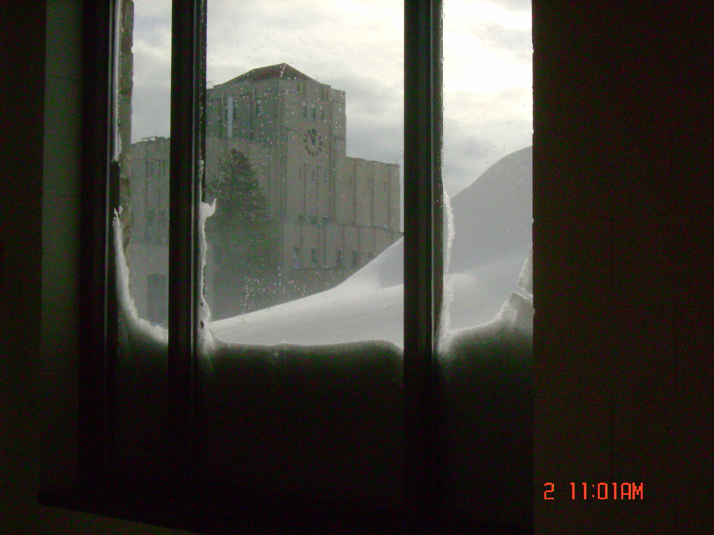
The Big Freeze:
Wisconsin Winter of 2013-2014
Carrie Lewis, Superintendent
Milwaukee Water Works

Slide 2
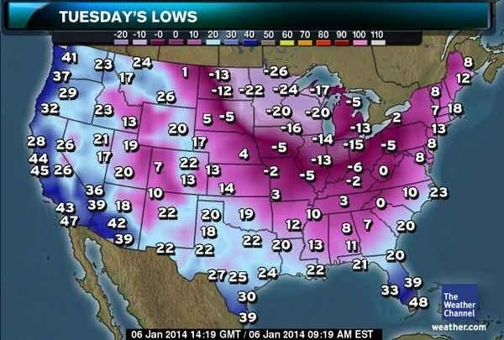
January 6, 2014

Slide 3
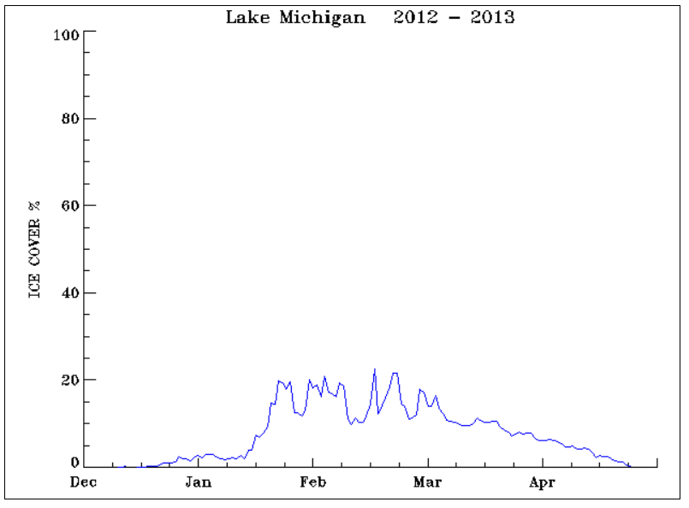
Lake Michigan
Percent Ice Cover
2012-2013

Slide 4
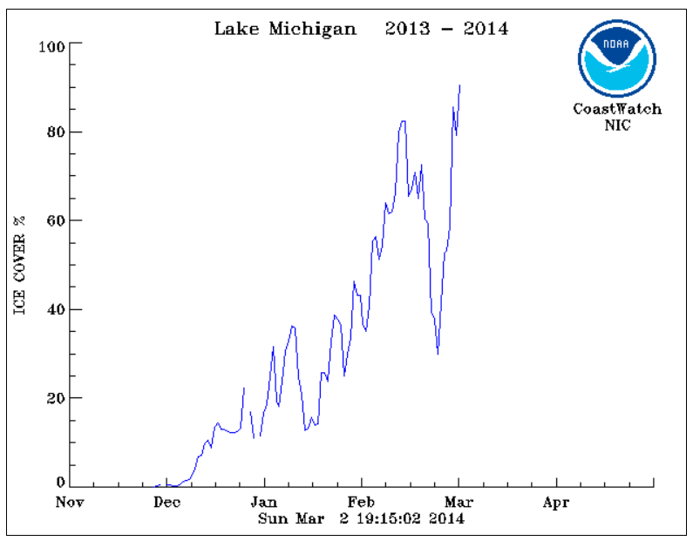
Lake Michigan: Percent Ice Cover 2013-2014

Slide 5
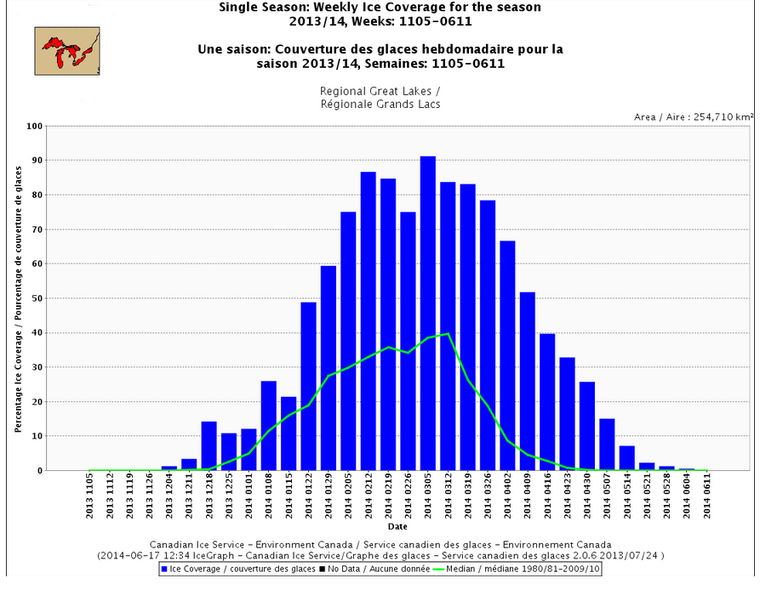

Slide 6
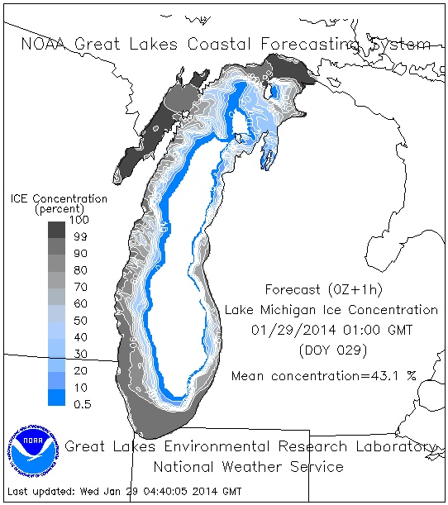
Ice Cover
1/29/14

Slide 7
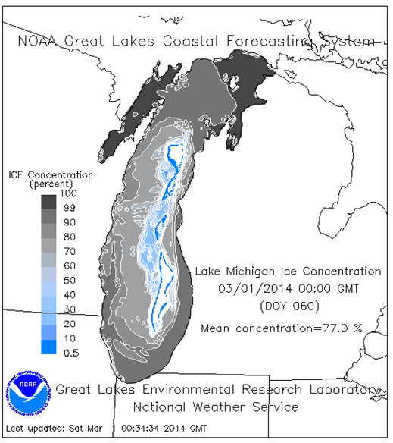
Ice
Cover
3/1/14

Slide 8
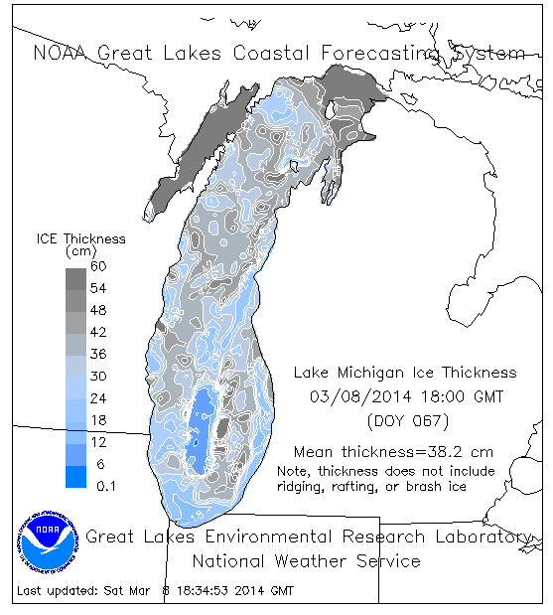
Ice
Thickness
3/8/14

Slide 9
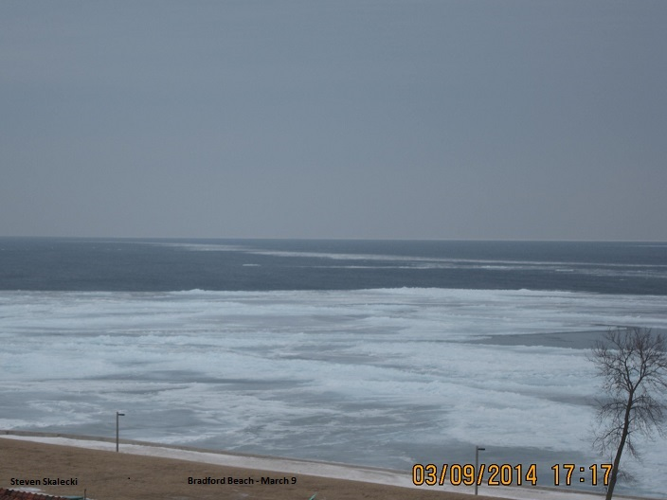

Slide 10
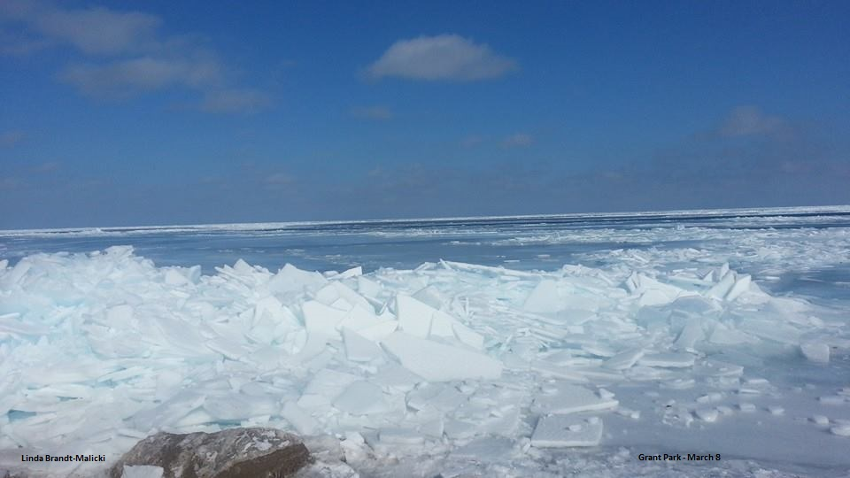

Slide 11
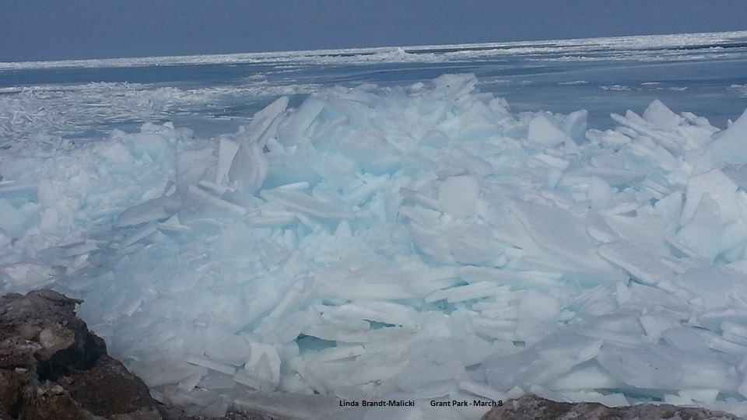

Slide 12
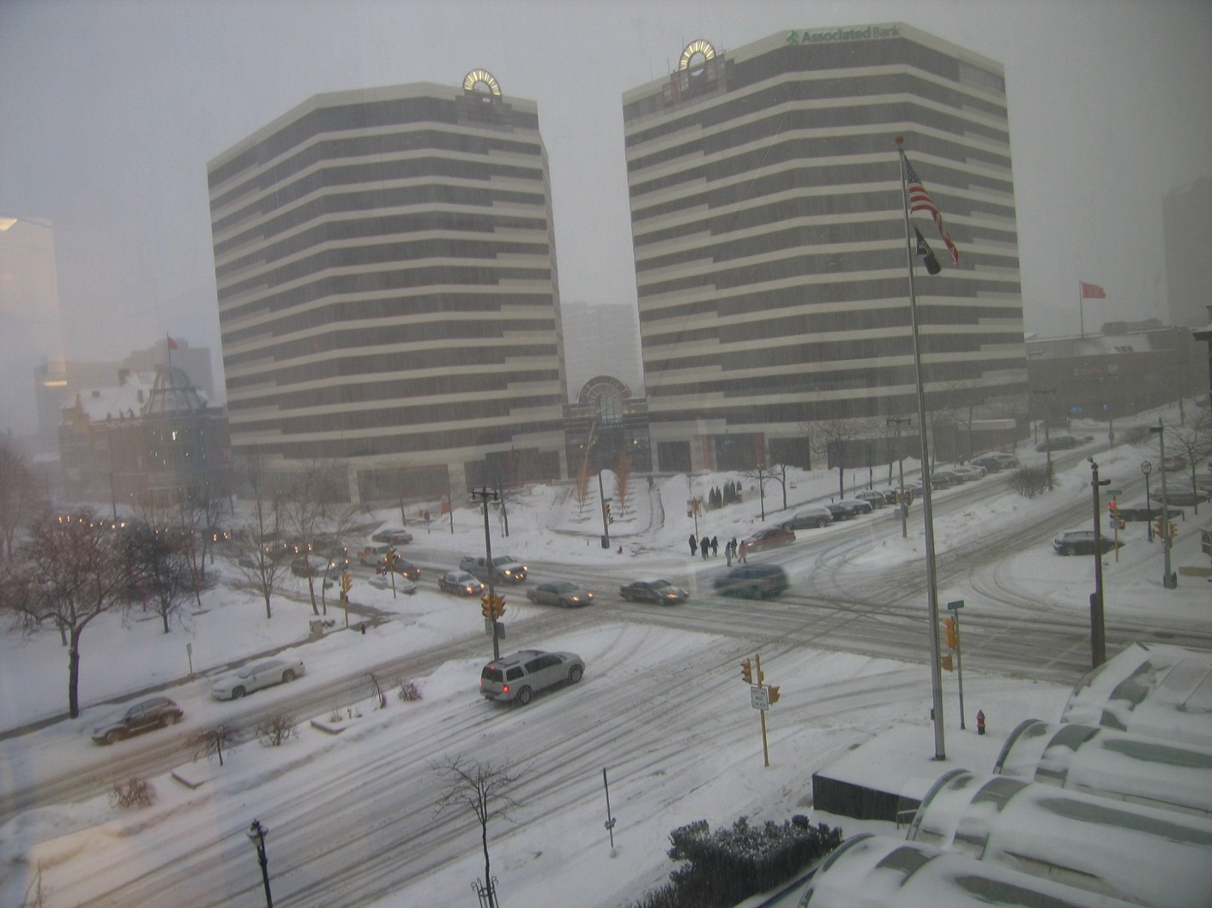

Slide 13
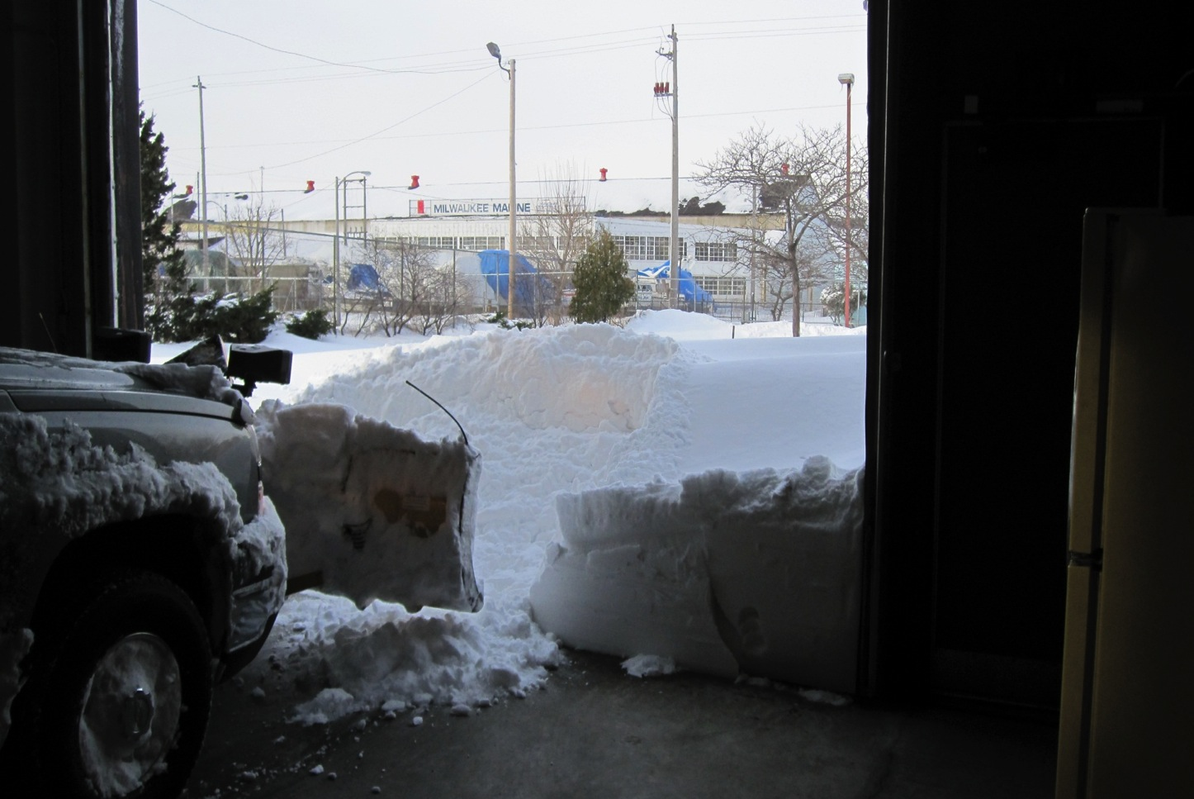

Slide 14
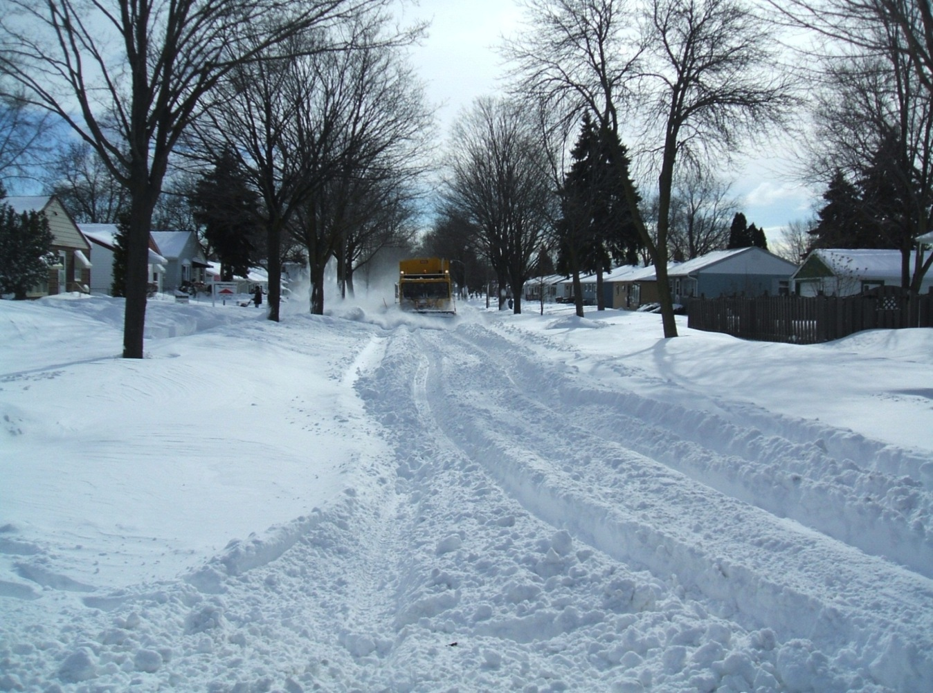

Slide 15
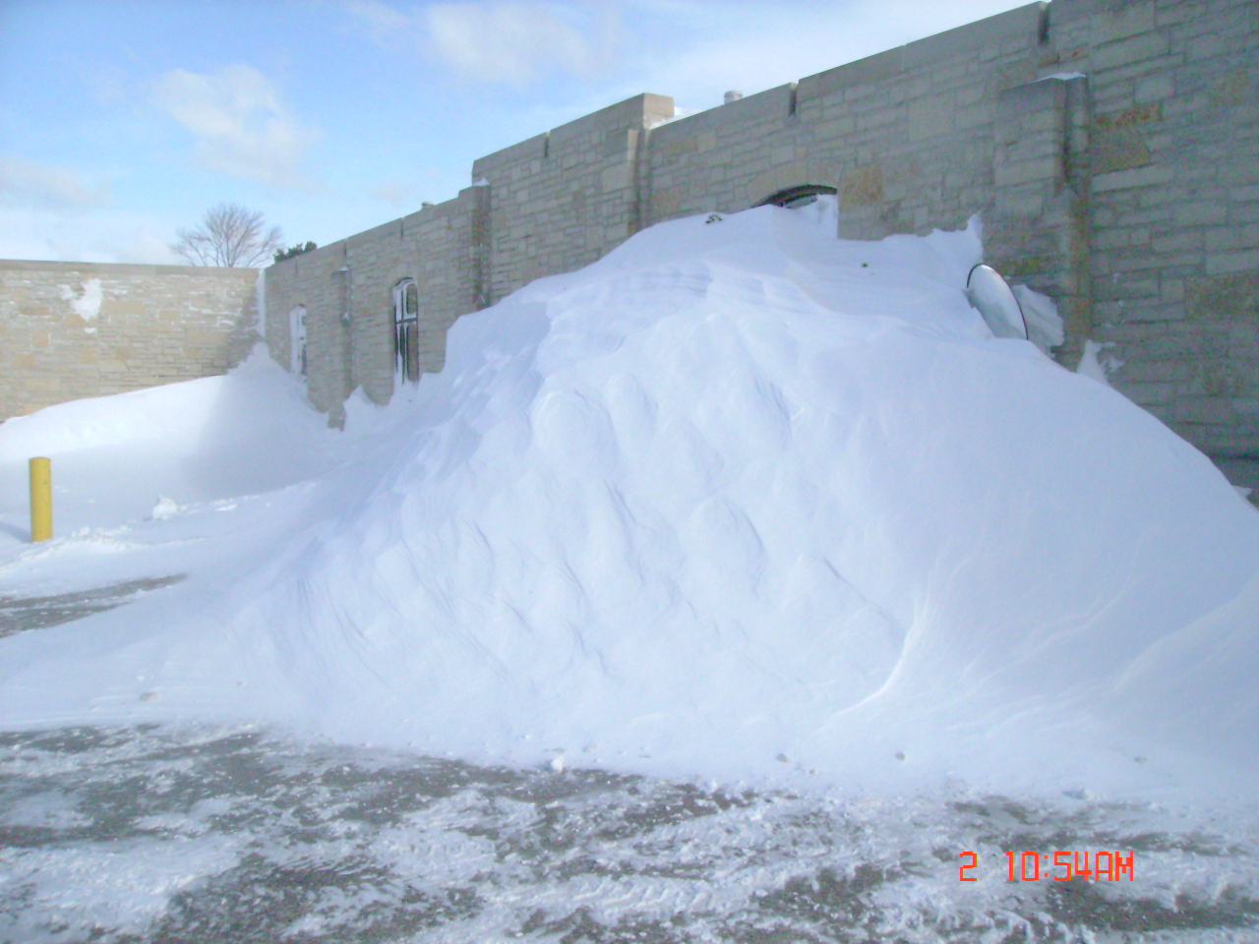

Slide 16
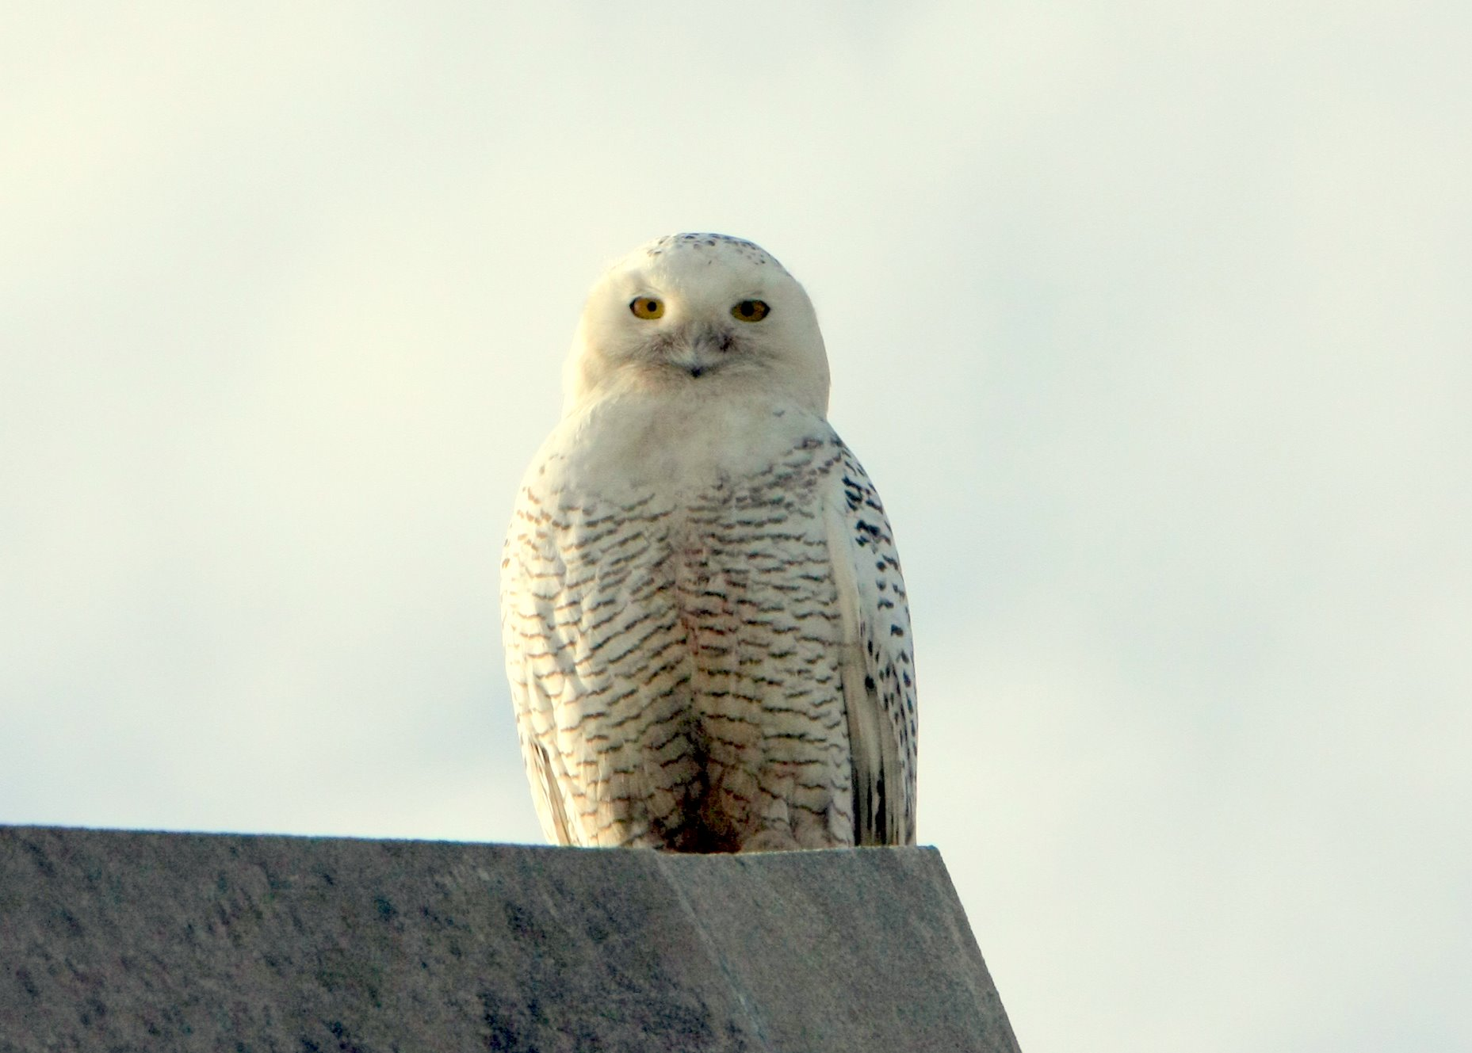

Slide 17
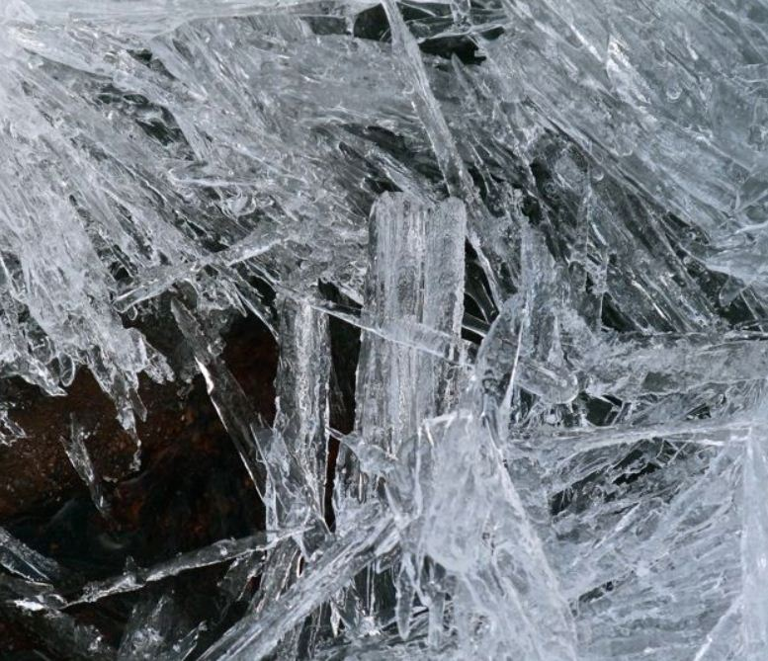
Frazil Ice

Slide 18
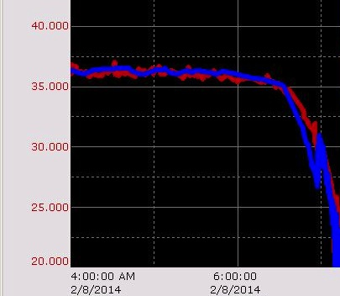
Significantly Reduced Pumpage
Increased discharge pressure from raw water pumps

Slide 19
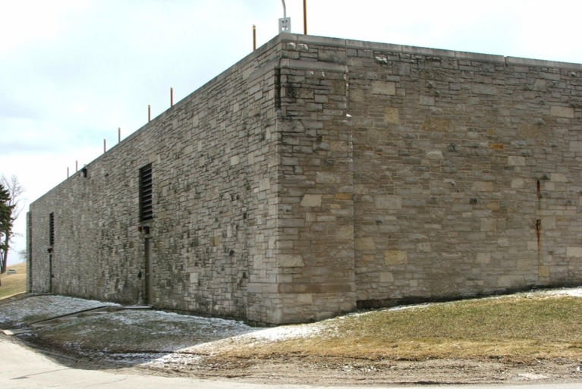
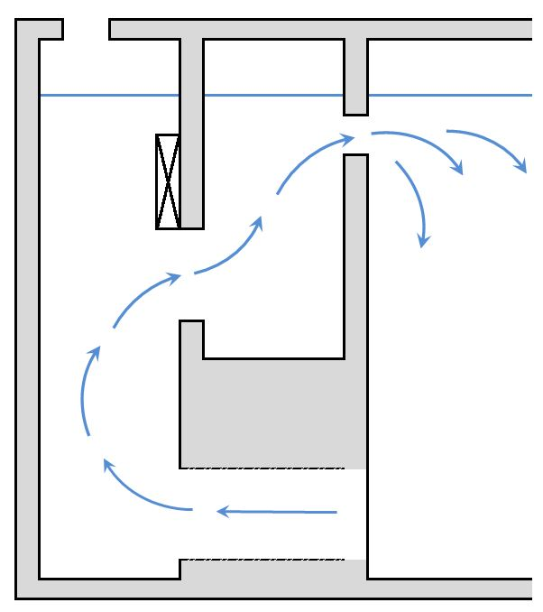
Frazil Ice on the Water Surface

Slide 20
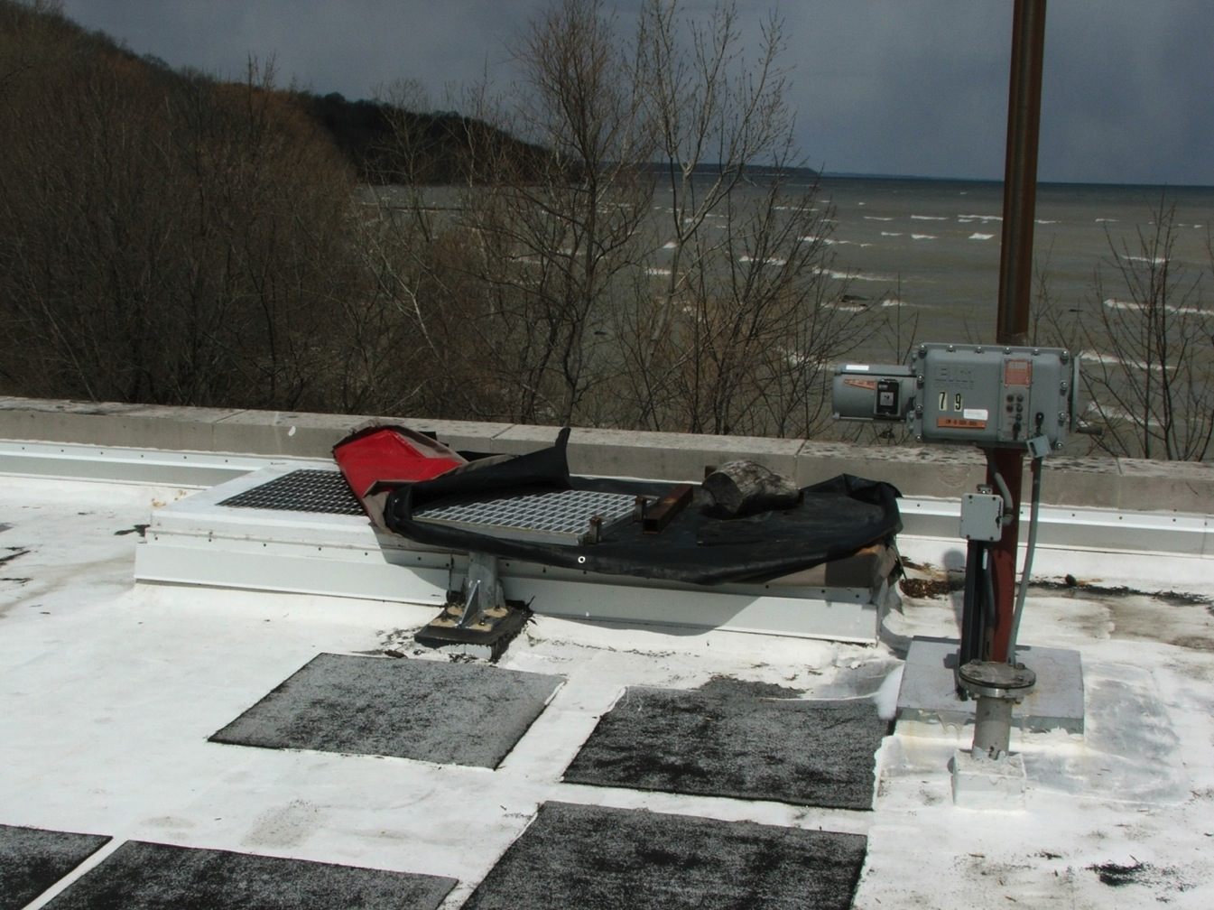

Slide 21
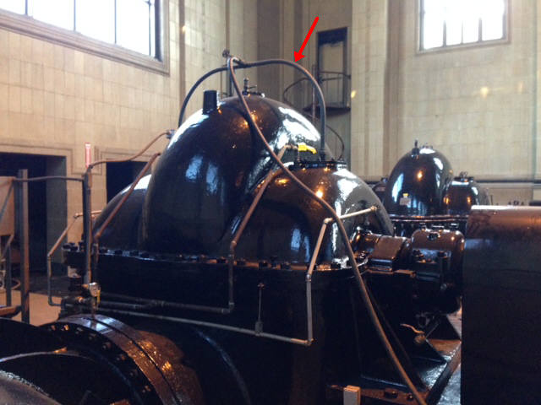

Slide 22
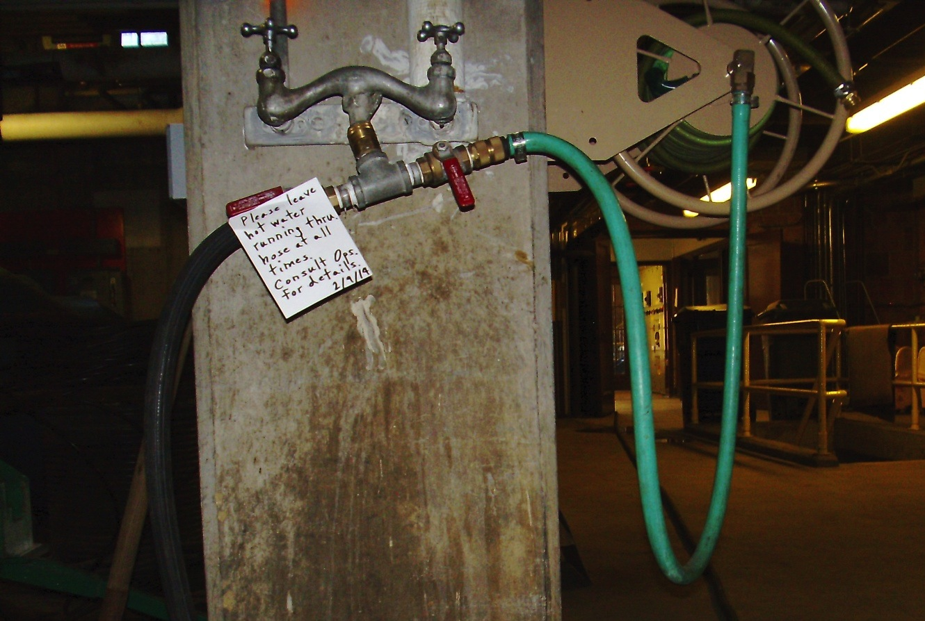

Slide 23
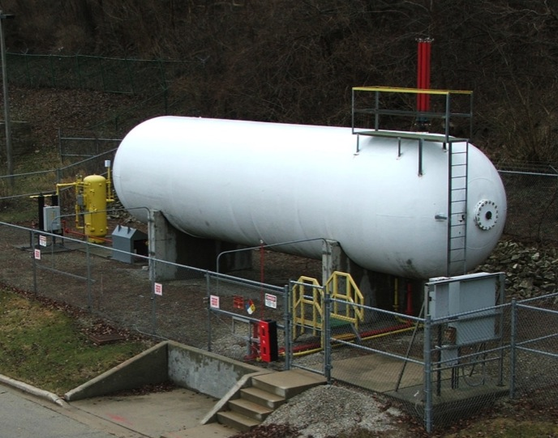
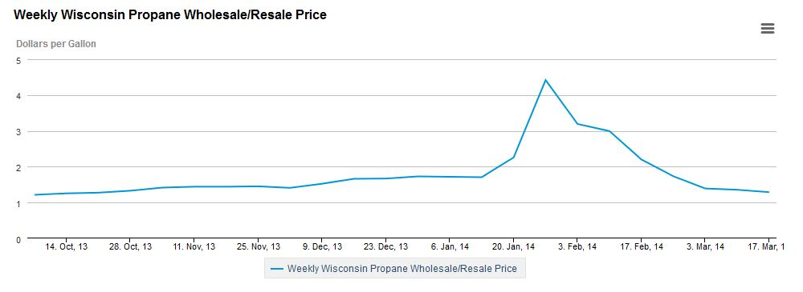
Propane Backup to Natural Gas
Savings of about $100,000 per year.

Slide 24
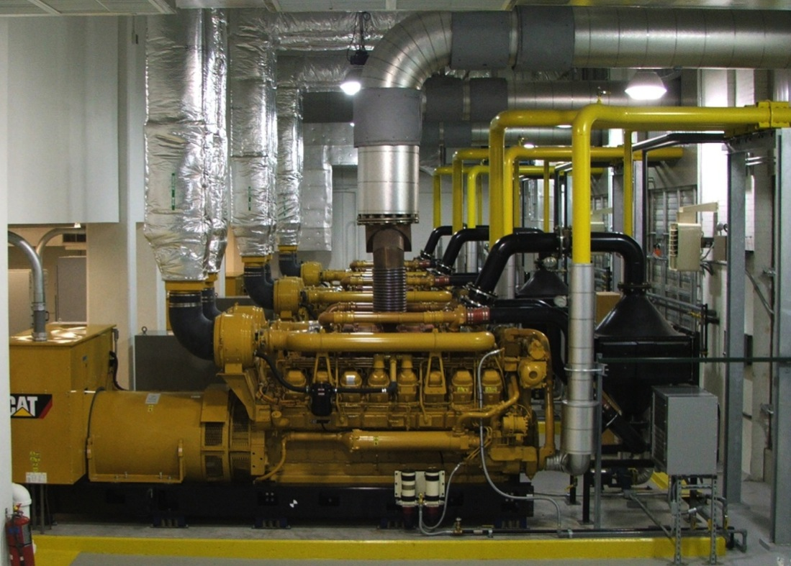
Back-Up Power

Slide 25
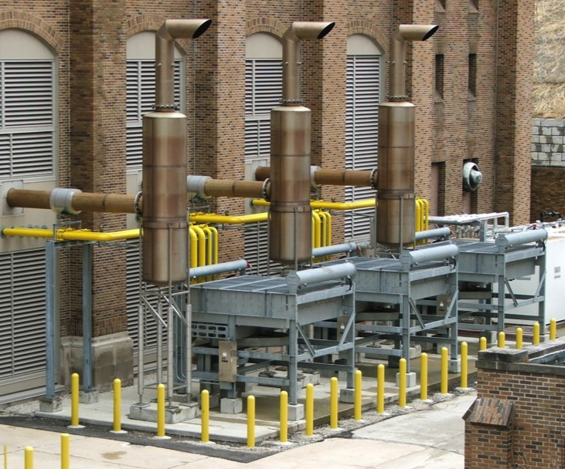

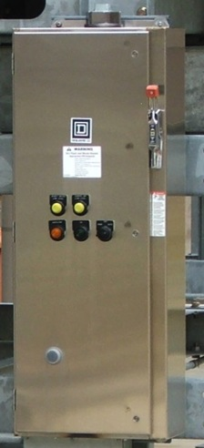
Tested During Cold Weather
All three engines started
Two radiator fans did not
X
Starting device had seized up in the cold weather
SOLUTION: Install a small heater.

Slide 26
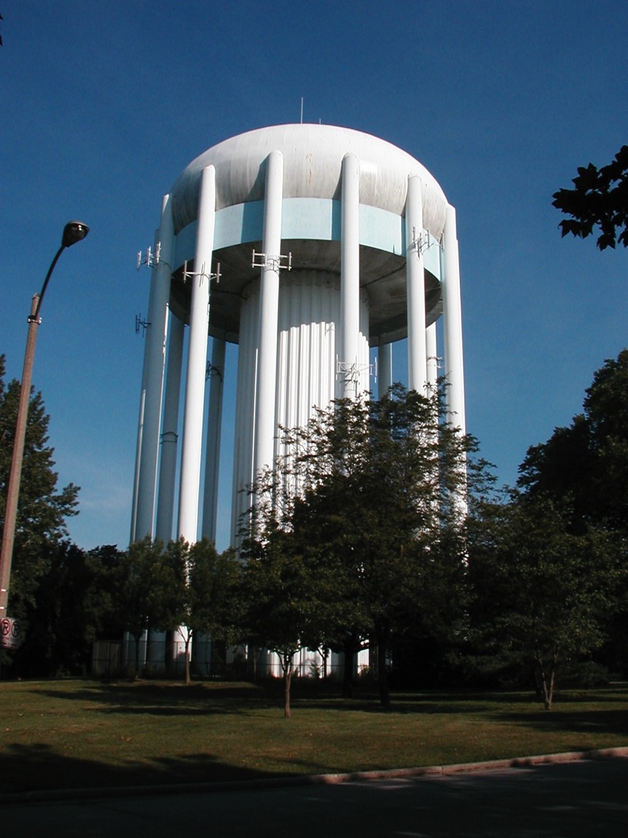

Slide 27
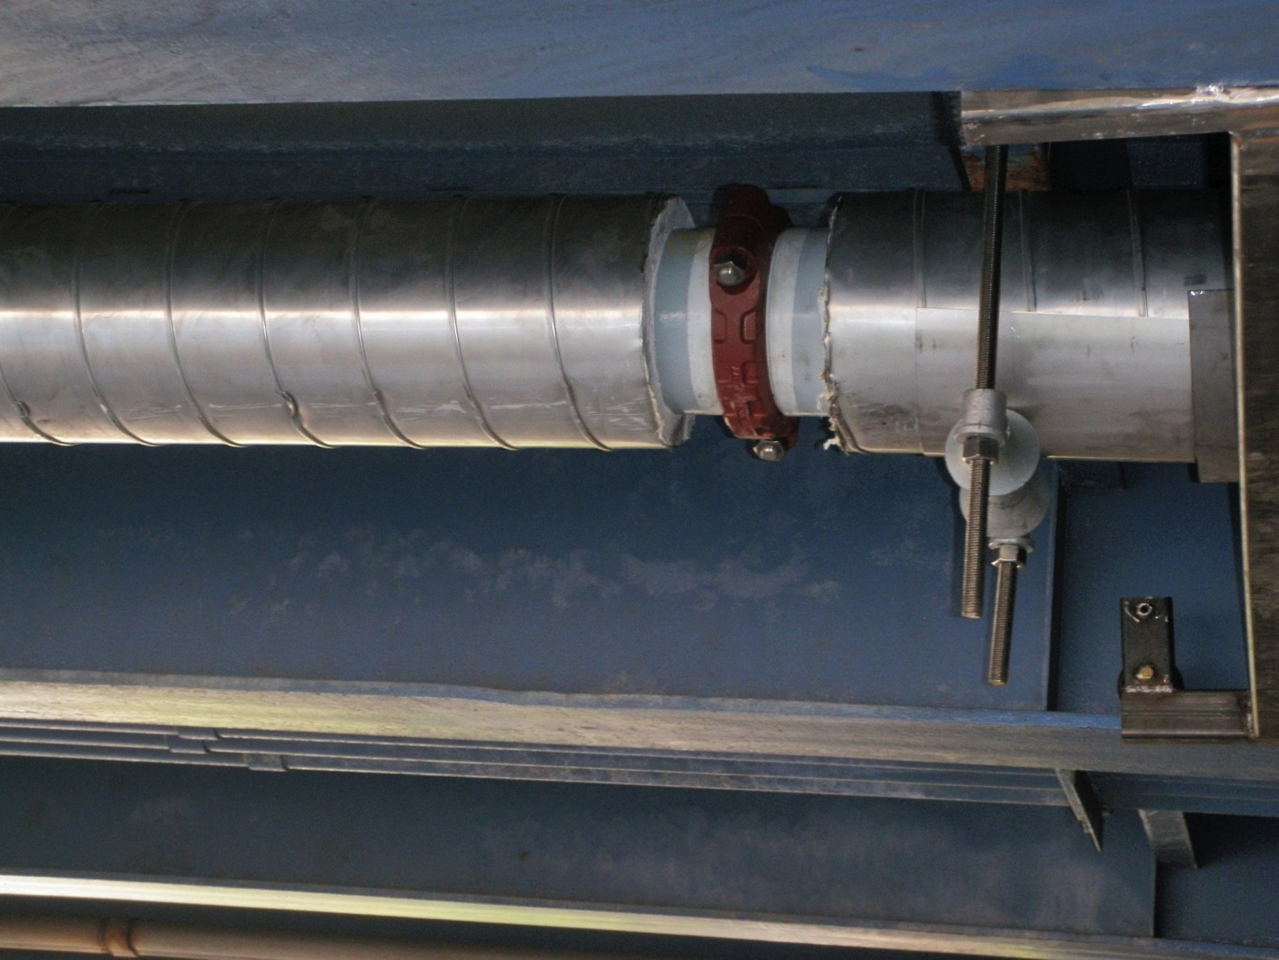

Slide 28
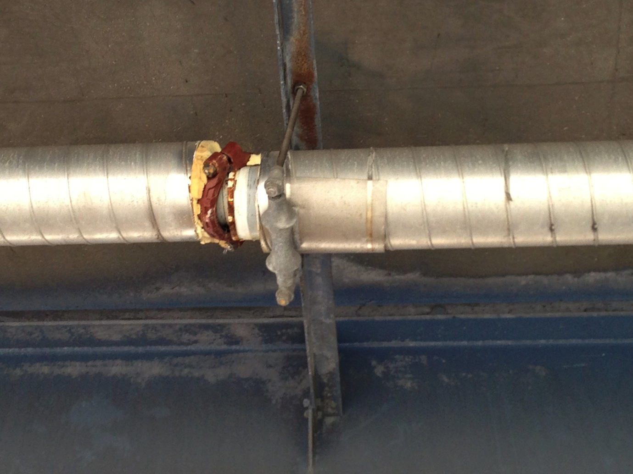

Slide 29
Distribution System
 | Dec. 1, 2012 to Mar. 31, 2013 | Dec. 1, 2013 to Mar. 31, 2014
Investigations | 3,171 | 4,091
Main Breaks | 345 | 644
Frozen Services | 0 | 154
Burst Meters | 126 | 509
Excavations | 801 | 1,093

Slide 30
Water Main Breaks
Through Sept. 30th of Each Year

Slide 31
Hours Worked by Field Personnel

Slide 32
Assistance from Contractors
 | 2013 (full year) | 2014 (to 9/30)
Water main breaks repaired by contractors | 88 repairs | 249 repairs
 | $ 1 million | $ 2.8 million
Thawing of frozen services | $ 0 | $ 400,000
Street restoration | $1.2 million | $2.2 million

Slide 33
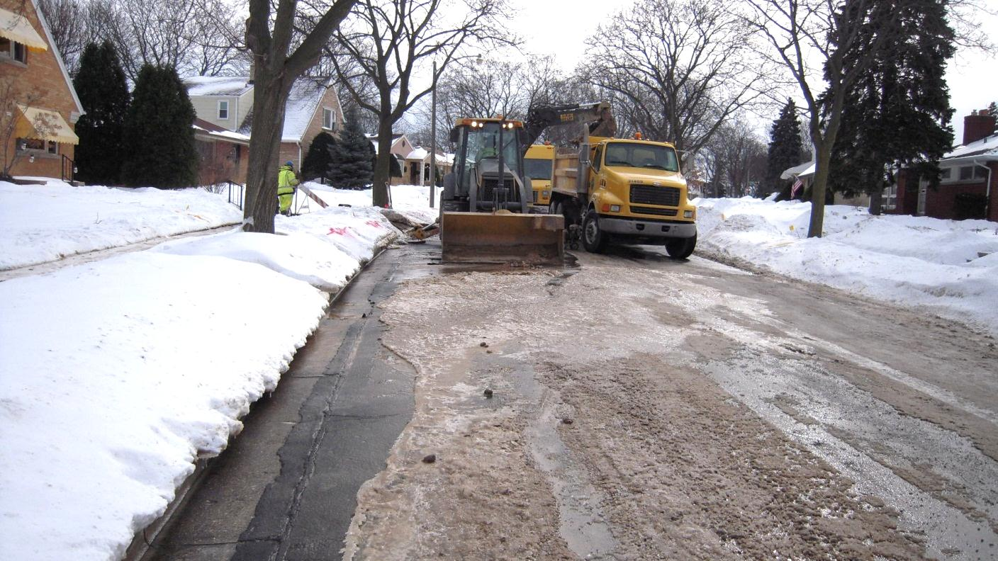
1 Billion Gallons of Water Leaked

Slide 34
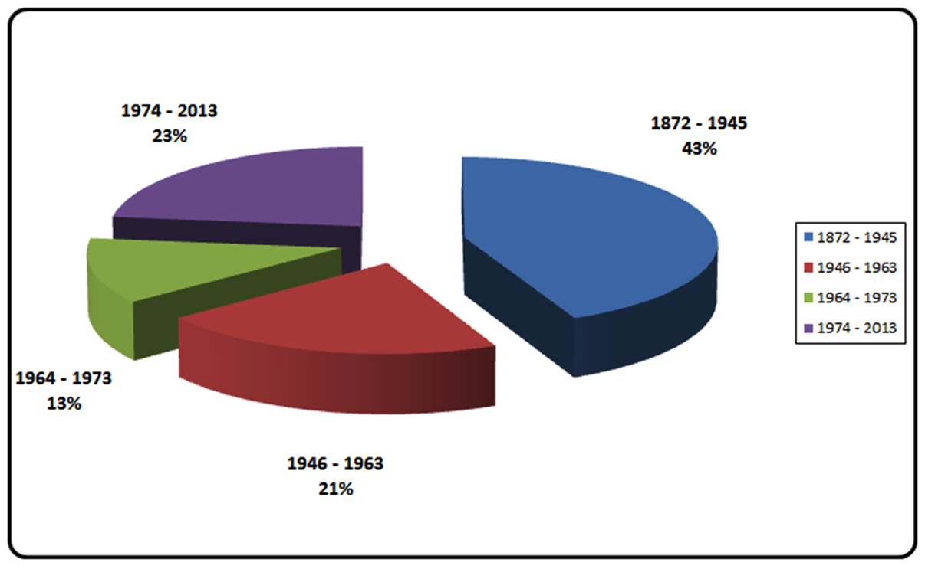
Miles of Mains – By Year Constructed

Slide 35
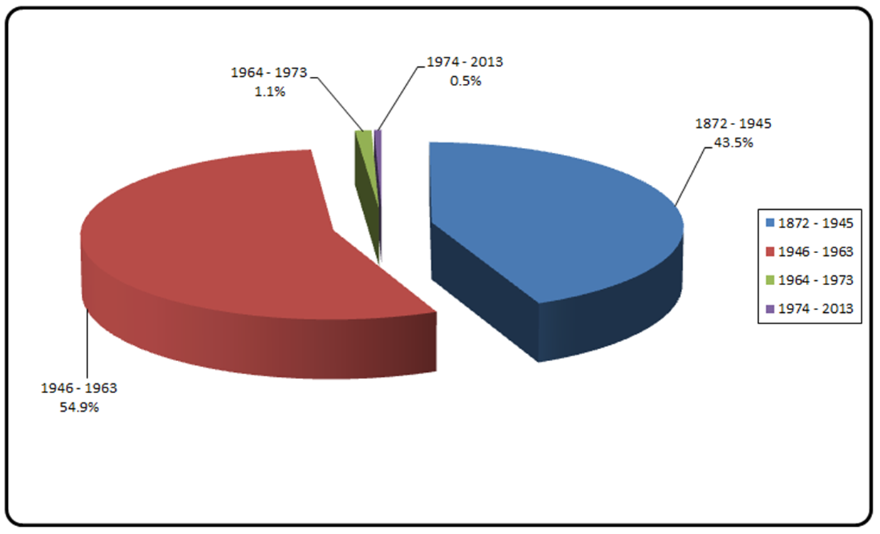
Main Breaks, All Years

Slide 36
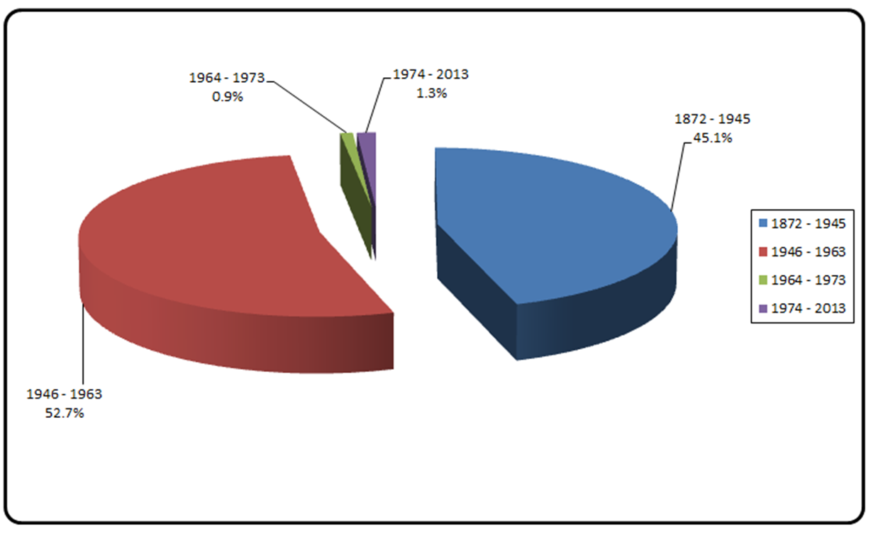
Main Breaks in Jan & Feb 2014

Slide 37
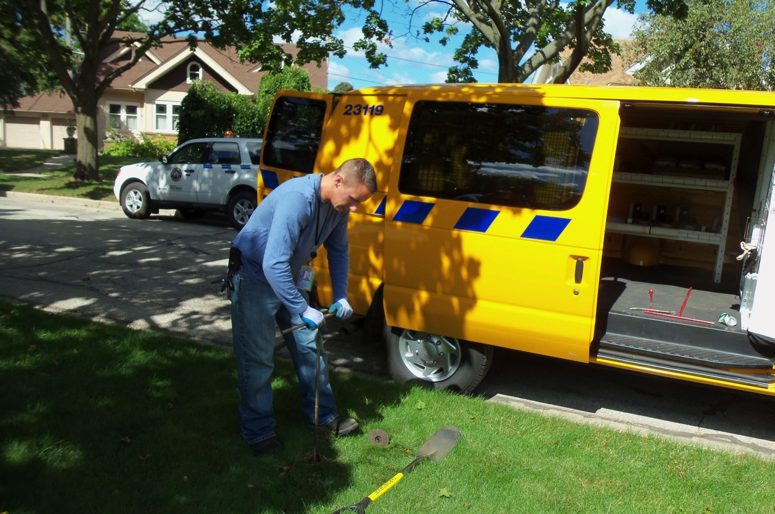

Slide 38
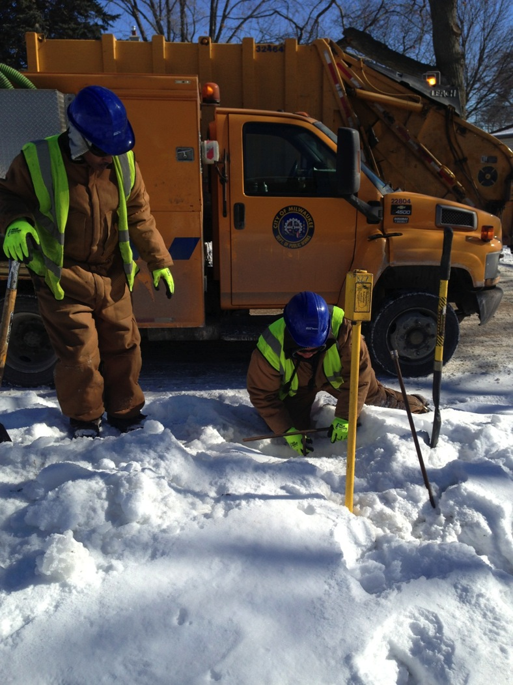

Slide 39
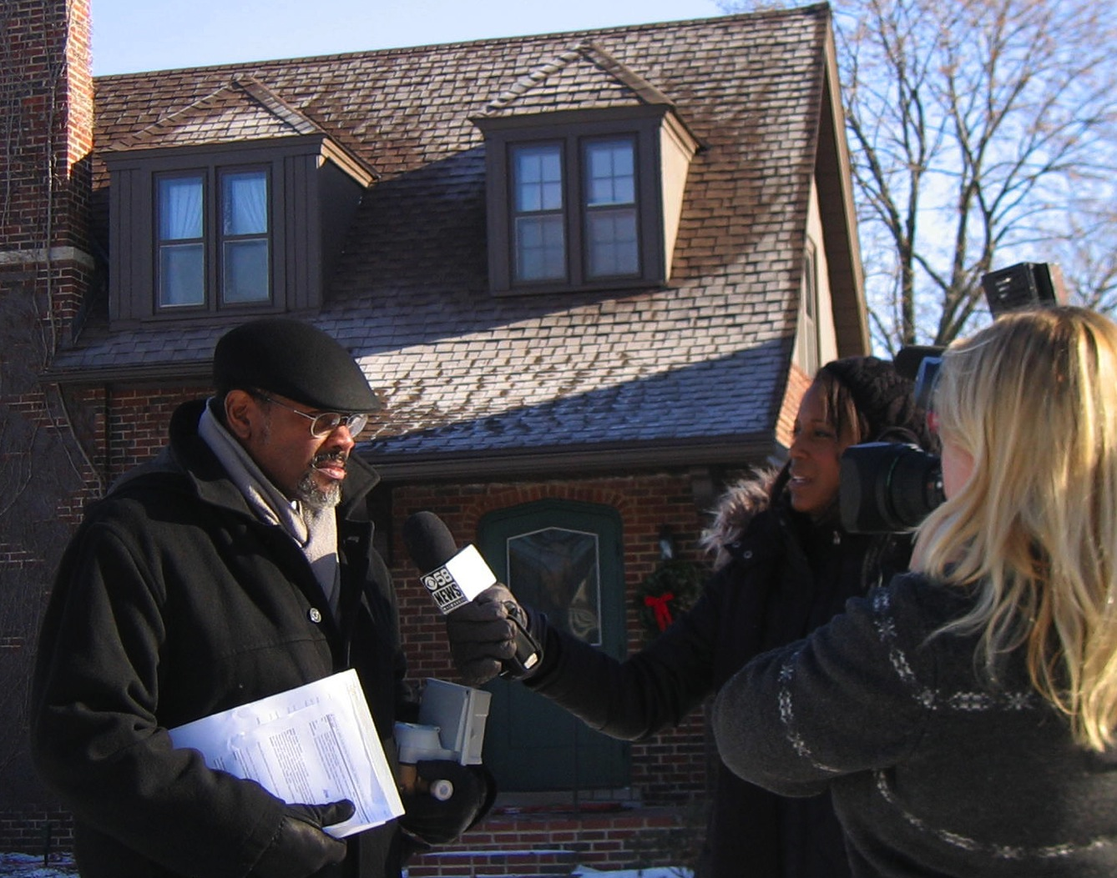

Slide 40
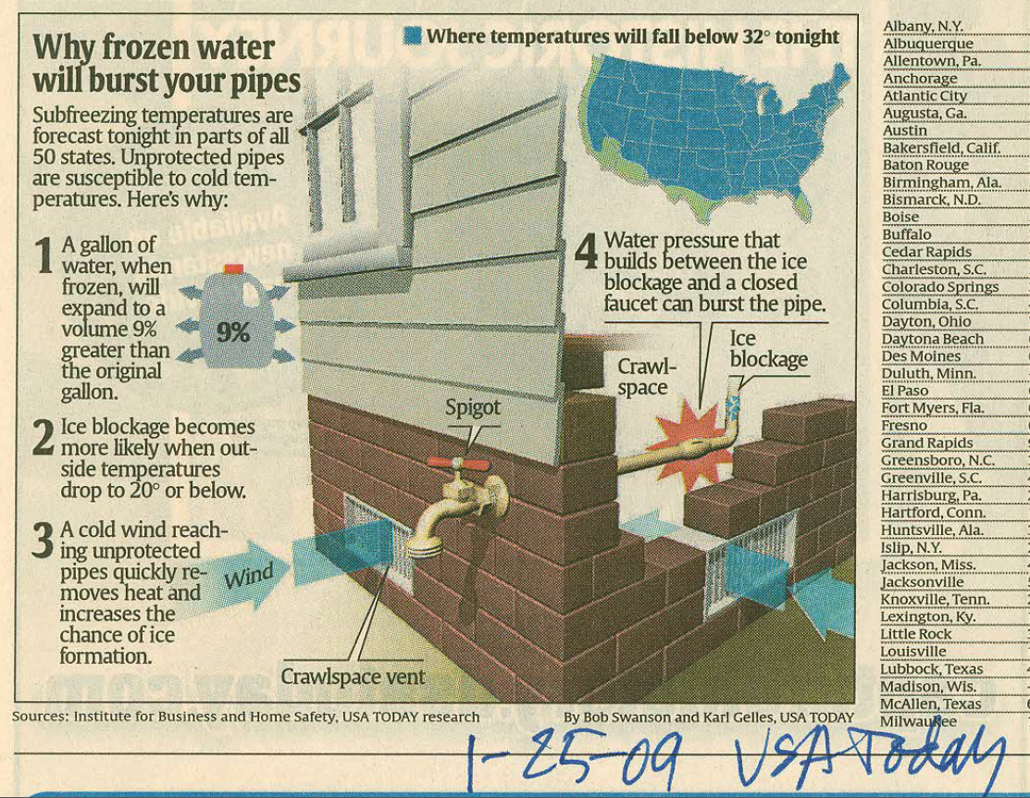

Slide 41

Who thaws services?
Customer if
  Lateral is non-conductive
  Customer did not properly protect
  Customer did not follow utility advice
Utility if
  Lateral is conductive
  First thaw of season
  Utility did not provide seasonal notice

Slide 42
2014 PSC Decision
Preceding only applies to CUSTOMER portion of lateral
  Freeze-up of utility portion indicates poor design or construction
Utility can only request, not require, customer to run water to protect utility-owned property from damage

Slide 43
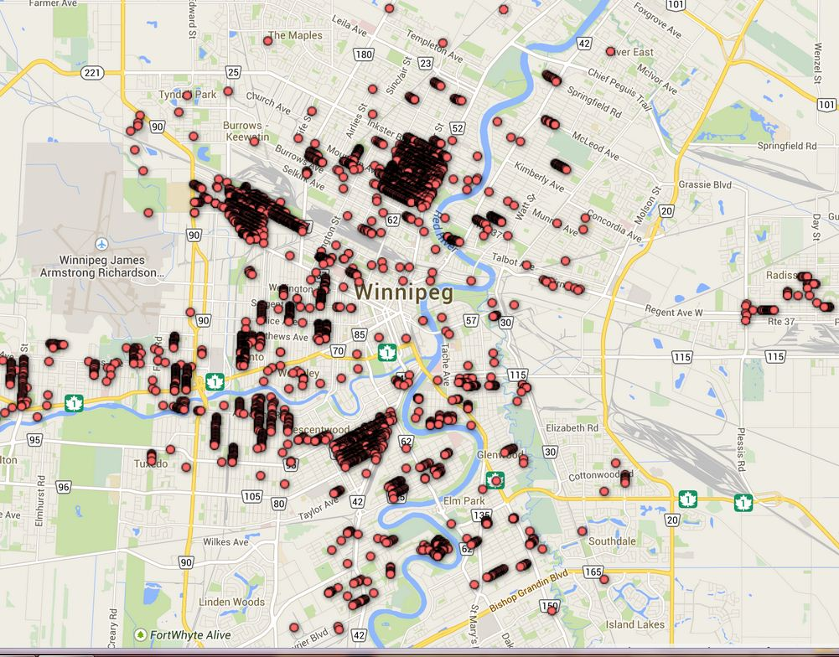

Slide 44
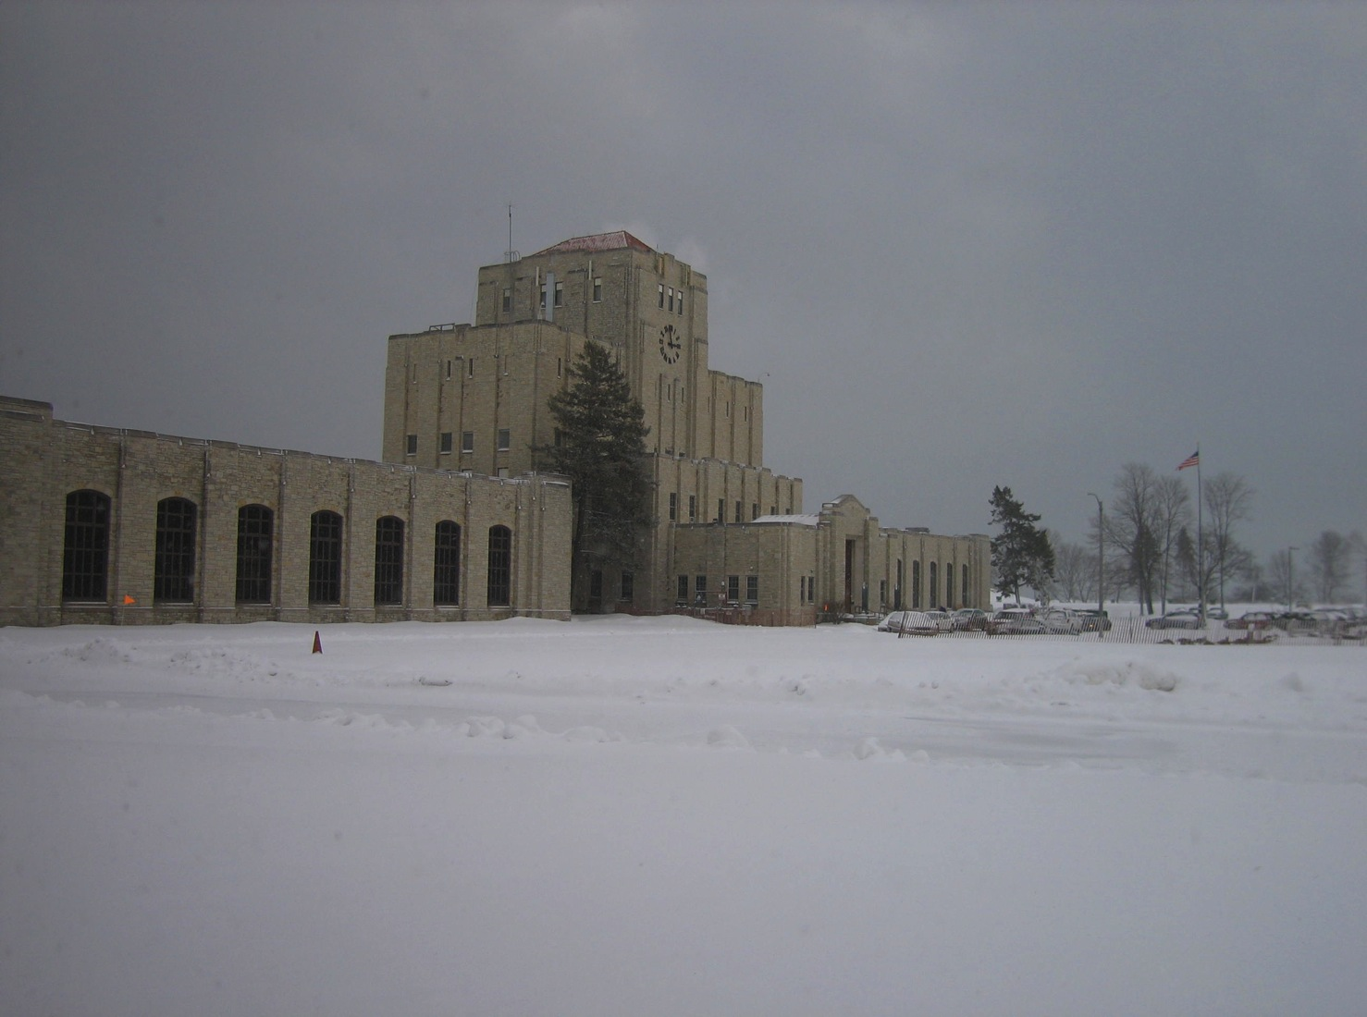
Lessons Re-Learned
Do it right the first time
Cross-train
Preserve expertise
Test equipment under all conditions
Know interdependencies
Have backups to backups

Slide 45
