Slide 1
2017 North Bay Fires; Response and Recovery Lessons Learned
AMWA, October 2018
Bennett Horenstein

Slide 2
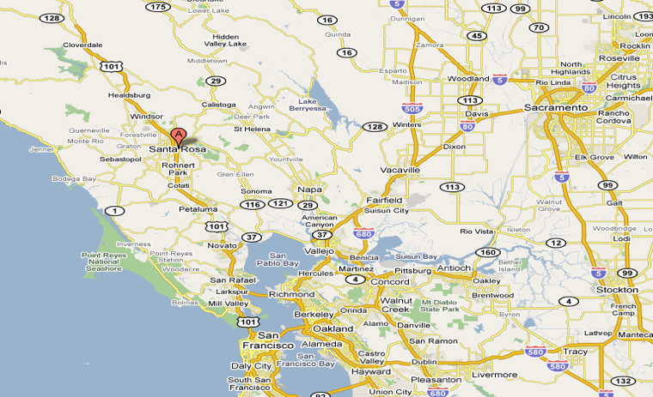
About Santa Rosa Water
Provide water and sewer services to 175k customers in Santa Rosa
Provide regional wastewater treatment for 213,000 (7 cities and county served)
Stormwater and flood control services
250 highly trained and skilled staff
Annual operating budget—$150 million

Slide 3
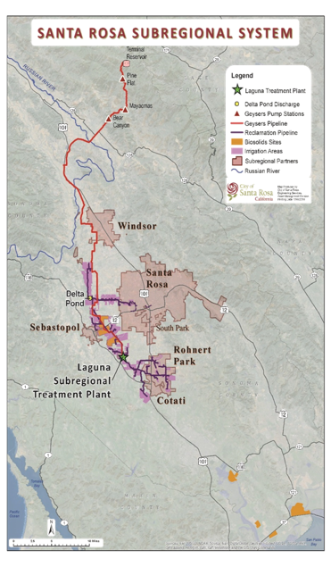
Regional Water Reuse
System
Regional WWTP averages recycle 98% of effluent
  2/3 delivered to Calpine geysers project
  1/3 of recycled water irrigates 6,200 acres of farmlands, vineyards, golf courses and urban landscaping
  Infrequent discharges to Russian River system under a nutrient no net-loading permit requirement
Notes:
Recognize value of recycled water as a supply

Slide 4
Presentation Overview
The Fires
The Response
The Recovery
  The Water Contamination event

Slide 5
First and Foremost
This was a tragic devastating event
Hit the Santa Rosa community in a very personal way, including many/most City employees
22 residents died as a result of this event
3500 homes were destroyed
Countless heroes and heroic efforts from the staff of Santa Rosa

Slide 6
The Fires

Slide 7
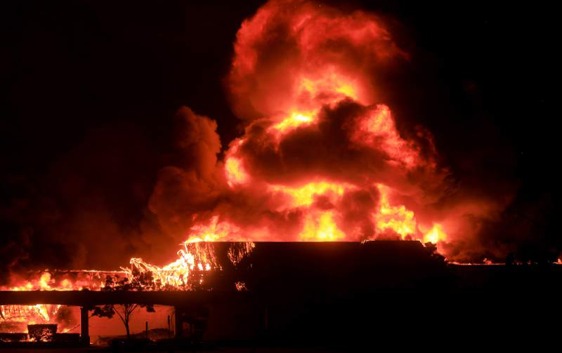
Kmart complex

Slide 8
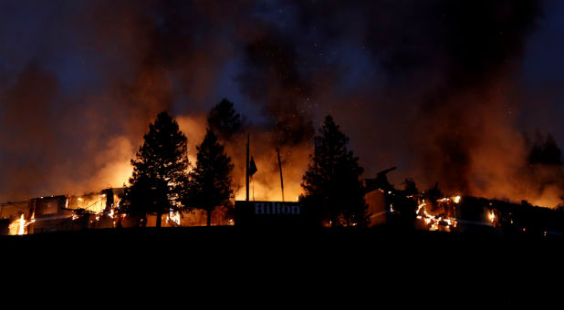
Hilton Hotel

Slide 9
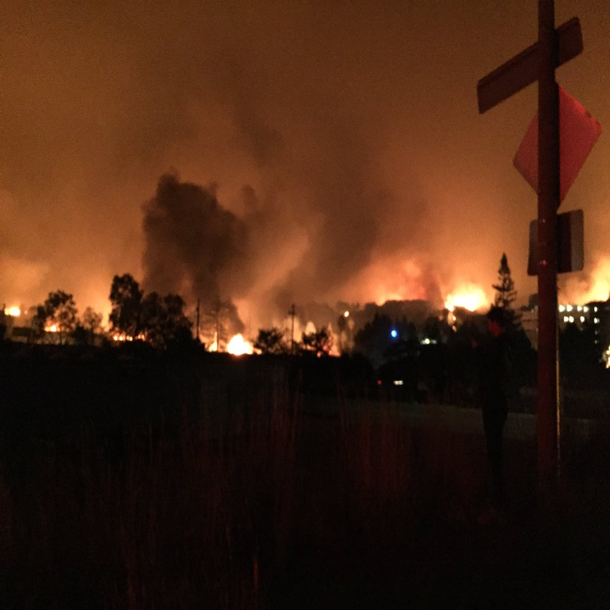

Slide 10
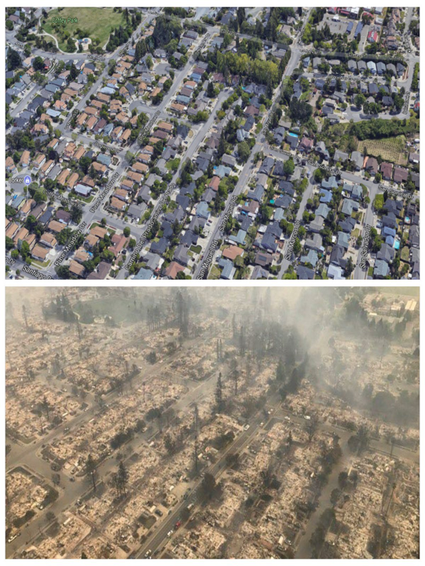

Slide 11
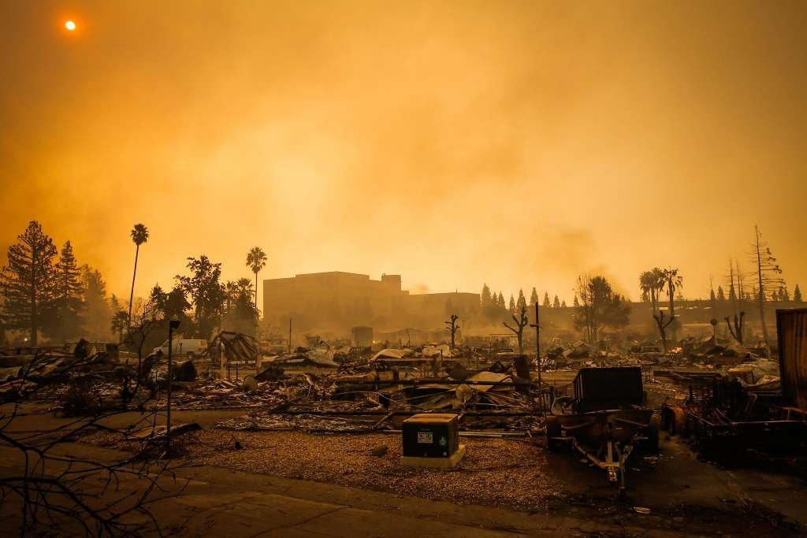

Slide 12


The Response

Slide 13
Fire Response – Key Lessons Learned
“Who’s in Charge?
Plan/process for adaptively manage your response plan
Tactics vs. Strategy
FEMA processes/contacts
Fatigue
Mutual Aid

Slide 14
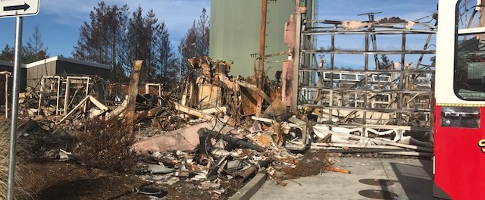
The Damage

Slide 15
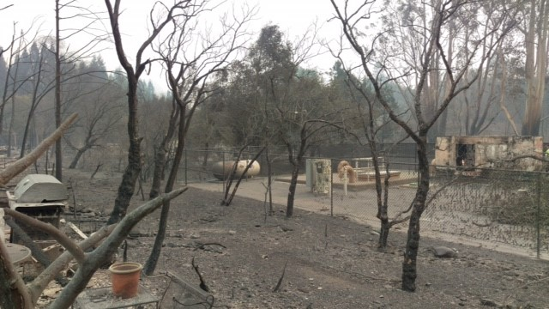
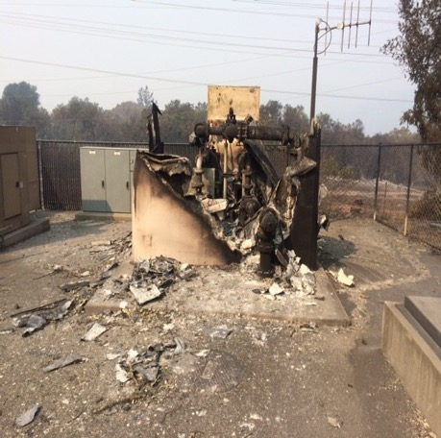
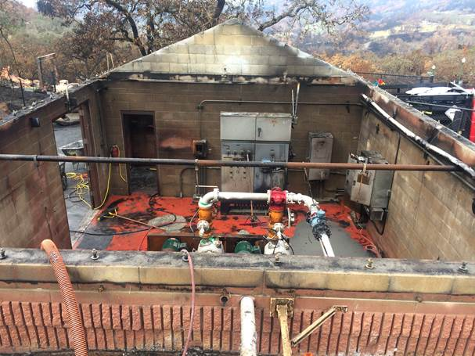

Slide 16
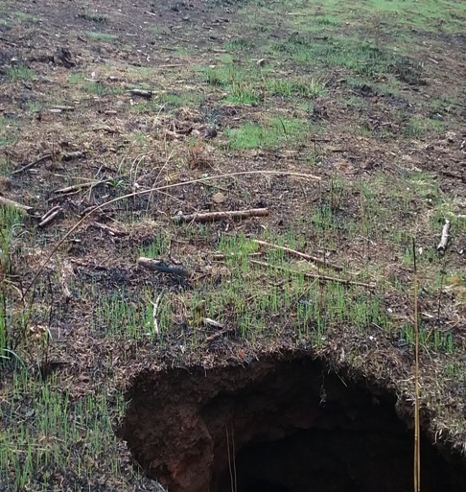
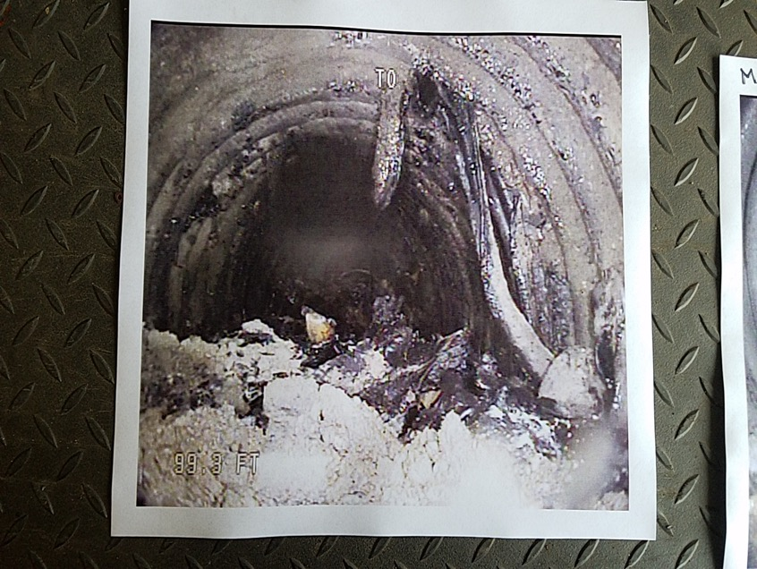
The unexpected

Slide 17
The Recovery
Debris cleanup
Rebuild damaged infrastructure
Update fiscal plan with 5-7% loss of revenue stream
Watershed post-fire concerns
Residual issues with fire-related contamination in water system

Slide 18
Santa Rosa Fire and WQ Contamination
Began with a single taste and odor complaint
Analysis found benzene concentrations as high as 900 ppb
  Federal MCL 5 ppb
  CA MCL 1 ppb
Also found many other toxic organics, all others below their MCLs

Slide 19
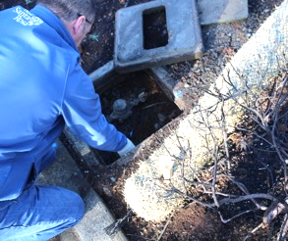
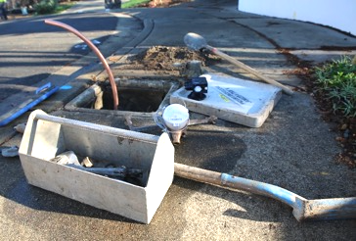
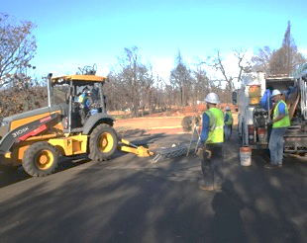
The Investigation
What are the Possible Sources?
Steps taken to Identify the Sources
What Sources can we Rule Out?
Finding on the Source of Contamination

Slide 20
Approach to the Investigation
Absolute 100% transparency with all of the data and information
The approach to the resolution will be “driven by the data”

Slide 21
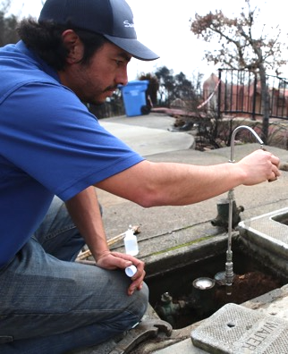
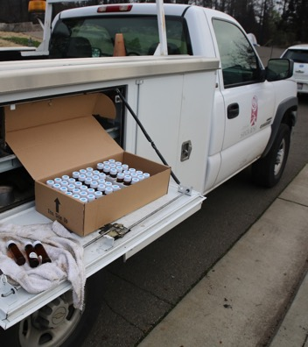
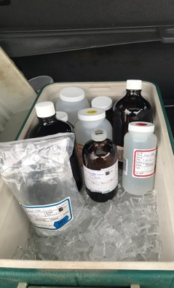
Water Samples
Notes:
Team of 20 Trained Samplers
They have taken Thousands of Water Samples
Which have been Analyzed for hundreds of Compounds
By City’s Lab and 3 Outside Labs

Slide 22
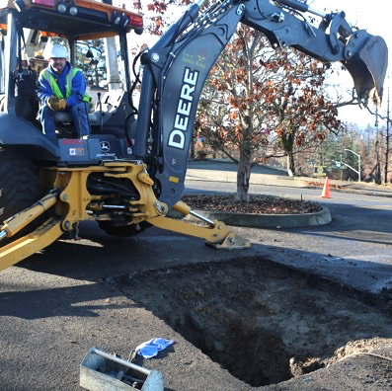
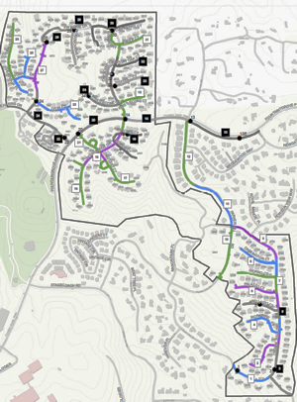
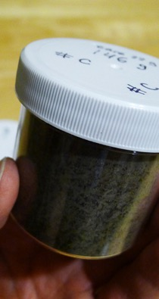
Soil Samples
Notes:
Done Extensive Soil Sampling

Slide 23
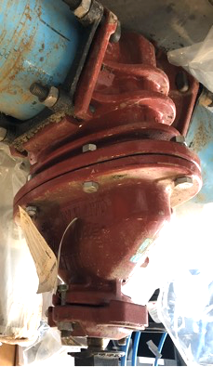
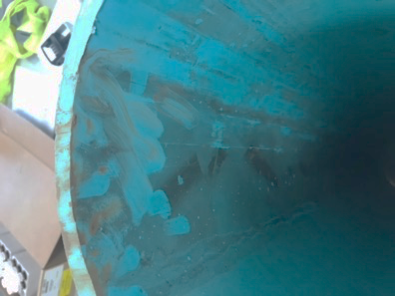
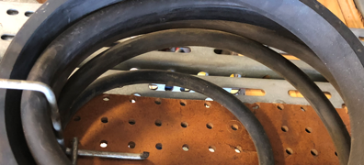
Material Samples
Notes:
Valves, Water Mains, Gaskets, Services, Meters, Every componets

Slide 24

What Happened?
Water Service
Water Main
Notes:
Maintain integrity of the water system through pressure

Slide 25
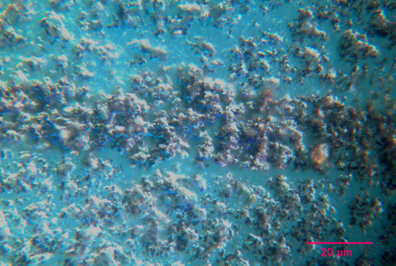
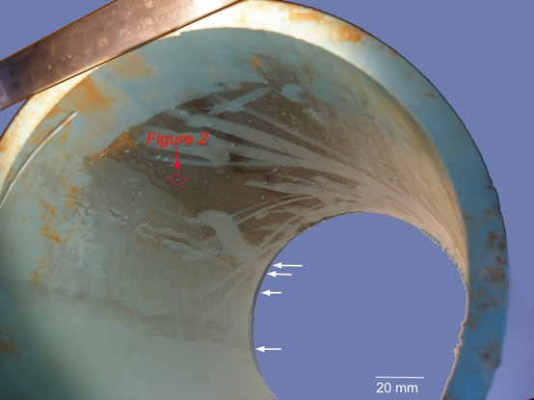
PVC water main (inner surface)

Slide 26
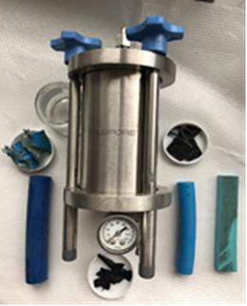
Leachability
Determination of leach potential of piping and ancillary equipment
Identification of contaminants and byproducts leached from materials

Slide 27
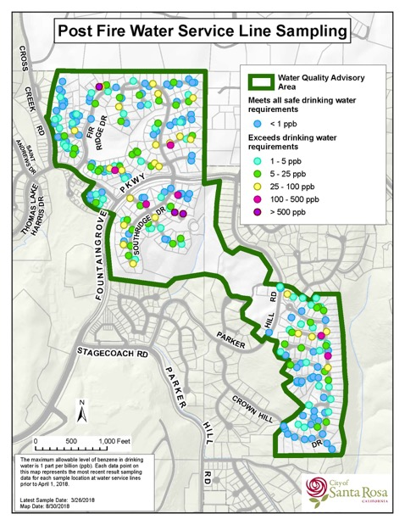
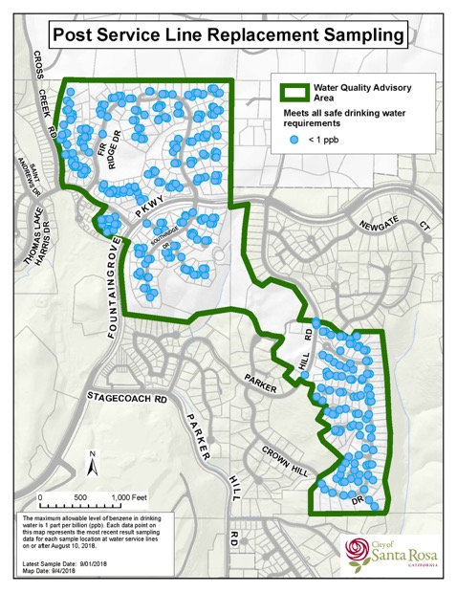
Prior to Service Line Replacement
After Service Line Replacement

Slide 28
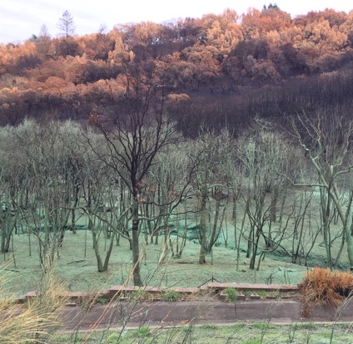
Wrap-up
Over 60 community meetings
Approximately 45 press reports
Advisory lifted October 11, 2018
Generally, the community gave the City the benefit-of-the-doubt throughout this event
The work continues:
  Ongoing coordination with FEMA
  Watershed vigilance during wet weather season

