Slide 1

INSIGHT SURVEY DISCUSSION
Peiffer Brandt, Raftelis
Rocky Craley, Raftelis
Notes:
Peiffer Kicks off

Slide 2

Insight Survey
Most comprehensive industry survey
Access to INSIGHT database
Access to INSIGHT online analysis tool
Notes:
Peiffer

Slide 3
Taking the Survey
Administered using an Excel-based survey tool
Previous participants receive a survey tool with the utility’s most recent response prepopulated
162 Questions
Data sources
  CAFRs, Billing Systems, Budget, Bond Documents, CIP, Rate Ordinances, Financial Strategic Plans, and Fixed Asset Records
Notes:
Peiffer

Slide 4
Key Milestones
Start Date: Sept 12
Complete by: Nov 20
Data Available: Jan 2019
Webinar: Jan/Feb 2019
Notes:
Peiffer

Slide 5
Survey Participation
2008: 84
2010: 106
2012: 109
2014: 102
2016: 117
Goal for 2018: 120
Notes:
Peiffer
Goal was provided by Diane

Slide 6

Real Life Application
*published in Sept/Oct 2018 Issue
Notes:
Hand off to Kathryn. She debriefs a little. Rocky demos while she’s talking (related to her points).

Slide 7
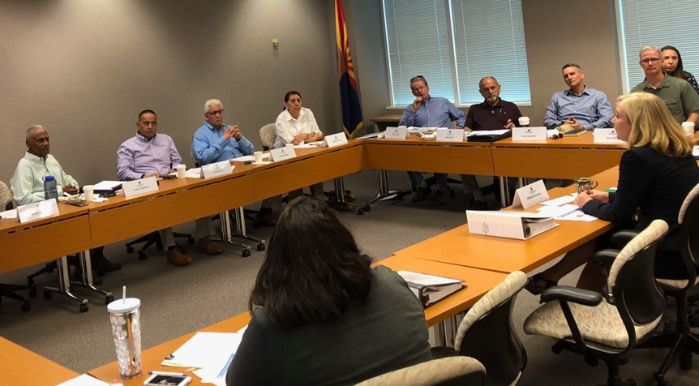
Citizens’ Water/Wastewater
Rate Advisory Committee

Slide 8
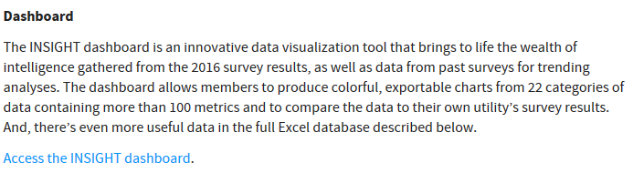
Accessing the INSIGHT Dashboard
www.amwa.net/insight

Slide 9
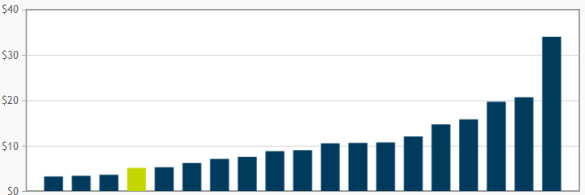
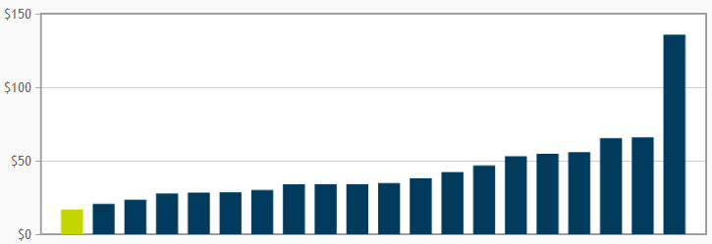
User Charges
Monthly Base Charge
5/8” Meter
Monthly Residential Bill
10 Ccf

Slide 10
Annual O&M and Capital Costs

Slide 11
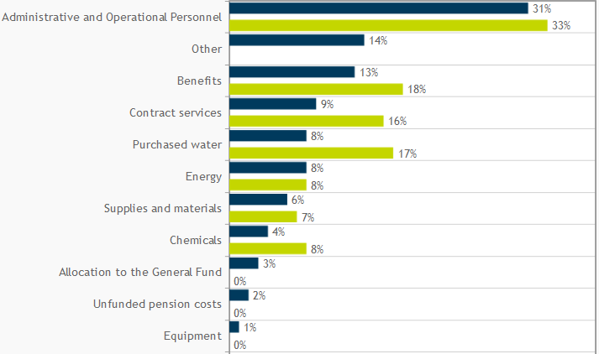
O&M Costs

Slide 12
Thank you!
Contact AMWA with questions or to request your survey form:
Carolyn Peterson
202-331-2820
peterson@amwa.net

