Slide 1





The Energy-Water Nexus:
Challenges and Opportunities
Kristen Averyt, PhD
University of Colorado Boulder
Associate Director for Science
Cooperative Institute for Research in Environmental Sciences
Western Water Assessment
October 21, 2014 AMWA Annual Executive Management Conference

Slide 2
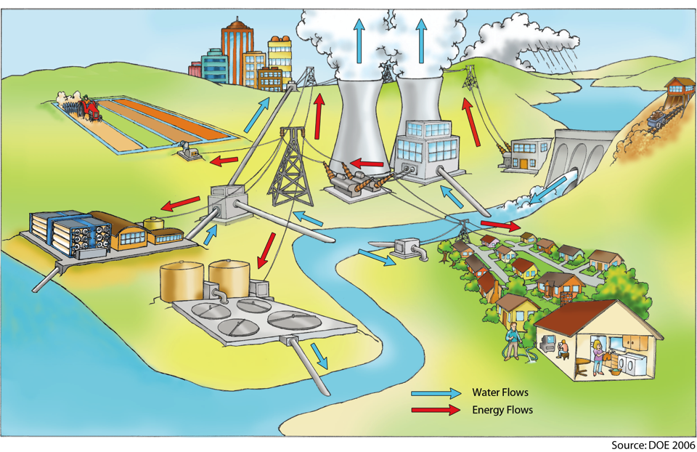
The Energy-Water Nexus
US Electricity Sector:
41% of total withdrawals
5% of total consumptive use
US Water Sector:
~13% of the US electricity supply
Southwest Electricity Sector:
~7% of total withdrawals
~2% of total consumptive use
Southwest Water Sector:
>20% of the SW electricity supply
DOE 2006
Notes:
But what I am gong to be discussing today are the connections between energy and water
-- energy resources require water, and water requires energy
-- nationally: US electricity

Slide 3
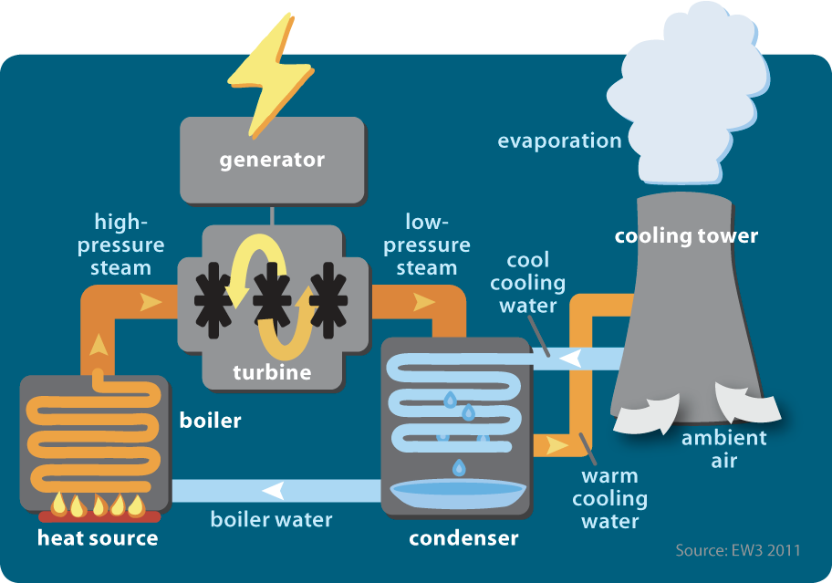
EW3, 2011

Slide 4
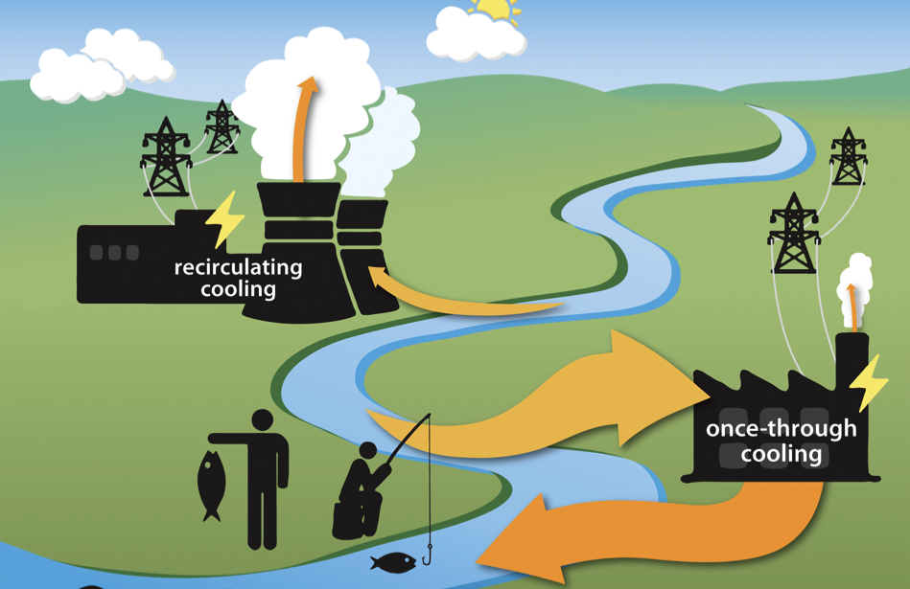
EW3, 2011

Slide 5
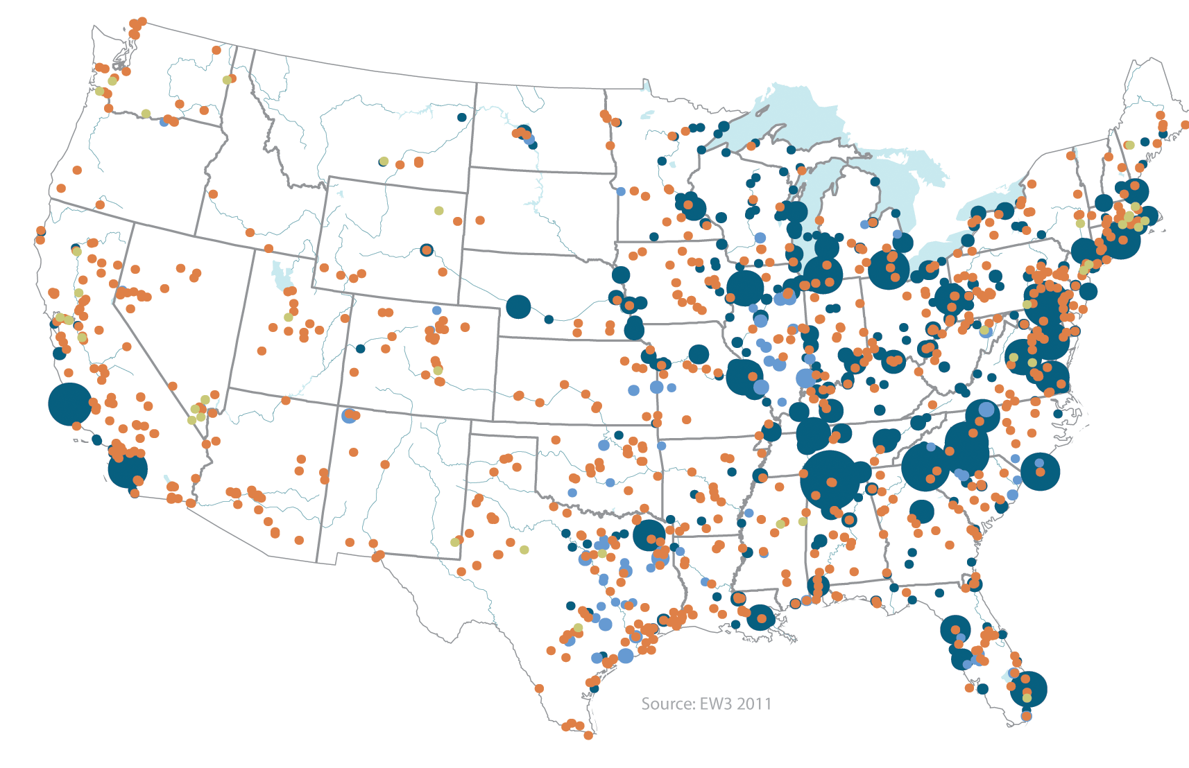
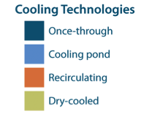
National Power Plant Water Withdrawals (2008)
Averyt et al. 2011, 2013a

Slide 6
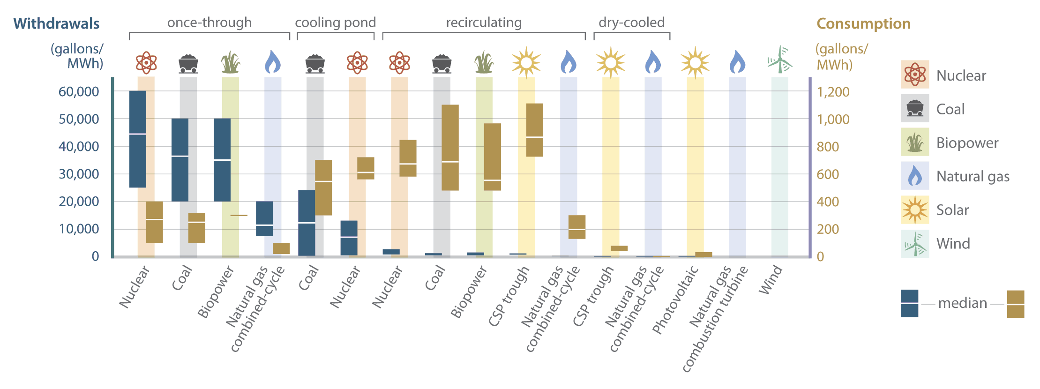
Water for Power
Averyt et al., 2011; Macknick et al. 2012; National Climate Assessment, 2014

Slide 7
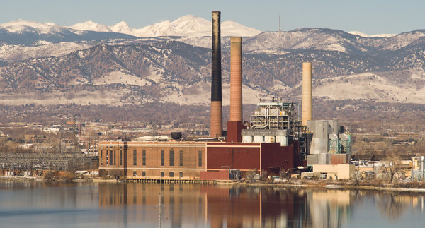
Coal Fired Power Plant

Slide 8
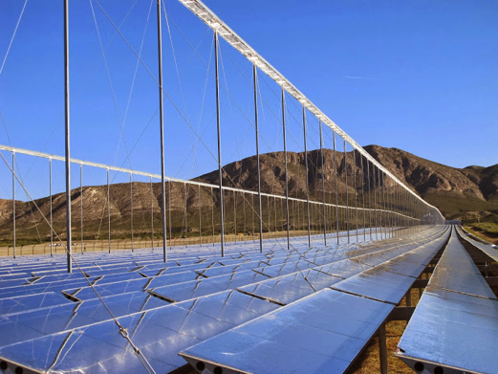
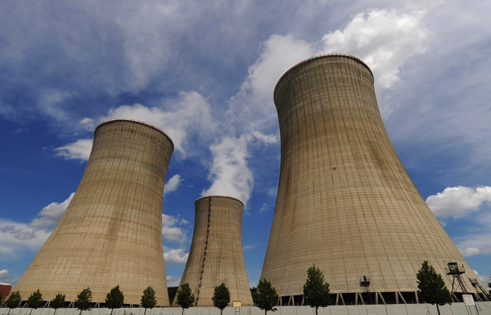
Concentrated Solar Power
Nuclear

Slide 9
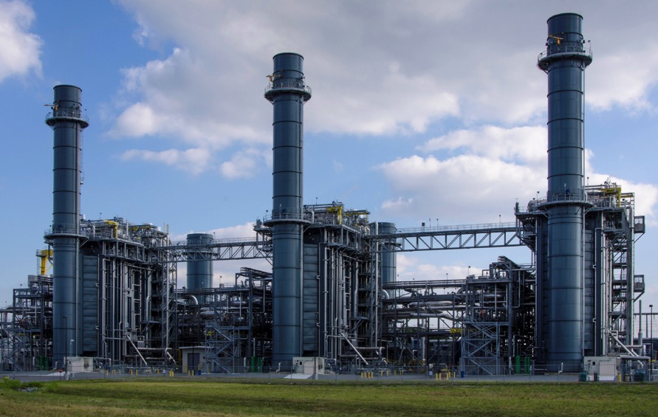
Natural Gas

Slide 10

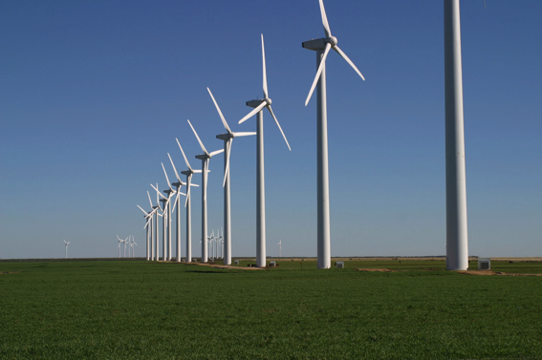
Photovoltaic
Wind

Slide 11
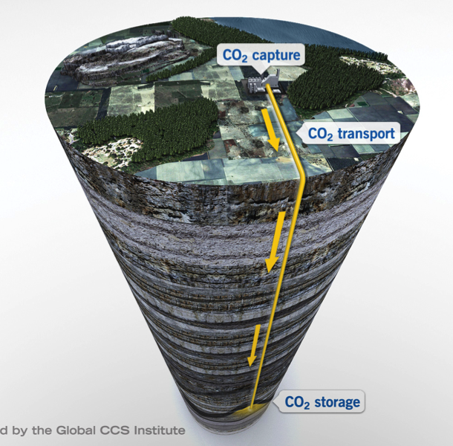
Carbon Capture and Storage

Slide 12
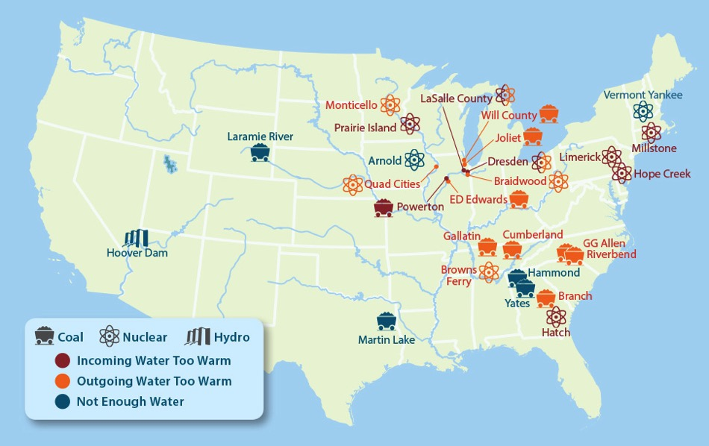
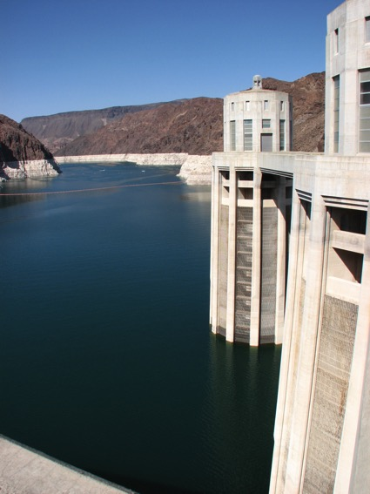
Energy-Water Collisions: 2006–2009
Max:
1220 ft
A year ago:
1107 ft
Today:
1081 ft
Hydro Critical Level:
950–1050 ft
EW3, 2013

Slide 13
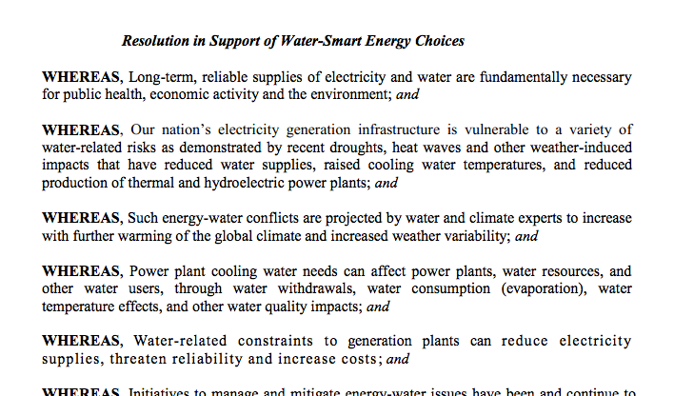
NARUC Resolution

Slide 14
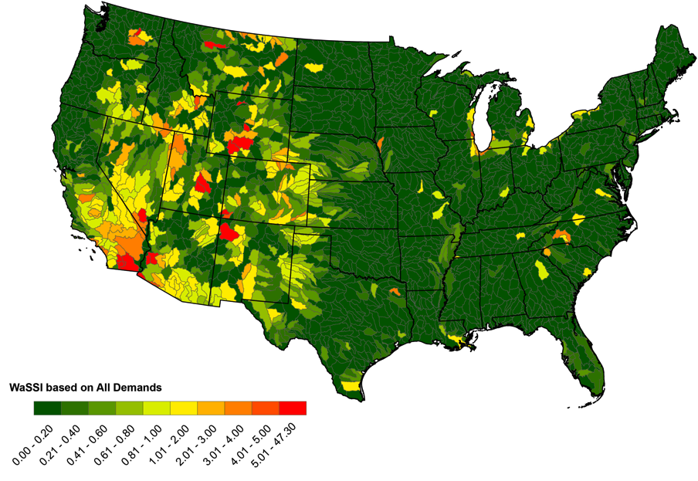
Power for Water: Water Stress (1999–2007)
Averyt et al., 2013
National Climate Assessment, 2014

Slide 15
Energy Intensity of Water Supply
2,700
kWh/million gallons
4,000
kWh/million gallons
12,700
kWh/million gallons
5,000
kWh/million gallons
Averyt et al., 2013; Twomey and Weber, 2011;
National Climate Assessment, 2014

Slide 16
Energy Intensity of Water Supply
Seawater (Desalination)
Wastewater Reuse
Wastewater Treatment
Groundwater
1000 m³ = 264,000 gallons
1233 m³ = 1 acre ft
Lake or River
0
2
4
6
8
10
MWh per 1000 m³
WBCSD & CFSGAM Research

Slide 17
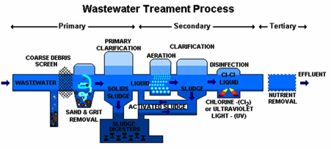
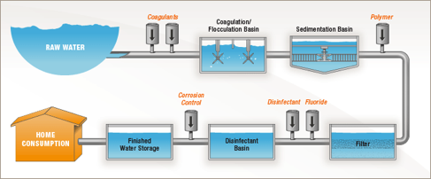
Energy Intensity of Water Supply
Water Treatment Plants (15,000)
Drinking Water Plants (200,000)
Energy use for aeration, pumping, & solids processing
80% of energy use for pumping
2nd highest budget item after labor
Municipalities: energy expenses 30-40% total costs
Age of system and equipment important for energy efficiency and costs

Slide 18
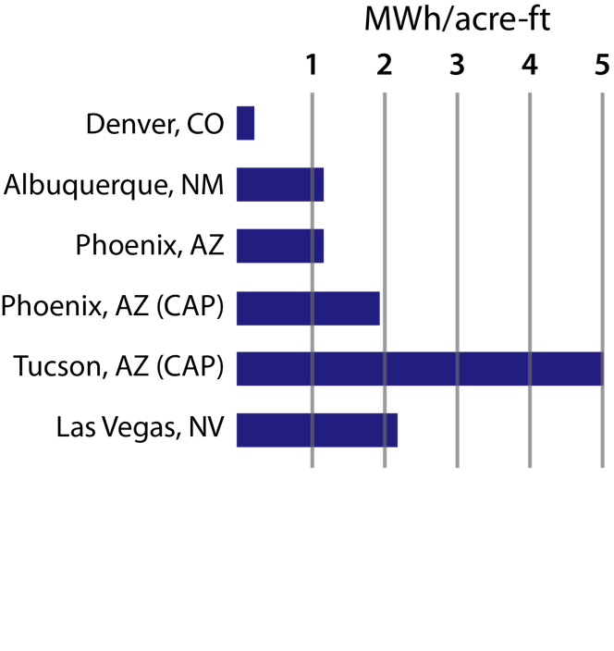
Energy Intensity of Current Water Systems
Adapted from WRA, 2012; Skaggs et al. 2013

Slide 19
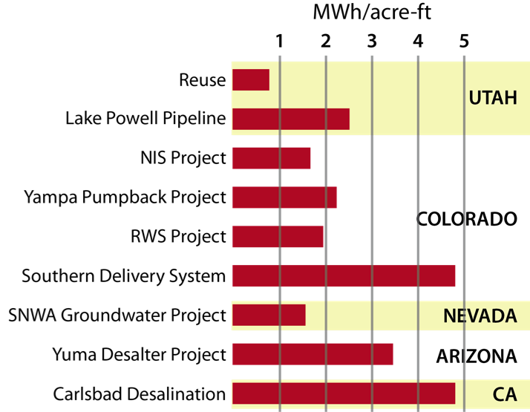
Energy Intensity of Proposed Water Systems
Adapted from WRA, 2012; Skaggs et al. 2013

Slide 20
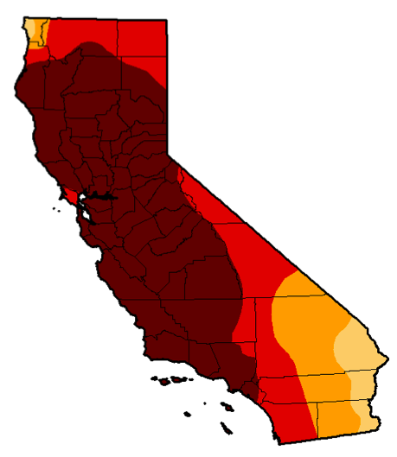


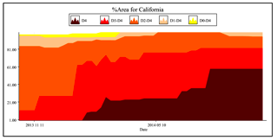
The California Example
Drought is expected to continue through 2015
Hydropower decline from 20% to 10% of total generation
Solar and wind increase to 30% of total generation
Nat gas increase by 16%
Heat waves: Sept & Oct peak electricity demand
Agriculture: $1.5B revenue loss-- $0.5B in pumping costs

Slide 21
Challenges & Opportunities
Energy savings is water savings… and vice versa
More information about energy use for self-supplied water, (e.g. agriculture), by the transportation sector, and bottled water industry is necessary
Leveraging communications infrastructure
Conservation and efficiency are opportunities for improvement
Energy and water coordinated planning and decision making to address risks
Utility of the Future?
Managing drinking water, waste, energy, carbon, and more

Slide 22

THANK YOU
Kristen Averyt, PhD
University of Colorado Boulder
kristen.averyt@colorado.edu
Associate Director for Science
Cooperative Institute for Research
in Environmental Sciences

Slide 23
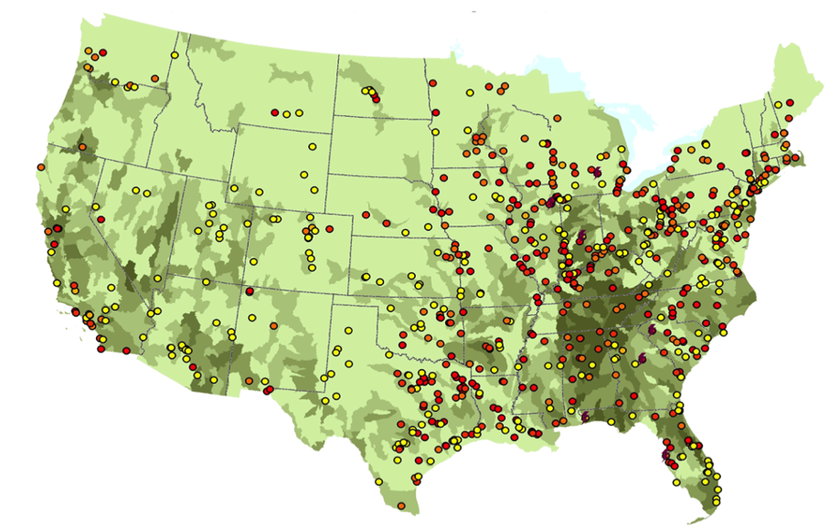
Temperature Limitations
Peak summer temperatures for return flows from more than 350 power plants exceeded 90°F in 2008
Laws 2000; Madden et al. 2010; Averyt et al. 2011; Madden et al., 2013

Slide 24
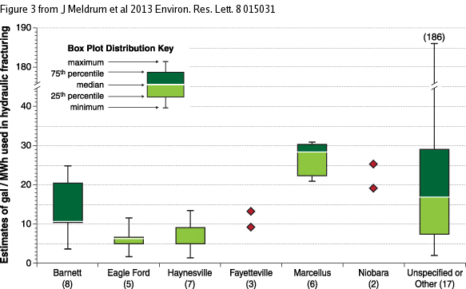
Water for Hydraulic Fracturing

Slide 26
Lake Mead & Hoover Dam
Hoover Dam
2,080-MW
80% of peak power in 5 Western States
Generation: 23% drop
5.7 megawatts/ft drop
Today
1081 ft (down 26 ft)
Hydro Critical Level:
1050 ft
The Future?
20% chance by 2025

Slide 27
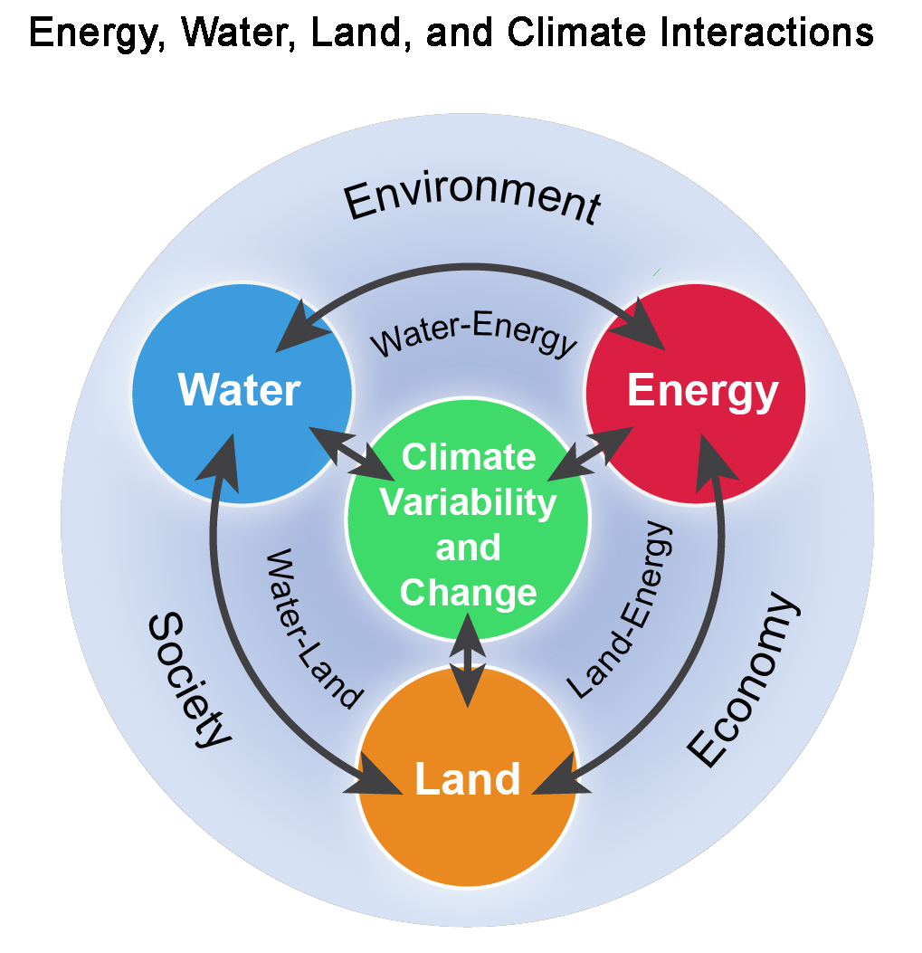
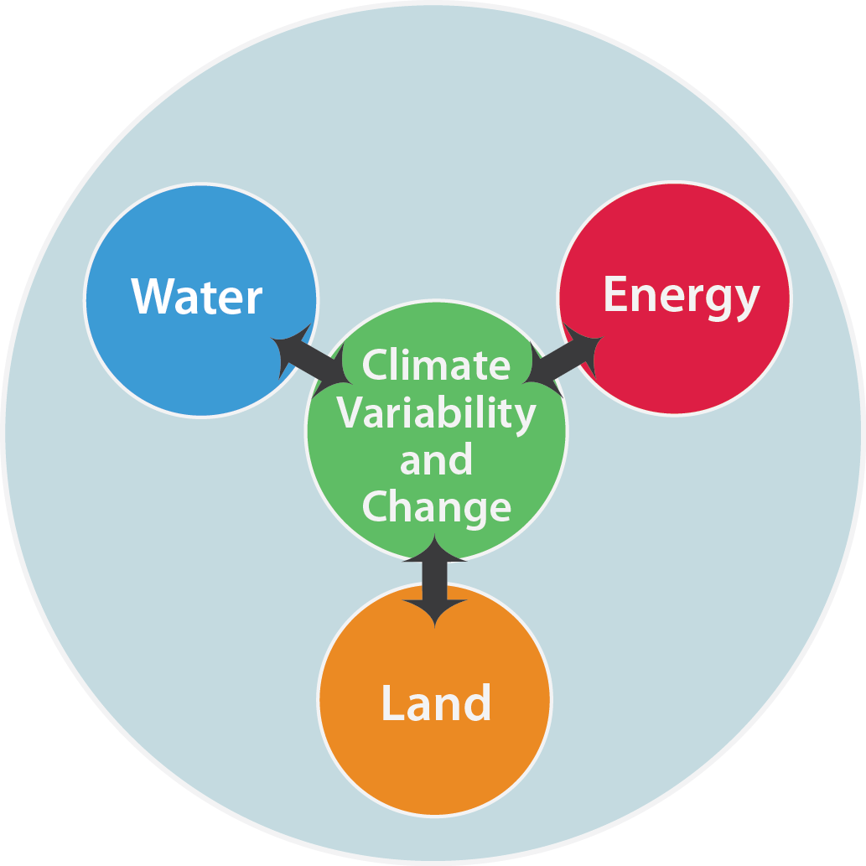
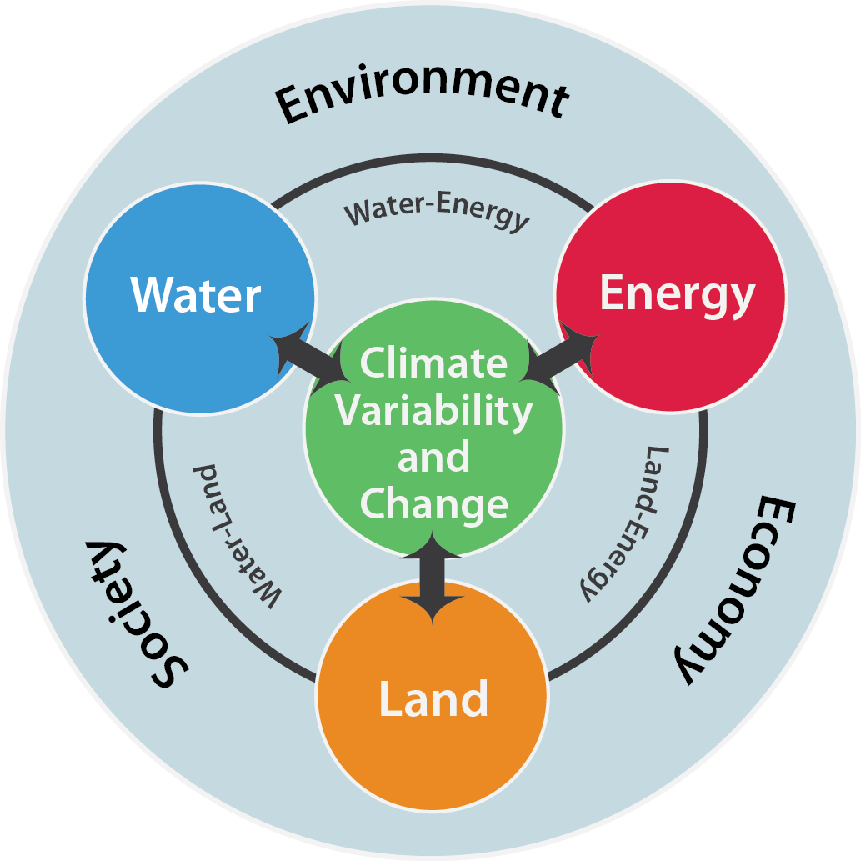
National Climate Assessment, 2014

Slide 28
National Climate Assessment, 2014

Slide 29
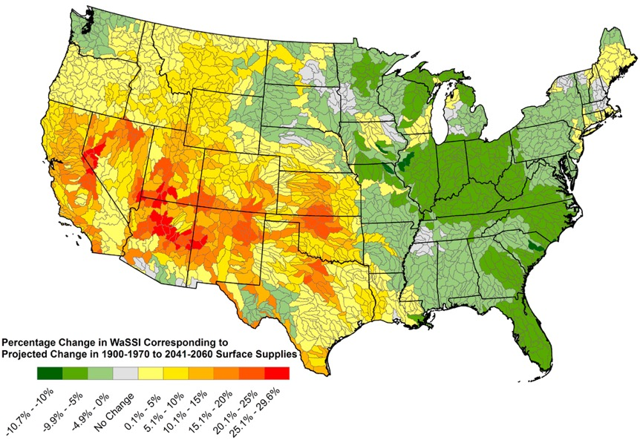
Power for Water: Water Stress (2050)
Averyt et al., 2013

